Slide 1
Kern County Safety Committee 4th Quarter
Brad Aragon, CSP
Kern County Risk Management

Slide 2
Today’s Agenda
Prepare for Cal-OSHA log 300 completion for calendar year 2019
Claims Dashboard demonstration
Electronic Safety Data Sheet library update
2019 Motor Vehicle Accidents
Winter Driving alerts for your departments

Slide 3
Cal-OSHA Log 300 and 300A Prep
Log 300s should be up to date and will need to be updated and completed by 12/31/2018
The log 300A forms will be due and required to be posted by February 1, 2019
I will ask that each department send me an electronic copy of their Log 300 and 300A.

Slide 4
Cal-OSHA Log 300-300A link
https://www.dir.ca.gov/dosh/etools/recordkeeping/CaStandard/CalStandard.htm
This is a link that includes the Log 300, and 300A forms.
Here is a great resource to general questions about recording incidents on the log 300. It is Cal-OSHA’s general industry safety order 14300.7
https://www.dir.ca.gov/t8/14300_7.html

Slide 5
Log 300 Quiz
Where do you record an injury that occurs on December 31st but is not reported until January 2nd?
You report the injury on the log in the year it happened
Do I county the day on which the injury occurred?
No. You begin counting days away on the day after the injury occurred
Is there a limit to the number of days away from work I must count?
Yes, you may “cap” the total days away at 180 days
Is drilling a fingernail or toenail to relieve pressure considered first aid?
Yes

Slide 6
Workers’ Comp Claims from 1/1 to 11/1

Slide 7
Common Claim Types
Repetitive Motion Injuries
Slips Trips
Strains (Lifting)
Burns/Exposures
Motor Vehicle

Slide 8
Claims Dashboard Project
Brings workers’ comp information to life.
Able to see claims trends & historical views
Can identify types of injuries and personnel at a glance

Slide 9
Safety Data Sheet – SDS Project
Velocity – MSDS Online is our vendor.
Available to all County staff
Able to search for any product, even if it is not in our library.
Able to filter by department
Less intimidating than the huge binders

Slide 10
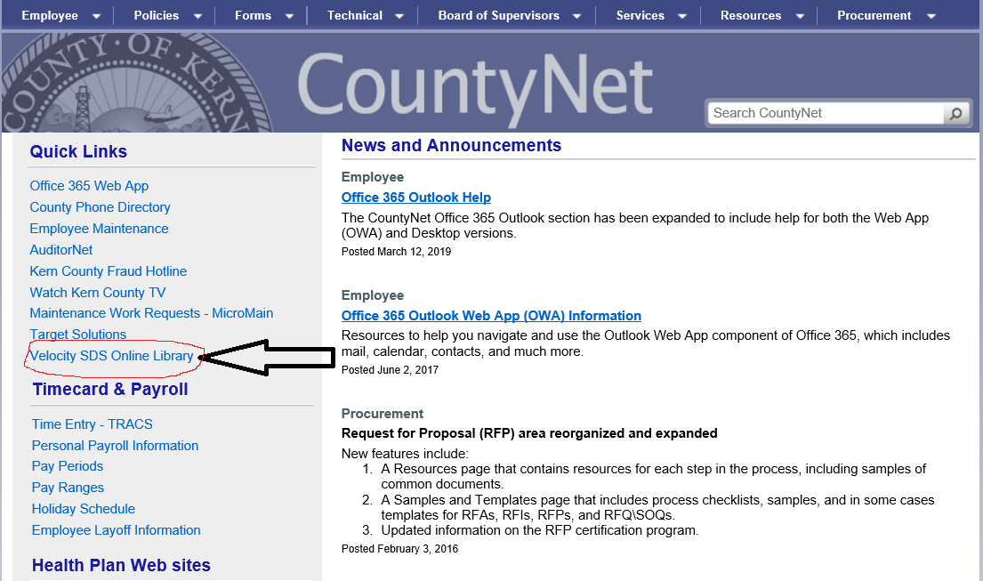
Velocity MSDS Online

Slide 11

Motor Vehicle Accidents

Slide 12
Motor Vehicle Accidents

Slide 13
Winter Driving Preparation
Remind drivers to check windshield wipers now before they are in a rain storm.
Replace wipers if needed.
Also, this is a good time to check :
Heater/defroster
Tires
Remind drivers to have safety items with them when traveling long distances during the winter:
Blanket, snacks, water, charged cell phone, review process of what to do if vehicle breaks down.

