Slide 1
Kern County
Safety Committee Meeting
4th Quarter - 2018
Brad Aragon, CSP
Kern County Safety Officer

Slide 2
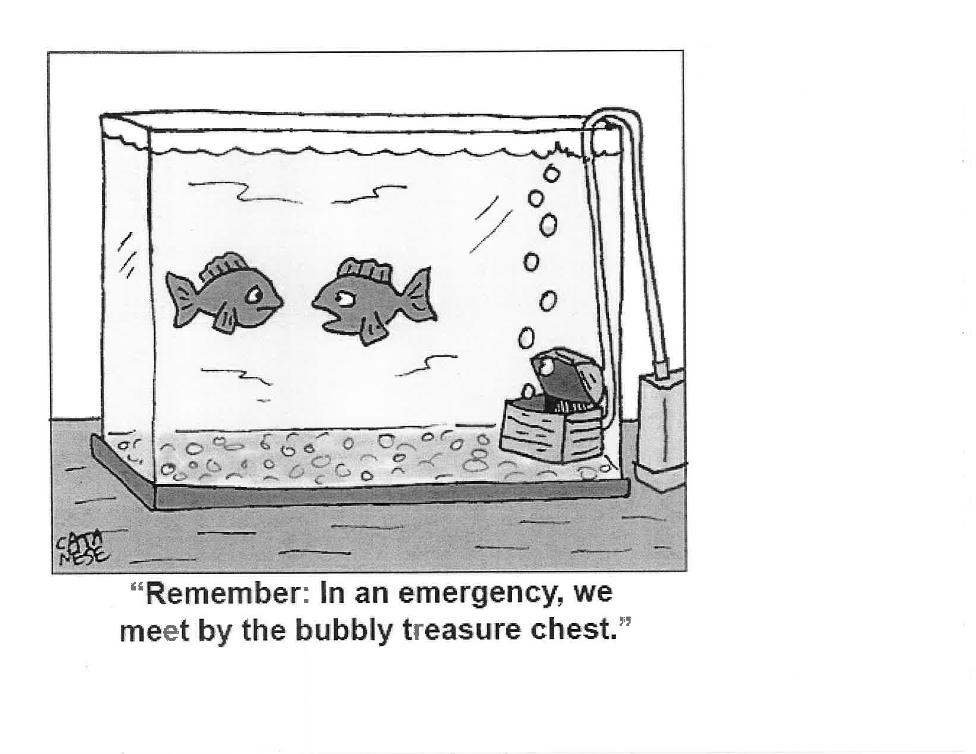

Slide 3
Today’s Agenda
Welcome- Introductions
Guest Speaker – Dr. Felizarta
New Safety Data Sheet program
  Electronic Library versus the traditional binder
  SDS binder updates
Cal-OSHA Log 300 and 300A reminders

Slide 4
Safety Data Sheet (SDS) Program
The new system will replace the SDS binder at each department
Each department and employee will have access to their own SDS library
Access by computer or mobile device is available
Demonstration

Slide 5
Safety Data Sheets (SDS) Program
ComplianceHub is the program platform
Link to the program will be similar to the link for Target Solutions on the CountyNet page.
https://countynet.co.kern.ca.us/

Slide 6
Cal-OSHA Log 300 and 300A Prep
Log 300s should be up to date and will need to be updated and complete by 12/31/2018
The log 300A forms will be due and required to be posted by February 1, 2019
I will ask that each department send me an electronic copy of their Log 300 and 300A.

Slide 7
Cal-OSHA Log 300-300A link
https://www.dir.ca.gov/dosh/etools/recordkeeping/CaStandard/CalStandard.htm

