Slide 1
County Safety Committee Meeting
4th Quarter- 2017
Brad Aragon, CSP
Kern County Risk Management

Slide 2
Today’s Agenda
Cal-OSHA Log 300 information and quiz
County Workers’ Comp claims data
County Motor Vehicle Accident information
Winter Driving tips
Working in cold weather
  Stretches handout
  Slips and trips

Slide 3
Log 300 & 300A Summary Information
The Log 300 captures recordable incidents for the calendar year.
Logs should be up to date and incidents that are recordable should be recorded as soon as possible.
Log 300 A – Summary reports are due to posted on February 1, 2018 thru April 30, 2018

Slide 4
Log 300 Quiz
Where do you record an injury that occurs on December 31st but is not reported until January 2nd?
You report the injury on the log in the year it happened
Do I county the day on which the injury occurred?
No. You begin counting days away on the day after the injury occurred
Is there a limit to the number of days away from work I must count?
Yes, you may “cap” the total days away at 180 days
Is drilling a fingernail or toenail to relieve pressure considered first aid?
Yes

Slide 5
Log 300 Information
Here is a great resource to general questions about recording incidents on the log 300. It is Cal-OSHA’s general industry safety order 14300.7
https://www.dir.ca.gov/t8/14300_7.html

Slide 6
Work Comp Claims History

Slide 7
Number of Claims by Month

Slide 8
Average Amount of Monthly Workers Comp Claims

Slide 9
Motor Vehicle Accidents -2017

Slide 10
2017 Motor Vehicle Accidents
14 departments had some type of MVA (Sheriff not include) for a total of 81 accidents
At Fault accidents – 40
Not At Fault accidents – 33
Unoccupied – 8

Slide 11
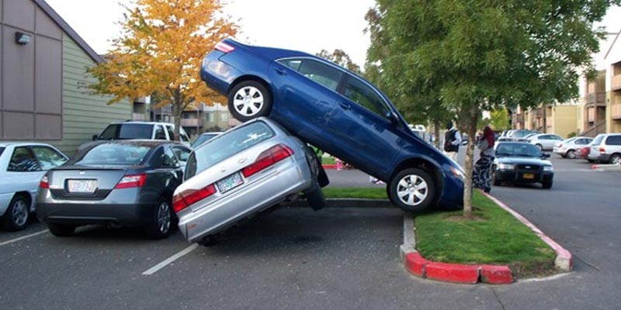

Causes of At Fault Incidents
Top 3 At Fault Incident Causes
  Parking (either entering or leaving)
  Rear ending the other vehicle
  Hit an Object

Slide 12
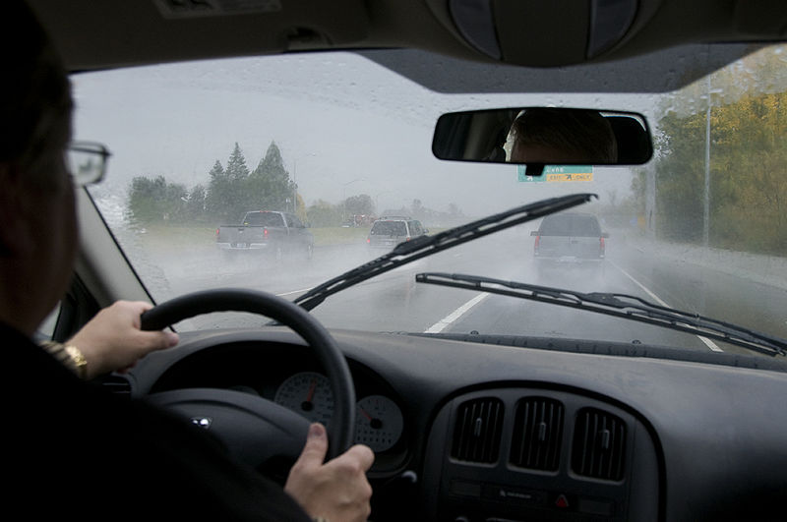
Winter Driving
Additional caution on the first rainy day we have. Oils on the road tend to float to the surface and can create slippery road conditions.
Help reduce the chance of hydroplaning by following the “tracks” of the vehicle in front of you , BUT, do not follow too close.
Remember the law: If your windshield wipers are on, then your headlights must be on.
Increase your following distance to allow for slippery conditions

Slide 13

Winter Driving - Fog
Always use low beams
When stopped, roll down your windows to listen for oncoming traffic.
If you must stop on the side of the road, then “black out” your car. This means no brake lights, or tail lights.
Use markers on your most commonly traveled routes to help judge distance.
Do you know how freeway exits are marked to help you know the exit is getting close?

Slide 14
Winter Driving
Things to check on your vehicle before the rain and fog arrive:
  Good working wiper blades that do not streak or “chatter” when moving.
  Are your headlights working and are the lenses clear?
  Does your vehicle’s heater and defroster work properly?
  Do your tires have adequate treads? No bald tires!!

Slide 15

Winter Slips –Trips
Use knock off mats before entering a building or once you step inside
Watch out for sprinklers/puddles on the sidewalk
Ice, Moss on the sidewalk
Wear appropriate footwear when you are walking to work from the parking lot

Slide 16
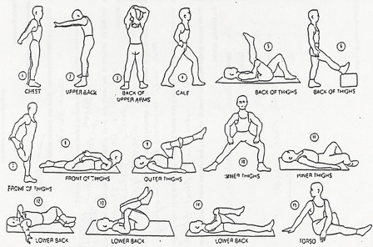
Review Stretching Handout

