Slide 1
County Safety committee
4th Quarter 2015
Brad Aragon, CSP
County Safety Officer
Risk Management – Office of County counsel

Slide 2
Today’s Agenda
County’s claims history
New claims & MVA database
All–in–One poster, Cal-OSHA Log 300 update
Ergonomics – Key to a comfortable chair
Winter Driving tips
Moonshot Thinking video and Your ideas

Slide 3
County Workers’ Comp claims History 1-1 t0 11-1

Slide 4
Claims and Motor Vehicle Accident (MVA) Database
Risk Management has developed a new database that can help detect claims and MVA trends within each department.
Ability to sort by various criteria
This information can be used to speak to specific departments about specific trends

Slide 5
All in One Poster Update
Thank you for the quick response
The order for posters will go in the first week of December and they are usually delivered by the end of December.
Once received, I will contact you to arrange delivery.
  Small orders may be sent via Inter-Office mail

Slide 6
Cal-OSHA Log 300 Update
Log 300 Annual Summary data for 2015 ends at the end of the year.
I would like to receive a copy of your department’s Log 300 and the Annual Summary by February 1, 2016.
The summary must be posted from:
Feb.1, 2016 through April 30, 2016

Slide 7
Ergonomics
Keys to a Comfortable Chair
Know the individual adjustments ---ALL OF THEM
Seat pan – Forwards and back
Seat back height – up and down
Armrest Height
Reclining Function and Tension

Slide 8
Driving In the Fog
Always use low beam headlights
If you must pull over, pull as far to the right as possible, turn off your lights, and remember to take your foot off of the brake. People behind you are looking for clues, and your taillights are just the clue they are looking for to try and see what is ahead of them.
Give your defroster time to work. Do not wipe small holes on the inside of your front windshield and driver’s side window to see out of.

Slide 9
Driving In the Fog
When at a stop sign, roll down your window and make your vehicle as quiet as possible so you can hear other vehicles approaching. In heavy fog, you are more likely going to hear the oncoming vehicle before you see it.
At a 2-way stop, if you are not comfortable crossing lanes after your stop, you can always turn right and then travel to a controlled intersection to make your turn to go in the desired direction.

Slide 10
Driving In the Fog
Be aware of patchy fog. Do not be in a hurry to get up to normal speed just because the fog has temporarily cleared. This may cause the need to brake hard when the fog re-appears. Ensure that the fog is completely lifted or burned off before getting up to normal speed

Slide 11
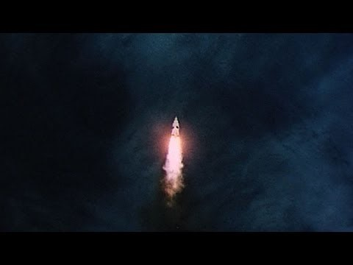
Moonshot thinking

