Slide 1
County Safety committee Meeting
4th Quarter 2014
Brad Argon, CSP
Loss Prevention Specialist
Risk Management / County Counsel

Slide 2
Agenda
All-In-One Posters
Workers’ Comp fraud Posters
Claims Update
Cal-OSHA Log 300
Winter Driving Tips
Safety Game
Next Year’s Schedule

Slide 3
2015 Workers Comp Posters
I have sent out an email asking you the number of posters you will need for 2015 .
Posters should be placed in an easily accessible area that all employees can get to
Good areas include break rooms or bulletin boards

Slide 4
Fraud Posters
Workers’ Comp Fraud posters are available. These are the same as before.
As you are putting up the new posters for 2015, you may want to put up a fraud poster.

Slide 5
Work Comp Claims Update

Slide 6
Cal-OSHA Log 300
What is this?
  Log of all industrial related injuries for the calendar year
  Required by all departments
What do I do with it?
  Transfer log information to the Annual Summary form also called the 300A
  Annual Summary is to be posted February 1, 2015 thru April 30, 2015. It can be left up year round if desired.
  3 years of past log information should be readily available for inspection at all times.
  How do I get the forms
    http://www.dir.ca.gov/dosh/dosh_publications/CalOSHARecordkeepForms.xls

Slide 7
Cal-OSHA Log 300
Remember that the Log 300 runs the same as a calendar year.
Please prepare a log 300 for the 2015 year.
I would like to receive a copy of each department’s Log 300 and Annual Summary as they are completed

Slide 8
Winter Driving Preparation
Now is the time to check your windshield wipers
Check the wear of your tires and air pressure
Does your heater & defroster work properly?
Carry a blanket in the vehicle in case you are forced to sit in the vehicle without power while you wait for help.

Slide 9
Winter Driving Tips
Slow down in wet or foggy weather. Speed is the number #1 cause of vehicle accidents.
Always use low beam headlights
Give your defroster time to work. Do not wipe small holes on the inside of your front windshield and driver’s side window to see out of.

Slide 10
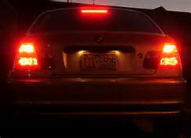
Winter Driving Tips - Fog
If you must pull over, pull as far to the right as possible, turn off your lights, and remember to take your foot off of the brake. People behind you are looking for clues, and your taillights are just the clue they are looking for to try and see what is ahead of them

Slide 11
Winter Driving Tips-Fog
When at a stop sign, roll down your window and make your vehicle as quiet as possible so you can hear other vehicles approaching. In heavy fog, you are more likely to hear the oncoming vehicle before you see it.
At a 2-way stop, if you are not comfortable crossing lanes after your stop, you can always turn right and then travel to a controlled intersection

Slide 12
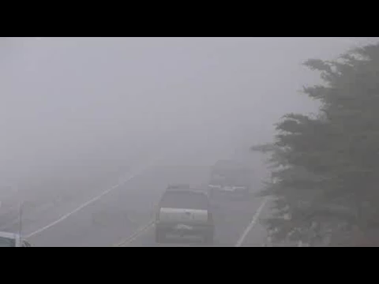
Fog Video

Slide 13
Safety Game

Slide 14
2015 Schedule
February 18, 2015
May 20, 2015
August 19, 2015
November 18, 2015

Slide 15
Questions & Comments

