Slide 1
4th Quarter
County Safety Committee Meeting
Brad Aragon, CSP
Loss Prevention Specialist

Slide 2
Today’s Topics
Posters
Cal-OSHA Log 300 Information
Supervisor’s Safety Training Course
Workers’ comp claims Update
Cal-OSHA Activity
Global Harmonization Update (GHS)
Winter Driving Tips

Slide 3
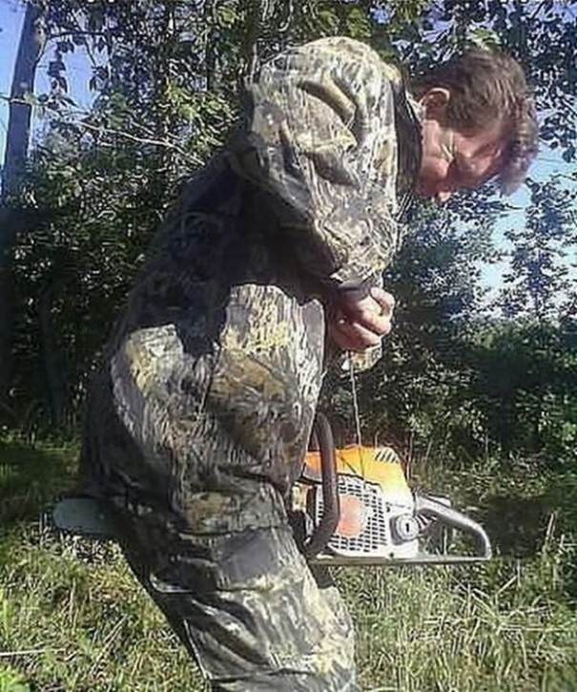
Identify the Safety Violation???

Slide 4
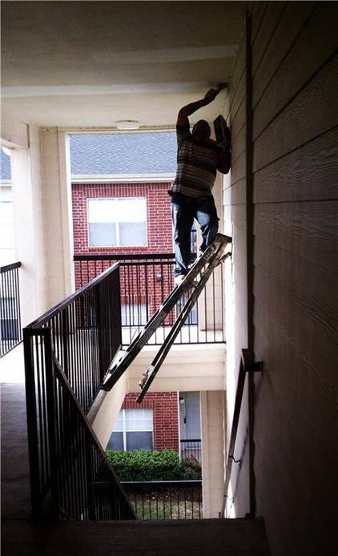
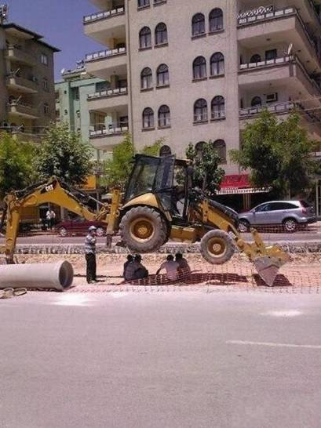
Identify the Safety Violation???

Slide 5
Posters
Workers’ Comp Fraud posters available upon request - Recommended - Not Mandatory
New 2014 All-In-One Poster
  Initial requests have been provided by departments
  Initial order has been placed
  Delivery time????

Slide 6
Cal-OSHA Log 300
What is this?
  Log of all industrial related injuries for the calendar year
  Required by all departments
What do I do with it?
  Transfer log information to the Annual Summary form
  Annual Summary is to be posted February 1, 2014 thru April 30, 2014. It can be left up year round if desired.
  3 years of past log information should be readily available for inspection at all times.
  How do I get the forms
    http://www.dir.ca.gov/dosh/dosh_publications/CalOSHARecordkeepForms.xls

Slide 7
Supervisor’s Safety Training Series
Completion of 1st class
Topic was Incident Investigation
Plan to have these courses on a quarterly basis
Announcements will go out to Safety Committee members
  Participants do not have to be supervisors, but a lead person

Slide 8
Workers’ Comp Claims
1/1 to 11/1 (2010-2013)

Slide 9
Total Number of Employees

Slide 10
Cal-OSHA Activity
Citations were received from Cal-OSHA from a prior inspection of Animal Services in June 2013.
  No lights in a freezer -$185
    “Illumination shall be provided in the room” #3249 (b)
  No use of mats in a potentially slippery environment - $280
    “…slippery floors shall be protected by using mats…” #3273(a)

Slide 11
Cal-OSHA Activity
  No required axe inside the freezer - $185
    “A firefighter’s type axe shall be kept in the room near the door” #3249(c)
  Doctor’s approval of first aid kits - $185
    “Adequate first aid materials approved by a physician” #3400(c)
  Secured stacking of materials - $280
    Materials stored…shall be piled, stacked, or racked in a manner designed to prevent it from tipping, falling, collapsing…” #3241(c)

Slide 12
Cal-OSHA Activity
Planned Appeals - Appeal process
  Time frame to respond
  Informal Conference
Attempt to reduce or eliminate the citation
Plan to show abatement of cited areas

Slide 13

Global Harmonization System (GHS)
Training deadline
  December 1, 2013
Available presentations
Who needs to be trained?
  All Staff

Slide 14
Winter Driving Preparations
Now is the time to check your windshield wipers
Check the wear of your tires and air pressure
Does your heater & defroster work properly?
Carry a blanket in the vehicle in case you are forced to sit in the vehicle without power while you wait for help.

Slide 15
Winter Driving Tips
Slow down in wet or foggy weather. Speed is the number #1 cause of vehicle accidents.
Always use low beam headlights
Give your defroster time to work. Do not wipe small holes on the inside of your front windshield and driver’s side window to see out of.

Slide 16
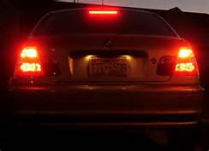
Winter Driving Tips - FOG
If you must pull over, pull as far to the right as possible, turn off your lights, and remember to take your foot off of the brake. People behind you are looking for clues, and your taillights are just the clue they are looking for to try and see what is ahead of them

Slide 17
Winter Driving Tips - FOG
When at a stop sign, roll down your window and make your vehicle as quiet as possible so you can hear other vehicles approaching. In heavy fog, you are more likely to hear the oncoming vehicle before you see it.
At a 2-way stop, if you are not comfortable crossing lanes after your stop, you can always turn right and then travel to a controlled intersection

Slide 18
Winter Driving Tips - FOG
Be aware of patchy fog. Do not be in a hurry to get up to normal speed just because the fog has temporarily cleared. Ensure that the fog is completely lifted or burned off before getting up to normal speed.

Slide 19
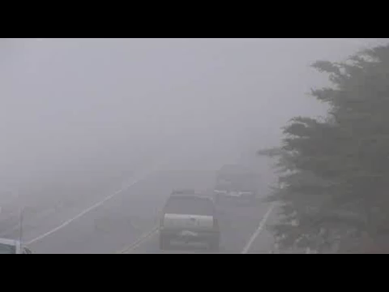
FOG video

Slide 20
2014 Safety Committee
Meeting Dates
February 19, 2014
May 21, 2014
August 20, 2014
November 19, 2014

Slide 21
Questions - Comments

