Slide 1
County Safety Committee
4th Quarter Meeting
Brad Aragon, CSP
Loss Prevention Specialist
Risk Management
Office of County Counsel

Slide 2
Meeting Agenda
County Workers’ Comp Update
Winter Driving Safety
Workplace Security
Photos from the Field
Ideas for the Committee in 2013
2013 Workers’Comp./Employer posters
2013 Committee Meeting dates

Slide 3
County Workers’ Comp Claims Update
1-1- thru 11-1

Slide 4
County Workers Comp Claims Trend
From 2008 to 2012

Slide 5


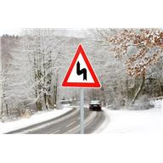

Winter Driving Tips

Slide 6
Tips for Driving in the Fog
Clues to help you navigate
“Blackout” when pulled off to the side of the road
Sudden fog
How to use the side of the road to exit the freeway
Listen and hear before you see

Slide 7
Winter Driving Tips
Fog
Always use low beam headlights
If you must pull over, pull as far to the right as possible, turn off your lights, and remember to take your foot off of the brake. People behind you are looking for clues, and your taillights are just the clue they are looking for to try and see what is ahead of them.
Give your defroster time to work. Do not wipe small holes on the inside of your front windshield and driver’s side window to see out of.
When at a stop sign, roll down your window and make your vehicle as quiet as possible so you can hear other vehicles approaching. In heavy fog, you are more likely going to hear the oncoming vehicle before you see it.

Slide 8
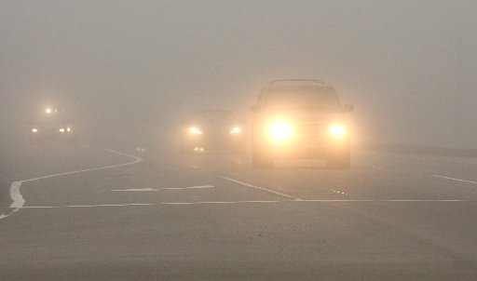
Fog
At a 2-way stop, if you are not comfortable crossing lanes after your stop, you can always turn right and then travel to a controlled intersection to make your turn to go in the desired direction
Be aware of patchy fog. Do not be in a hurry to get up to normal speed just because the fog has temporarily cleared. This may cause the need to brake hard when the fog re-appears. Ensure that the fog is completely lifted or burned off before getting up to normal speed

Slide 9
Help in the Fog
When exiting the freeway, use the reflectors on the right side of the lane to help judge distance.
  At 2100 feet – 3 reflectors
  At 1400 feet – 2 reflectors
  At 700 feet – 1 reflector
  Then, the white line breaks for you to enter the off-ramp
Practice judging distance in clear weather.
  Pick a target on your normal driving path and watch your odometer. Then see how far you have traveled when you get to another target or landmark. This will help you drive with more confidence in the fog.

Slide 10
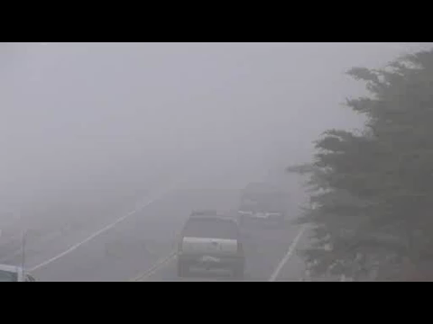
Driving in the Fog

Slide 11
Wet Roads
Wet conditions
Allow more distance to stop when the road is wet. A car traveling 60mph will cover approximately 90 feet in 1 second. It takes you more than 1 second to recognize a hazard and put your foot on the brake. Think of it this way, traveling 60 mph, a car will go from home plate to first base in a second. To actually stop the vehicle would take much more distance, and even more when the road is wet.
Make sure your vehicle is prepared for winter driving conditions. This includes tires, wipers, and the heater/defroster system. Do not wait until the first rain storm to think about these things.

Slide 12

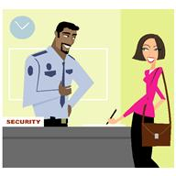
Workplace Security
Employees should feel that their building is secure and a safe place to work. Simple precautions can help eliminate any invitation and opportunity for criminal activity.
Areas of concern are
  Visitors/Public
  Personal Belongings
  Field Security

Slide 13
Workplace Security
Visitors & the Public
  Look at and greet all visitors. Ask if they need help or directions
  If your department has a log book, ensure that it is being used
  Make sure people sign in legibly
  Ensure that visitors are escorted to and from your office. Do not let them walk alone throughout your office
  When using a door with a combination lock, make sure to keep the combination private.
  Always wear your County ID to show others that you are an employee and belong in the building

Slide 14

Personal Belongings
Be careful not to leave personal belongings on your desk (Purse, sunglasses, wallet, keys)
Place personal items in the desk drawer and out of sight
Passwords should be kept secure. How many of you have them on a Post-It note next to your monitor??

Slide 15


Field Security
Perform a quick survey of the work area before exiting your vehicle. If there is a person or group of people who may pose a threat, you may want to leave the area then contact your supervisor to discuss the situation.
Keep all of your personal items locked in your vehicle such as your wallet/purse, personal keys, personal phones.
If you proceed to the work area and have concerns, contact your supervisor or office staff and let them know where you are and when you plan to finish the work.

Slide 16

Field Security
While working in the field, continue to observe your surroundings and who is in the area.
Think about an escape route or plan of action if things go wrong

Slide 17
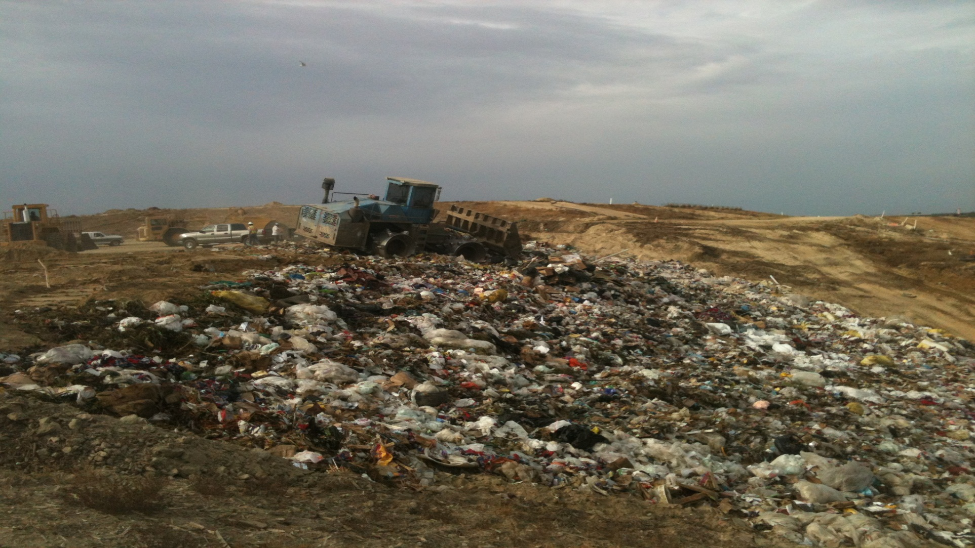
What’s This??

Slide 18
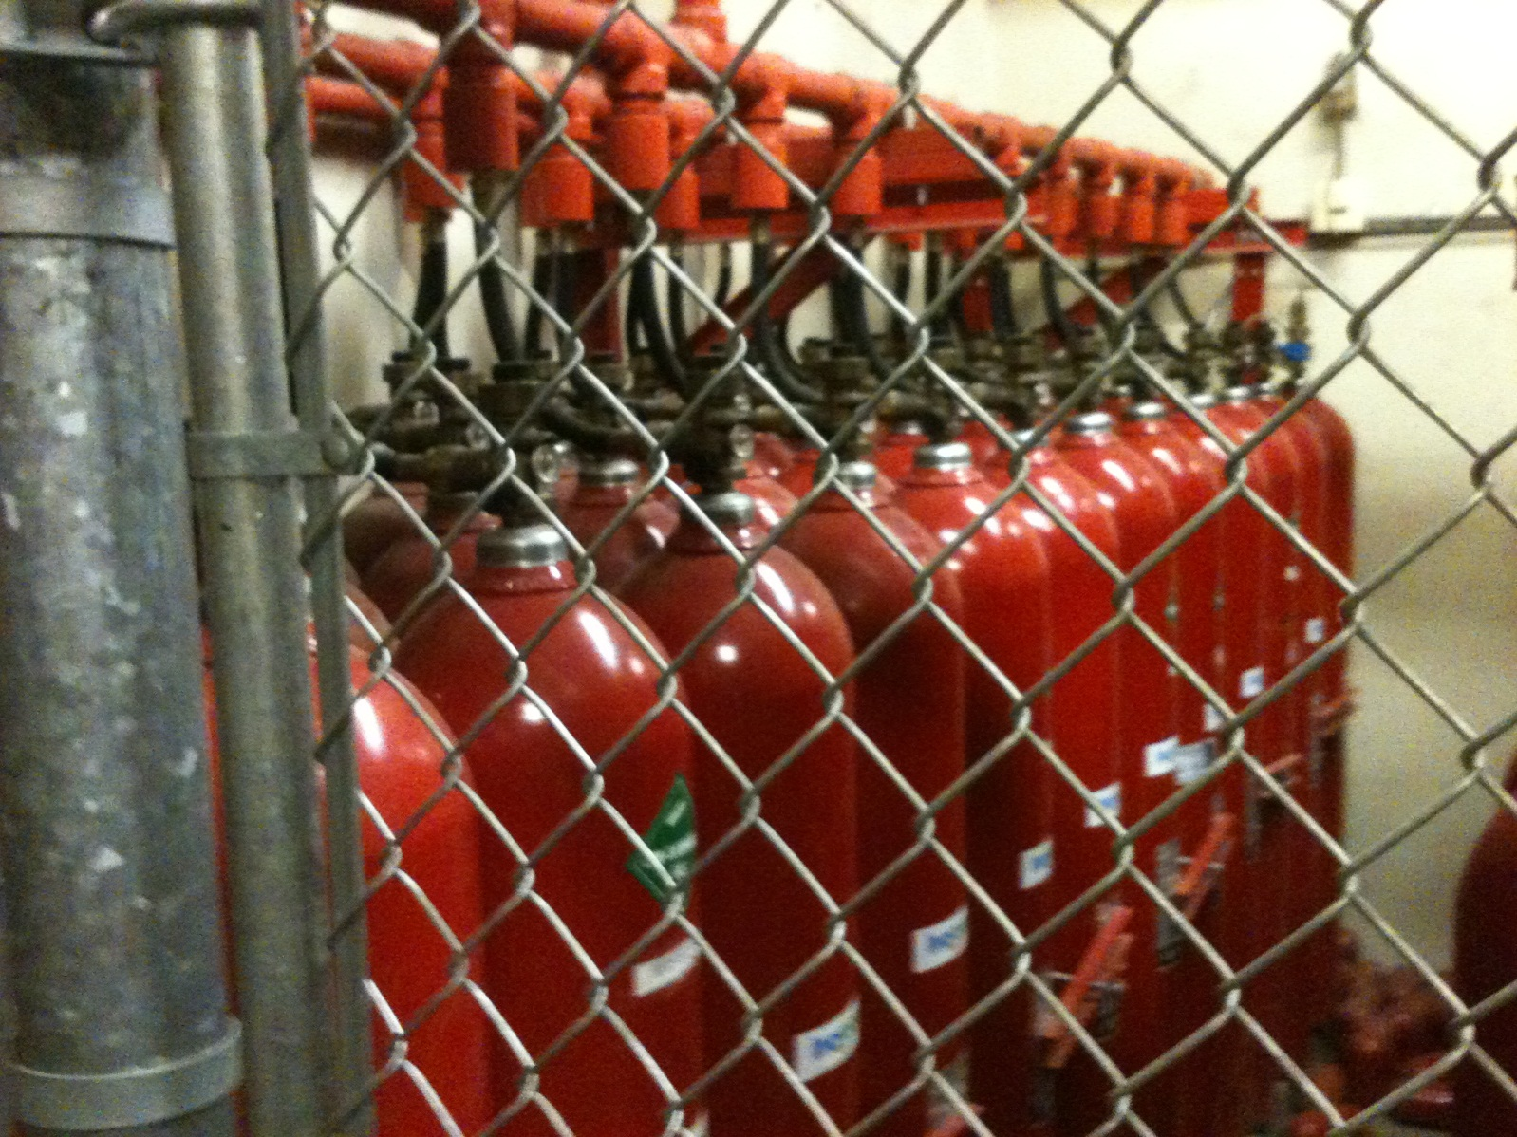
What’s This ??

Slide 19
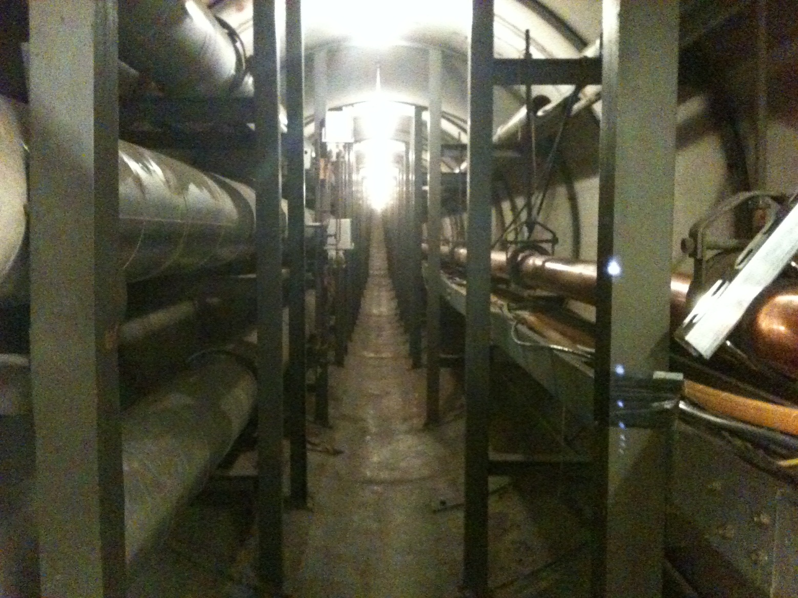
What’s This ??

Slide 20
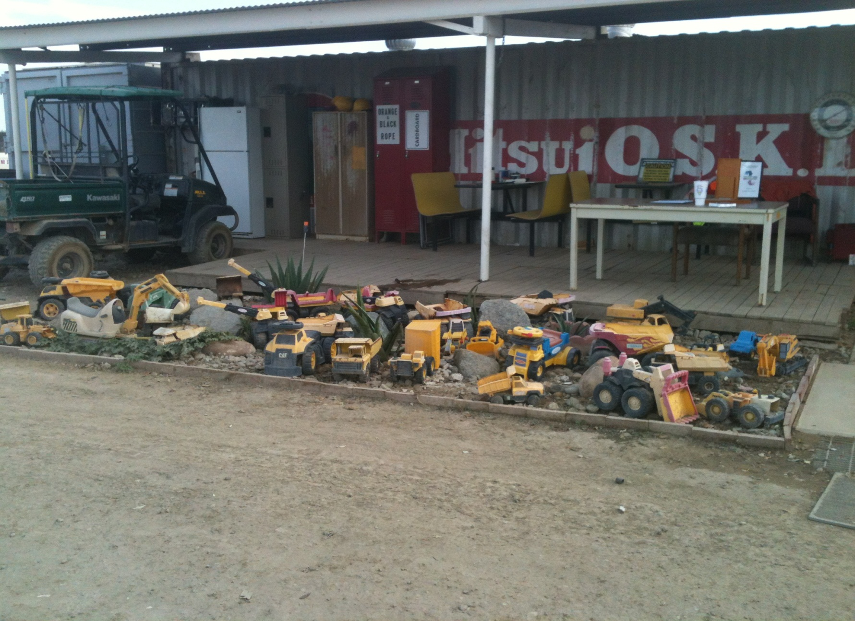
What’s This ??

Slide 21
2013 County Safety Committee Meeting Dates
Wednesday, February 20, 2013
Wednesday, May 22, 2013
Wednesday, August 21, 2012
Wednesday, November 13, 2012
All meetings start@ 10:00 am

Slide 22
2013 Workers Comp/Employer
Posters
Risk Management will be ordering the 2013 poster at the beginning of December. If you would like to receive the posters, then contact Brad Aragon by November 30th with the number of posters you need. After the order is placed, departments who did not order through Risk Management will need to contact the poster company and order them directly. At that time, each department will be responsible for their own cost.

Slide 23
2013 Safety Committee
Ideas & Suggestions
IDEA
IDEA
Safety topics to cover
Presentations you would like to see
Claims statistics??
Pictures??

