Slide 1
Kern County Safety Committee Meeting
3rd Quarter 2018
Brad Aragon, CSP
Loss Prevention Specialist
Kern County Risk Management

Slide 2
Todays Topics
Heat Illness Prevention Recap
Workplace Violence Types
Cal-OSHA Actions
County Claims History
County Motor Vehicle Incidents
Ergonomics

Slide 3
Heat Illness Prevention Update
A few heat related illness injuries this season.
  Multiple fires in one day
Effects of Heat Waves
  Body’s ability to recover
  Decision making/Understanding issues
Heat Illness Prevention Reminders
  Hydration, Shade, Emergency Action plan, Rest periods

Slide 4
Types of Workplace Violence
Criminal Intent
  Involves a criminal external to the organization that is trying to rob, vandalize or trespass
Customer/Client
  Angry person due to a lack of service, denial of goods or service, unhappy about a decision that is not in their favor. This is the County’s most probable situation.
Worker on Worker
  Terminated or reprimanded employees
Personal Relationship
  An abusive spouse, stalker, someone outside the organization

Slide 5
Cal-OSHA Activity
Several current investigations that are on-going at this time.
They include:
  Heat illness injury
  Bugs in the building complaint
  Odors in a building being remodeled complaint
  Valley Fever illness
Remember these things if Cal-OSHA arrives at your office:
  Ask them to wait until you gather the correct people –they will wait up to an hour before they begin anything
  Contact me and I will do my best to be at the meeting
  Be very concise with your answers, do not tell a big story. Provide very specific facts, not generalizations or ideas as to why Cal-OSHA is there.

Slide 6
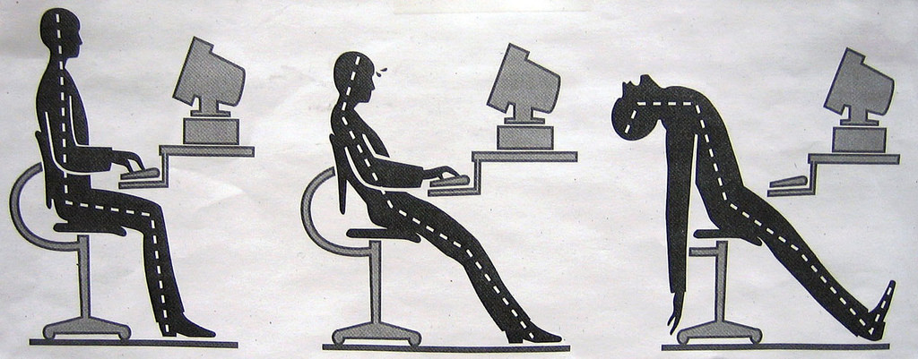
Ergonomics
Injury Risk Factors
Posture
Duration
Repetitioon
Force
Psychosocial

Slide 7
Ergonomic Risk Factors
Posture – You can control this
Duration – Hours in a day
Repetition – You have a little control
Force – Cannot control it to some extent
Psychosocial – Stressful environment

Slide 8
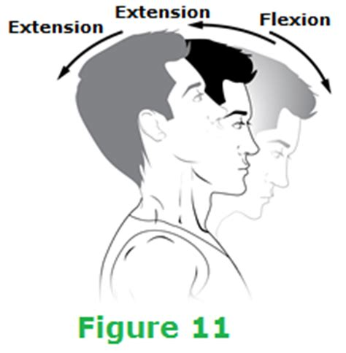
Ergonomics of the Neck
Contributing Factors
-Monitor height
-Do you wear glasses
-Seated posture
-Cell phone use

Slide 9
Ergonomic Chairs
A field study of 1000 office workers evaluated 60 chairs across 23 companies.
Results: Participants who sat in chairs with less than 3 controls reported significantly less frequent discomfort than those in chairs with more than 4 controls.
Most people do not understand how to operate the controls of their chair, therefore more controls do not make the chair better or more ergonomic.
I recommend that departments educate their staff on how their chairs can be adjusted.

Slide 10
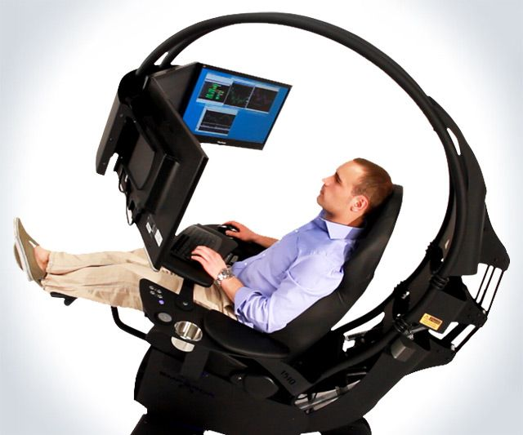
Keys to Seat Comfort
Thighs parallel to the ground
  This creates even pressure on the back of the legs and bottom
Feet on the ground or a footrest
  This reduces contact pressure on the back of the legs and helps reduce the need to bend your knees and put your feet under your chair.
Allow at least 2 inches of clearance between the edge of the chair and the back of the knees.
  This reduces the amount of contact pressure on the back of the knees where blood-flow to the lower legs is located.

Slide 11


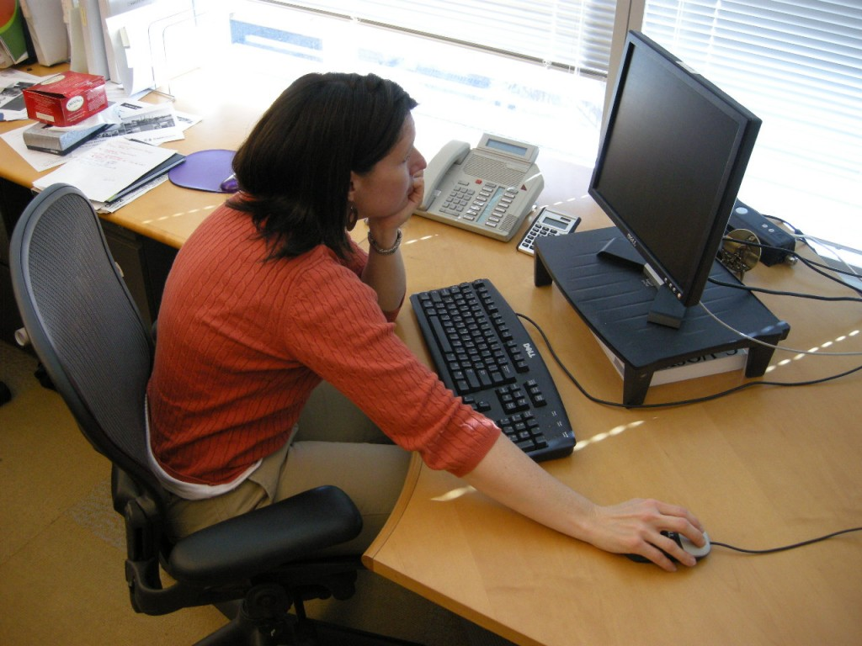
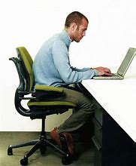

Improper Postures

Slide 12


Slide 13
Workers’ Comp Claims History 1/1 to 8/1

Slide 14
County Motor Vehicle Accidents

Slide 15
Next Meeting
November 14, 2018
10:00 am
3rd floor Multi-Purpose Room
County Administrative Building

