Slide 1
County Safety Committee
3rd Quarter
Brad Aragon
Kern County Safety Officer

Slide 2
Agenda
Cal-OSHA updates
Claims Updates
General Safety Information
Dealing with Venomous Creatures

Slide 3
Work Comp Claims History
1/1 to 8/1

Slide 4
Cal-OSHA Update
4 Active Cal-OSHA investigations going on at this time
2- Heat Illness related
1- Loss of Consciousness (possibly Heat related)
1- Serious Injury accident

Slide 5
Cal-OSHA Update
Preliminary Findings
  Documented training is a vital safety program item
  Verbal training (shadowing) will not be accepted
Regularly inspected items
  Log 300 information for the past 3 years
  Safety meeting records
  Accident investigation reports

Slide 6
Cal-OSHA
Serious Injury & When to Report to Cal-OSHA
Serious Injuries – injuries which requires hospitalization for a period of time greater than 24 hours for other than medical observation or
  Death
  Dismemberment (Amputations)
  Disfigurement
Cal-OSHA should be contacted within 8 hours of knowledge of the serious accident. If an employee is transported to a hospital by ambulance and the local Fire Dept. was on scene, then it is recommended that Cal-OSHA be called.
If it is later determined that the injury was not serious, then Cal-OSHA can be contacted again and given the revised status.
Local Cal-OSHA office – 661/ 588-6400

Slide 7
General Safety Information
School starts today. Remember
School Zone speed limits
Bus stops and the flashing lights
When to stop
Increased pedestrians
Distracted drivers

Slide 8
Dealing with
Venomous Creatures

Slide 9
What sort of creatures ?
Snakes
Bees
Wasps
Ants
Centipedes
Spiders

Slide 10
Death dealing animals in the U.S.*
Bees & wasps (90)
Deer, horses, & pigs (52)
Household dogs (31)
Cattle (20)
Mosquitoes (9)
Spiders (7)
Snakes (6)
Bears (1)
Sharks (1)
Alligator (1)
Mountain lion (.5)
* CDC, 2015

Slide 11
Leading causes of death in the U.S.*
Heart disease: 633,842
Cancer: 595,930
Chronic lower respiratory diseases: 155,041
Accidents (unintentional injuries): 146,571
Stroke (cerebrovascular diseases): 140,323
Alzheimer’s disease: 110,561
Diabetes: 79,535
Influenza and Pneumonia: 57,062
Nephritis, nephrotic syndrome and nephrosis: 49,959
Intentional self-harm (suicide): 44,193
* 2015

Slide 12
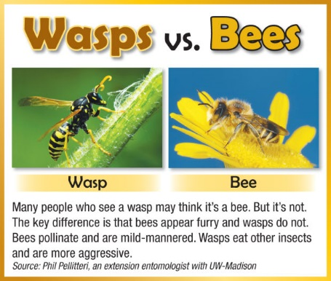

Slide 13
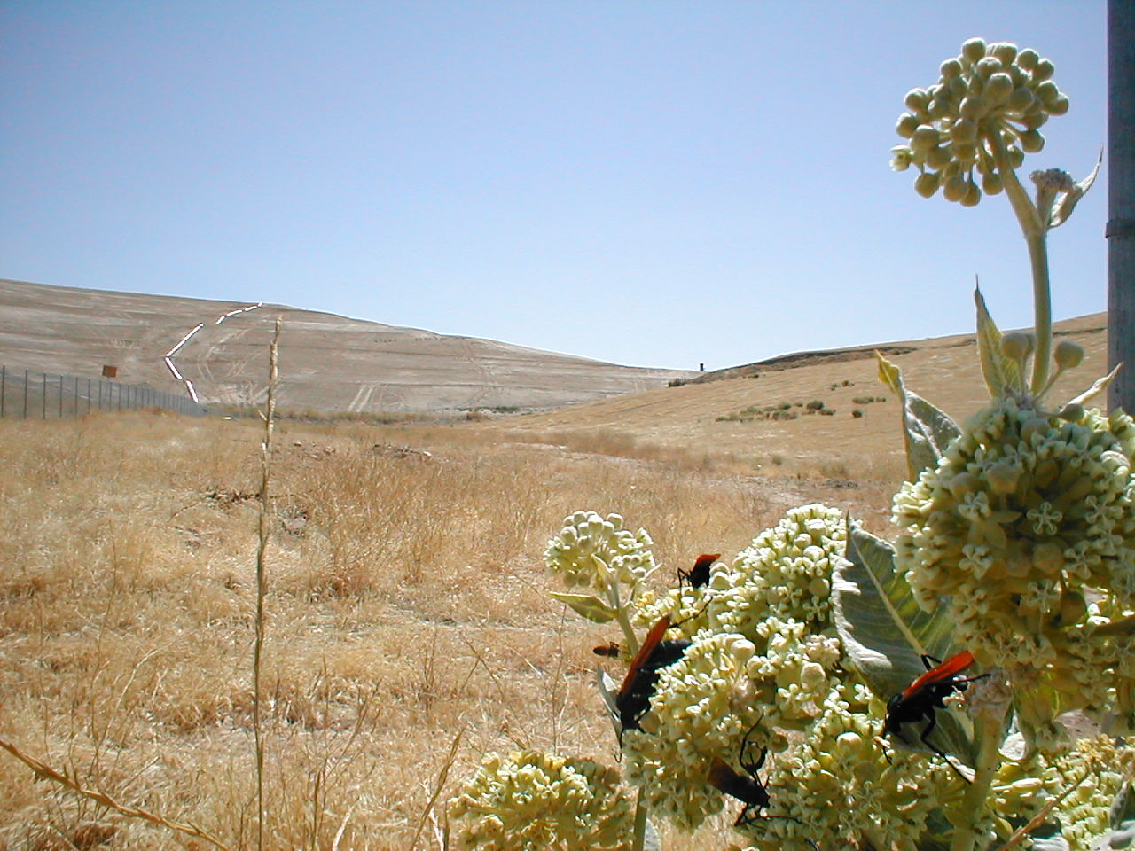
Tarantula hawk wasps foraging on milkweed

Slide 14
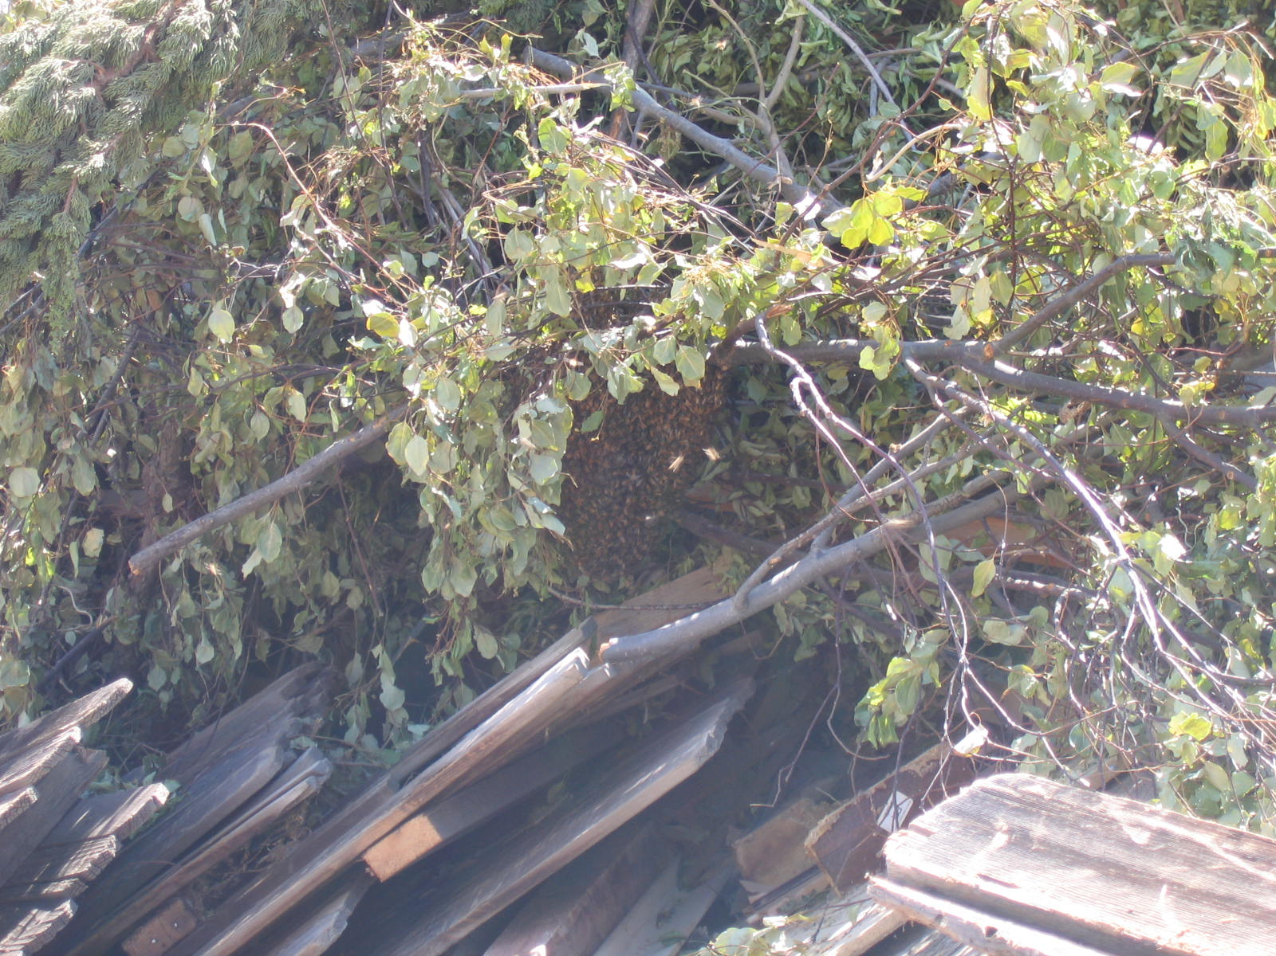
Honey bee swarm at rest.

Slide 15
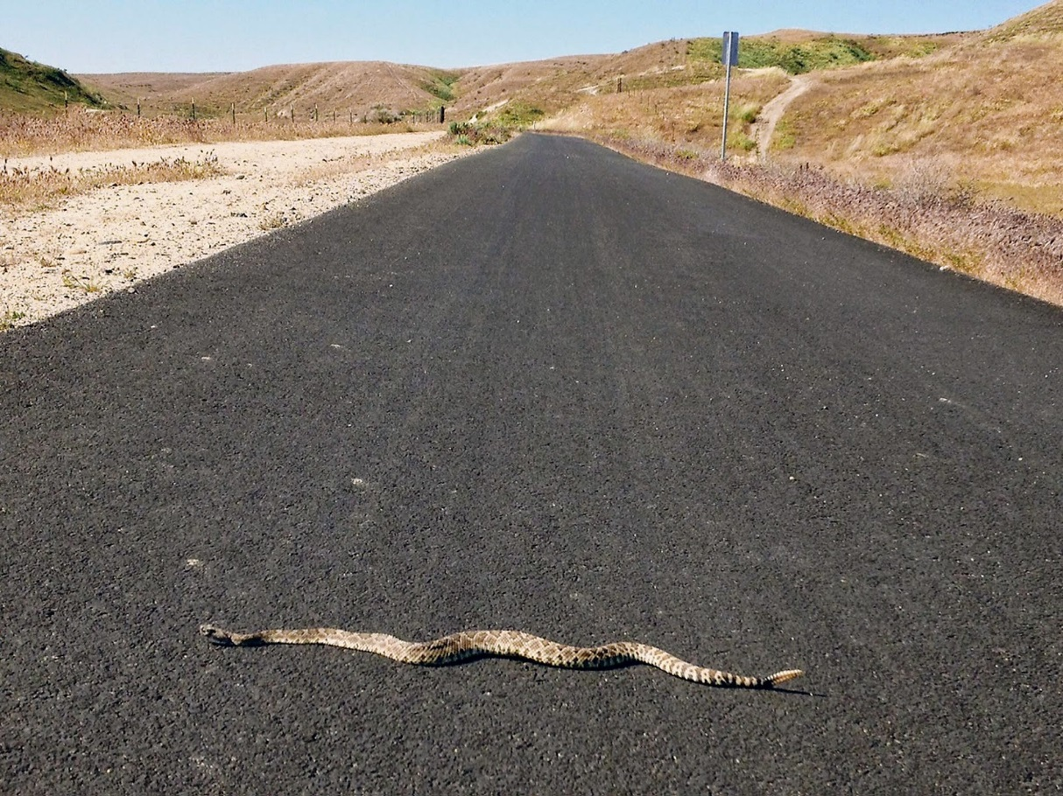
Western Diamondback Rattlesnake

Slide 16
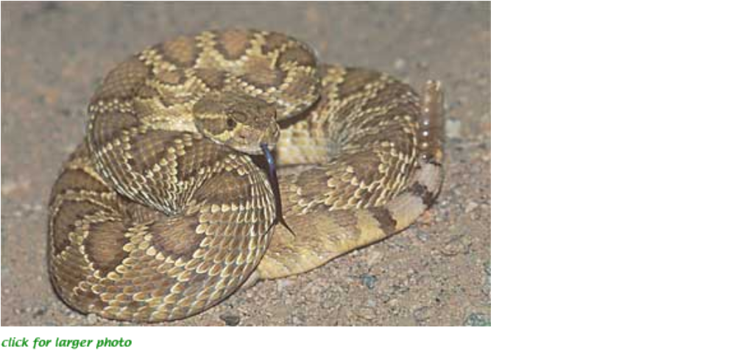
Mojave Green (Crotalus scutulatus) photo from Environmental Management

Slide 17
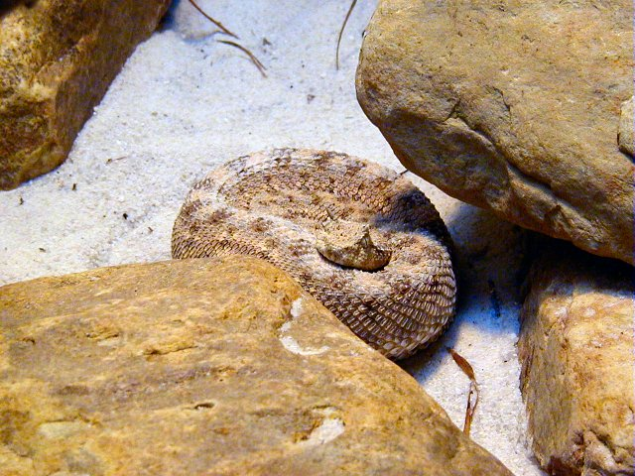
Sidewinder

Slide 18
If bit,
Call 911
Get to an ER, ASAP
Keep the bite site below the heart
Wash the bite with soap and warm water
Try to stay calm

Slide 19
If bit, never- never- never
apply a tourniquet.
pack the bite area in ice.
cut the wound with a knife or razor.
use your mouth to suck out the venom.
let the victim drink alcohol.
apply high voltage to the bite site

Slide 20
Local help. Call 911 and let the EMT Response Team determine where you go.
6 Kern County Emergency Rooms with Snake Bite Antivenin
East Kern-Desert Area, Ridgecrest Regional Hospital, 1081 N. china Lake Blvd., Ridgecrest, Tel: (760) 466-3551
North Kern County San Joaquin Valley, Delano Regional Medical Center, 1401 Garces Highway, Delano, Tel: (661) 725-4880
Kern Valley – Mountain Area, Kern Valley Healthcare District, 6412 Laurel Avenue, Mt. Mesa, Tel: (760) 379-2681
Bakersfield, Kern Medical Center, 1830 Flower Street, Bakersfield, Tel: (661) 326-2000
Mercy Hospitals of Bakersfield, 2215 Truxtun Ave., Bakersfield, Tel: (661) 632-5000
Southwest Bakersfield, Mercy Southwest Hospital, 400 Old River Road, Bakersfield, Tel: (661) 663-6000

Slide 21
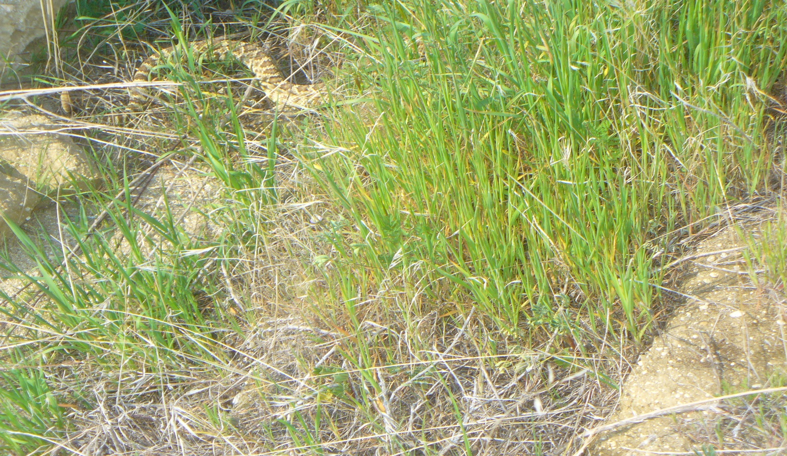
Cryptic nature of snakes.

Slide 22
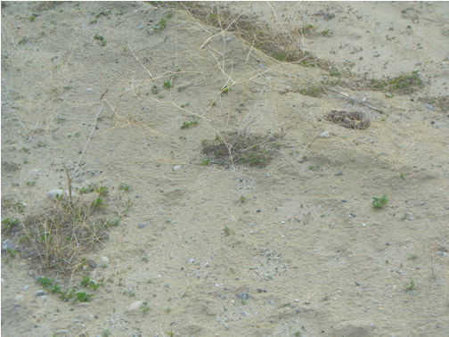
Cryptic nature of snakes

Slide 23
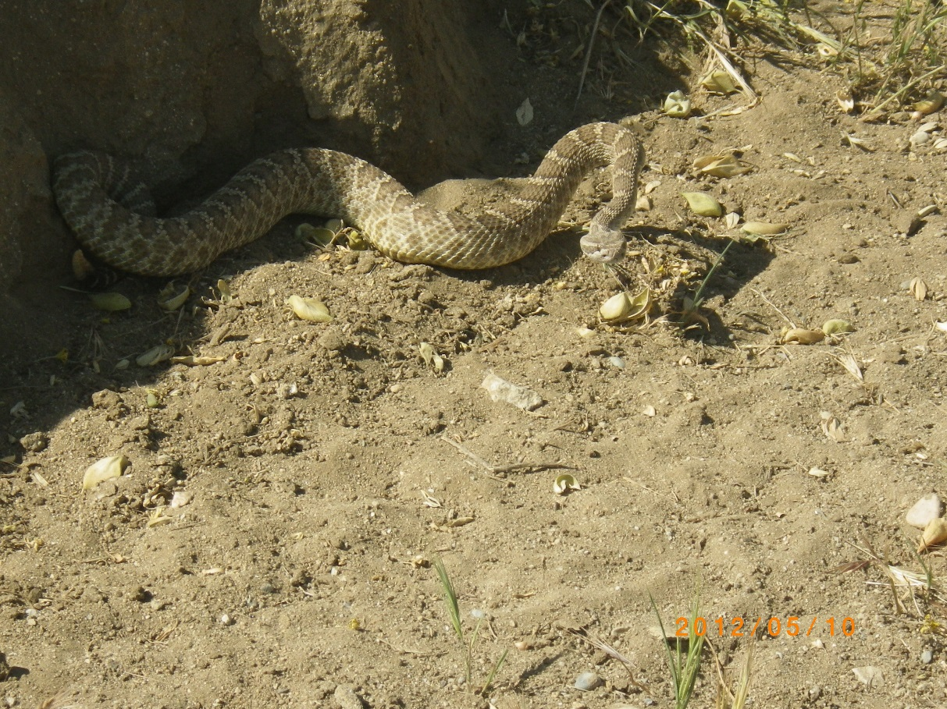
Triangular head

Slide 24
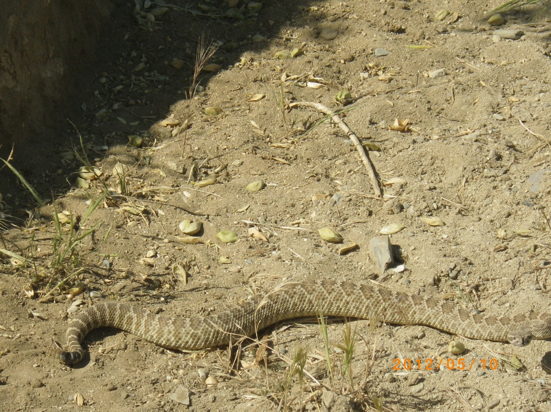
Blunt tail with rattle buds

Slide 25
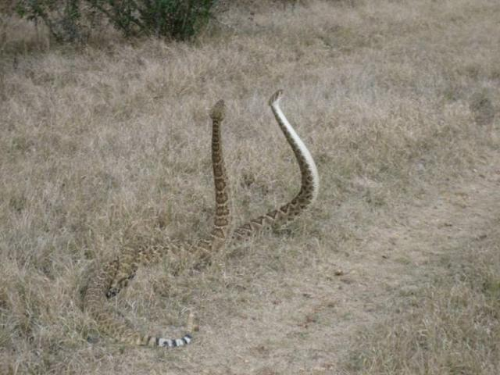
Diverse color patterns

Slide 26
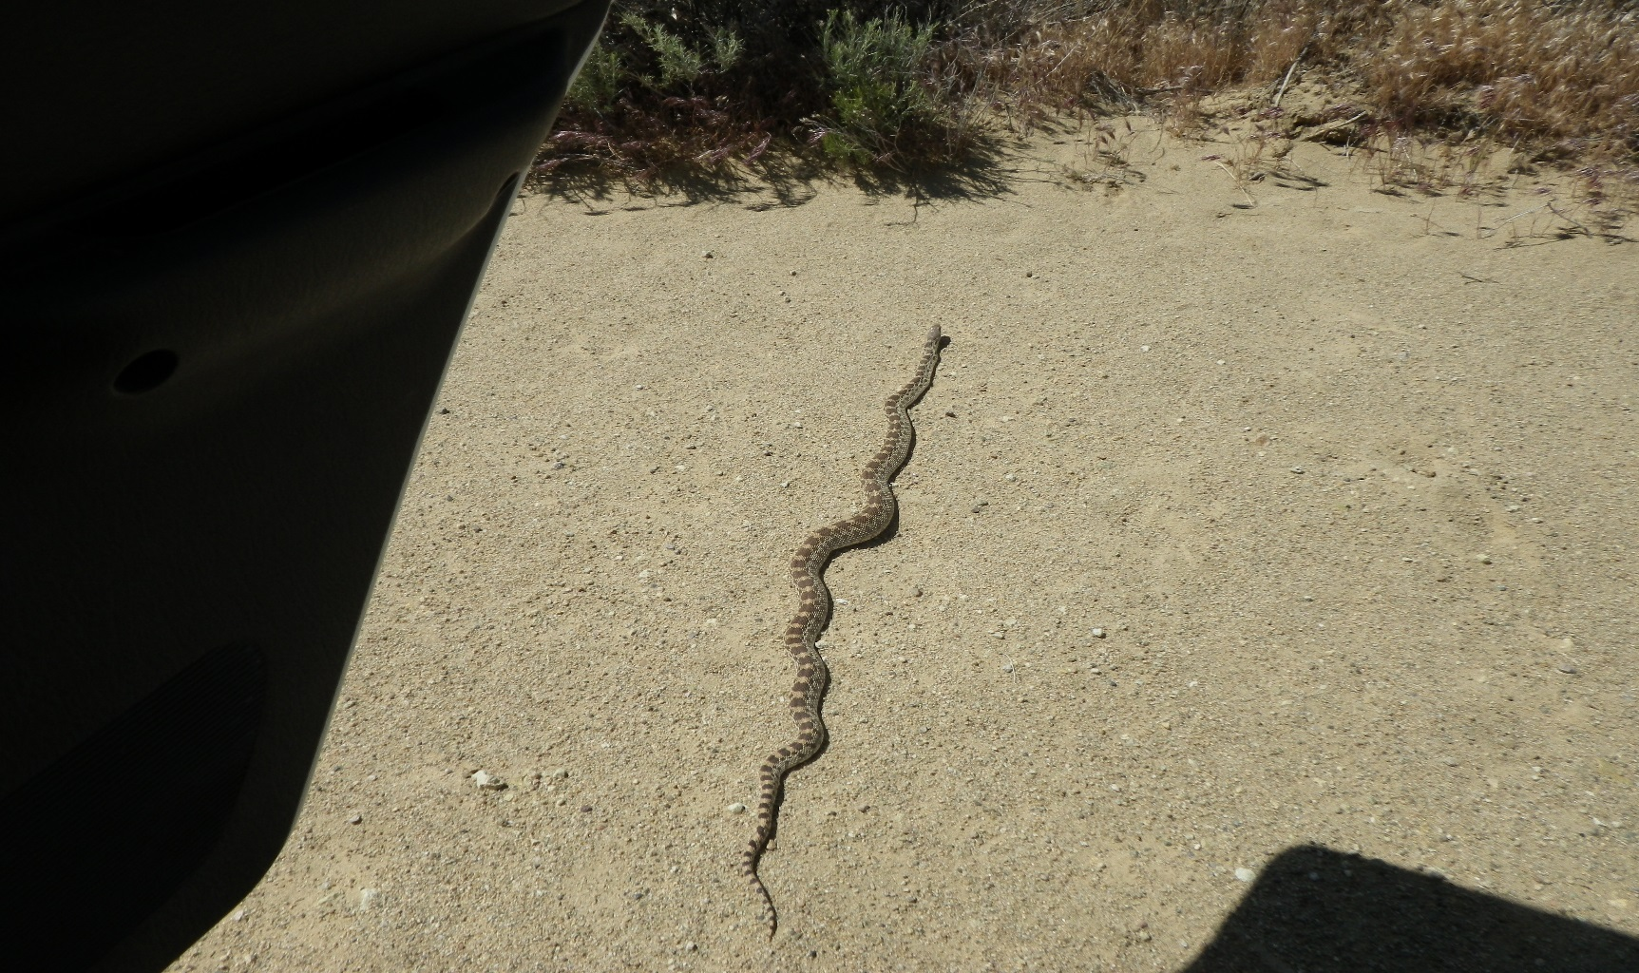
Gopher snake

Slide 27
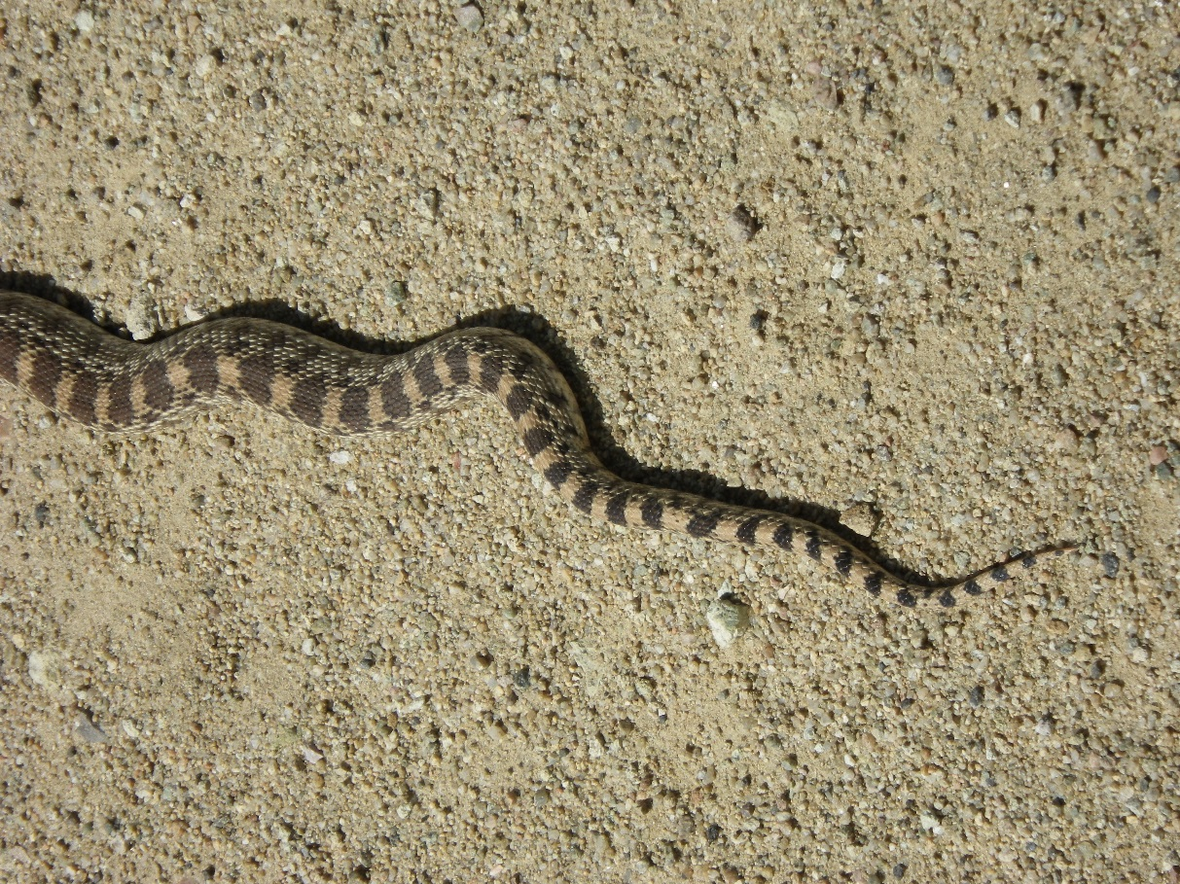
Gopher snake tail

Slide 28
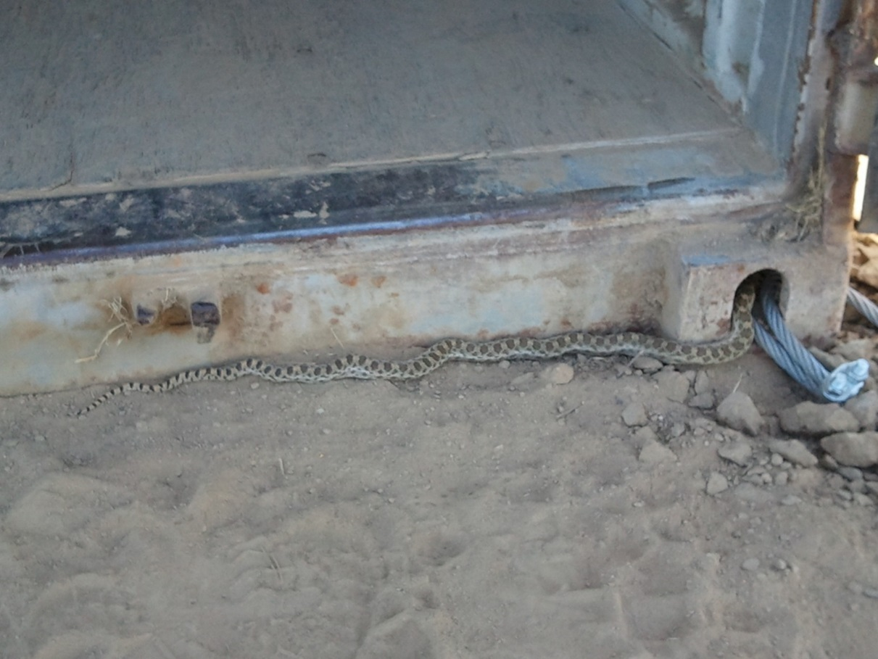
What is it?

Slide 29
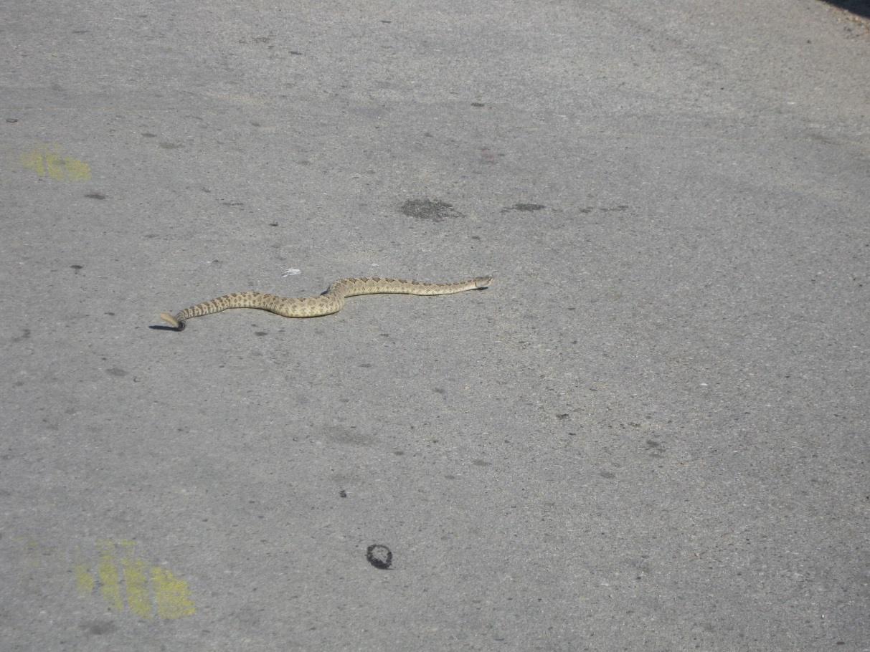
What is it?

Slide 30
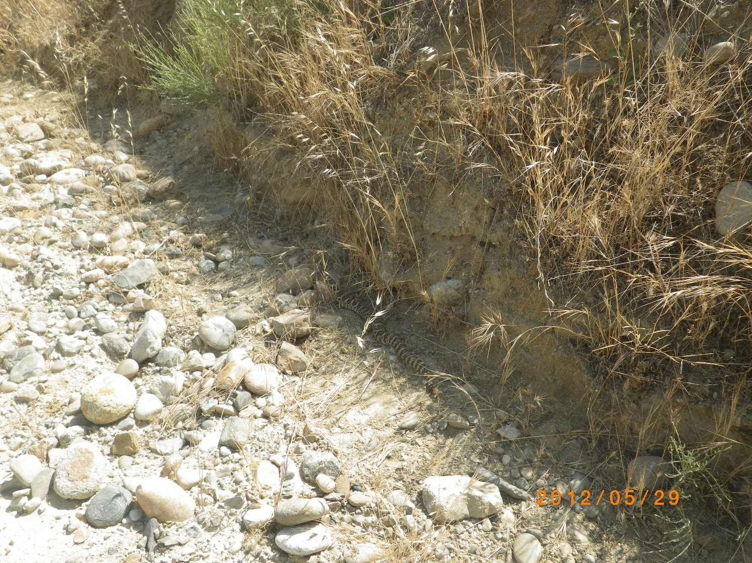
Typical hot weather behavior

Slide 31
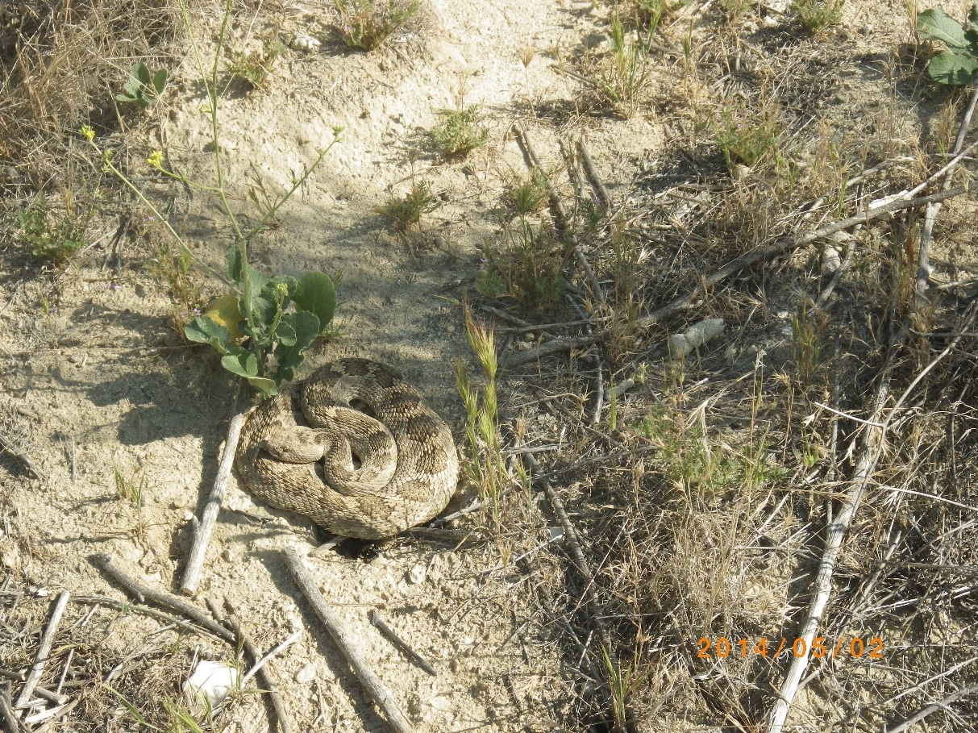
Post-feeding resting, but coiled.

Slide 32
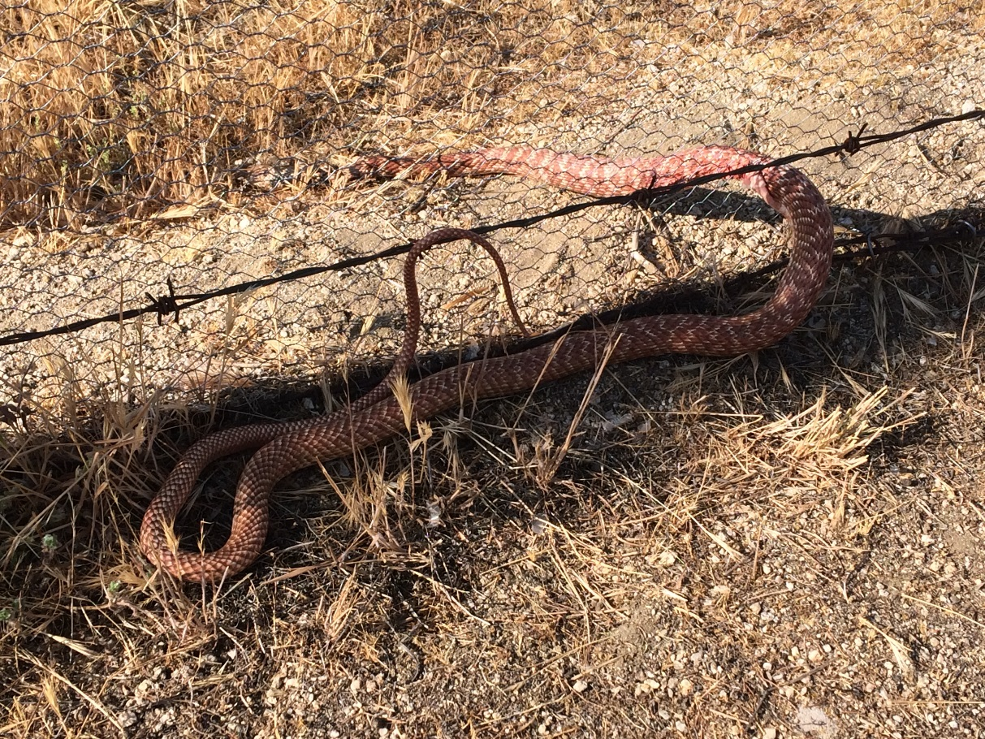
Red Racer

Slide 33
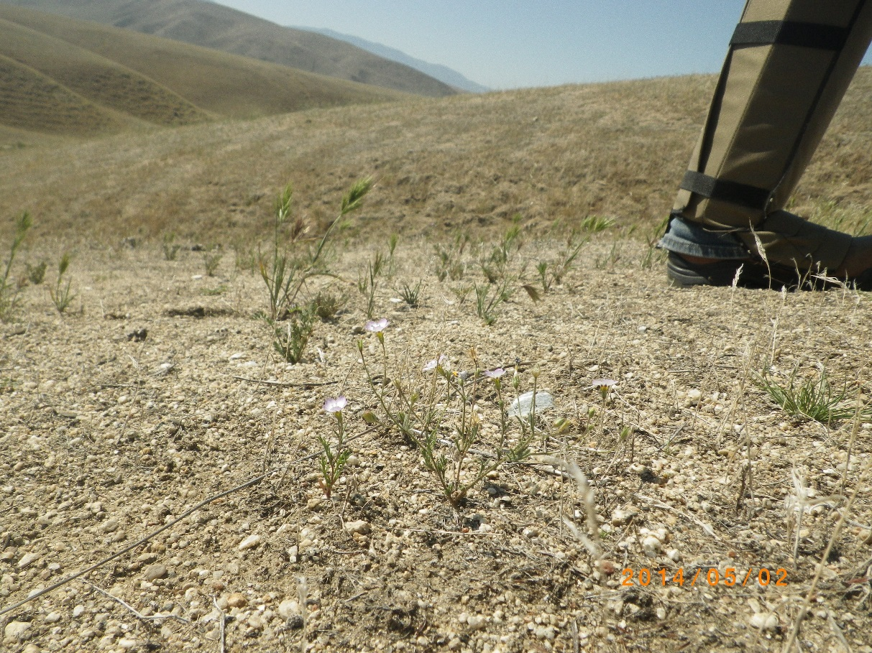
Protective gear: polycarbonate gaiters

Slide 34
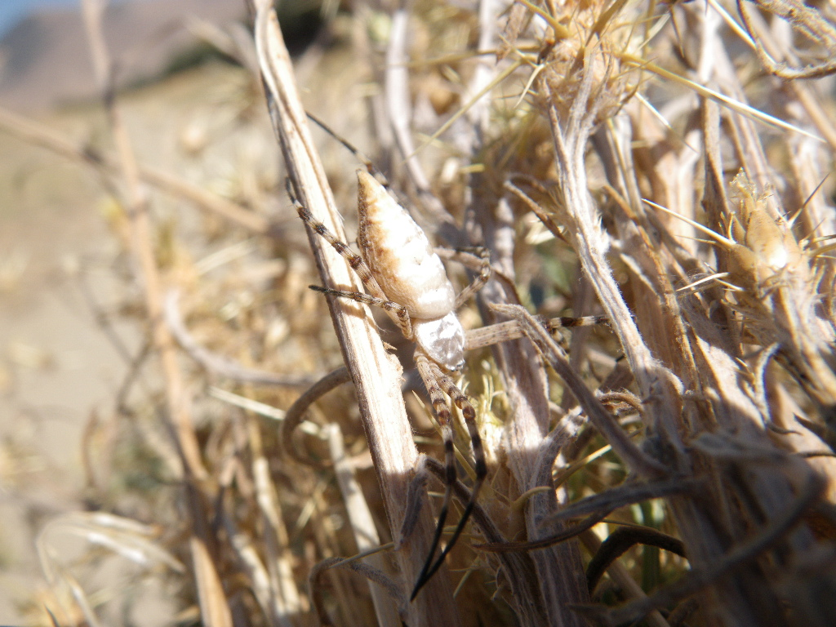
Banded garden spider

Slide 35
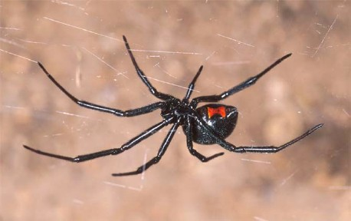
Black widow spider

Slide 36
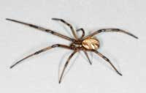
Immature female black widow spider

Slide 37
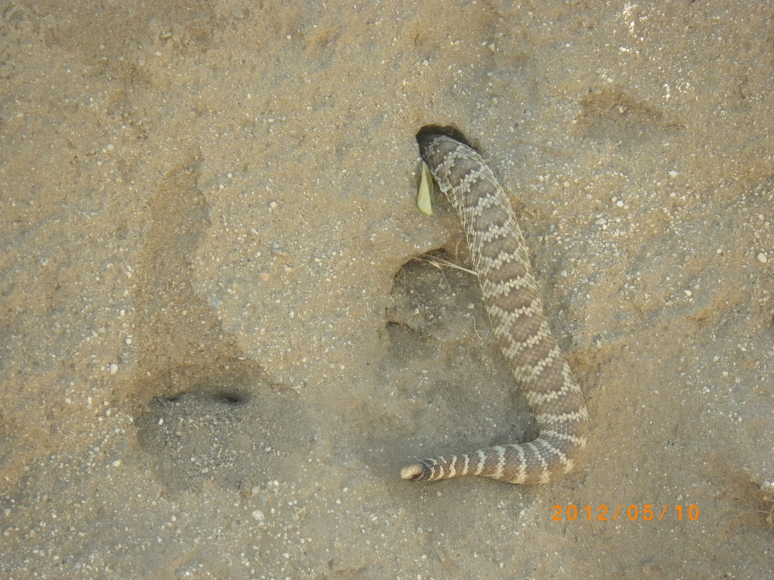
The end.

