Slide 1
County Safety Committee
3rd Quarter Meeting
August 19,2015
Brad Aragon, CSP
Loss Prevention Specialist
Risk Management

Slide 2
Today’s Agenda
County’s annual claim history
OSHA’s Top 20 citation categories
Heat Illness update – Lone Worker information
County vehicle accident information
When a workers’ comp claim get filed
Ergonomic video
New/Updated department safety programs

Slide 3
County Workers’ Comp Claim History
7/1/xx to 6/30/xx

Slide 4
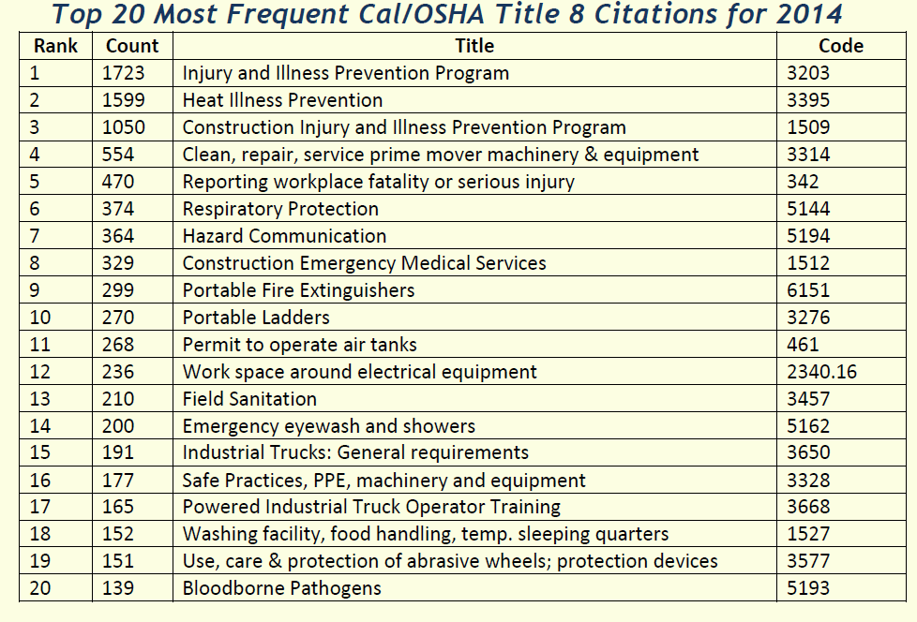
OSHA Top 20 Citations vs. Kern County
Kern County
IIPP -2
Heat Illness – 1
Forklifts – 1
Bloodborne Pathogens – 1
Log 300 info. - 1

Slide 5
Heat Illness Updates
There has been a new emphasis on the safety and health of “Lone Workers” during high heat periods. Although this new standard applies to the Construction Safety orders, it provides some good safe work practices that any industry can follow.
Working alon e- The performance of any work function by a worker who is the only worker for
that employer at that workplace at any time or is not directly supervised by the employer, or
another person designated as a supervisor by the employer, at any time.
The employer shall monitor or account for:
employees at regular intervals to discover and direct aid to employees who have become
incapacitated or non-responsive. The employer shall account for each employee:

Slide 6
Heat Illness Updates
(1) Throughout each work shift at regular intervals to ensure employee’s safety and health based
on the hazards identified under 1511(b); and
(2) At the end of the job assignment or at the end of the work shift, whichever occurs first.
(b) Where means of electronic communication are unreliable or unavailable, the employer shall
account for each employee by sight or verbal communication.

Slide 7
Total Vehicle Accidents – 6 Months

Slide 8
Types of Vehicle Accidents – 6 month

Slide 9
When a Workers Comp Claim is filed
Documentation that is typically received in order for the claims process to begin.
Supervisor’s Investigation Report http://www.co.kern.ca.us/rm/Forms/wc_supRpt.pdf
Form 5020 – Employer’s Report of Injury http://www.co.kern.ca.us/rm/Forms/Form5020.pdf
DWC 1 – Employee claim formhttp://www.co.kern.ca.us/rm/Forms/ClaimForm2010.pdf
The claims department may also receive notification from the treating doctor which would also start the claim process
Some departments provide additional information which is specific to their department

Slide 10
Beginning of a Claim
Once the Risk Management department receives the proper notification, a process of contacting the various parties will begin.
The claims department will contact the injured employee to gather additional information and get clarification on how the injury occurred.
The claims department will contact the treating physician for a copy of the initial doctor’s report if they have not received it already from the doctor.
The claims department will contact the department if additional information is needed or if the required forms are missing vital information.
This process is called the 3 Points of Contact

Slide 11
Ergonomics
Approximately 40% -50% of my time is spent addressing ergonomic concerns.
These include:
-Requested workstation evaluations from the doctor – post injury
- Requested workstation evaluations from the department
Recommendations and Action taken include:
-Includes chair adjustments, installing keyboard trays, wrist rest pads, footrests, and re-locating equipment on the desktop

Slide 12
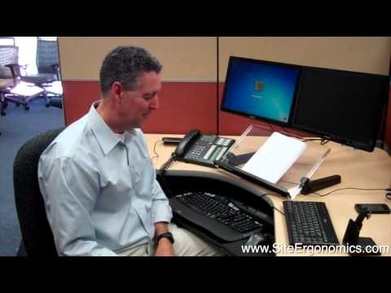
Ergonomics – Shoulder Pain

Slide 13
New/Updated Department Programs
1. The AG Commissioner’s /Weights & Measures department implemented a new vehicle safety program in response to some recent preventable incidents.
It involves a vehicle walk-around procedure prior to the person entering the vehicle and leaving.
2. With the creation of the Public Works Department, programs that were developed by the Waste Management dept. are being implemented into other departments.
-Updating the Roads Dept.’s heat illness program
-Creating a consistent method of reporting accidents and injuries within Public Works

Slide 14
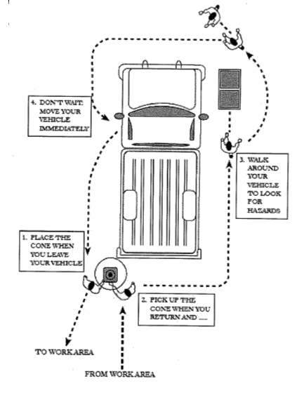
Circle of Safety

Slide 15
Questions or Comments
The next County Safety Committee meeting will be:
November 18, 2015

