Slide 1
County Safety Committee Meeting – 3rd Quarter 2014
Brad Aragon, CSP
Loss Prevention Specialist

Slide 2
Agenda
Workers Comp Injuries
Cal-OSHA update
Ergonomic Trends
New Hire Orientation
Active Shooter Discussion

Slide 3
Workers Comp Claims Comparison
1/1 to 8/1

Slide 4
Workers Comp Claims Comparison
8-1 to 8-1

Slide 5
Cal-OSHA Update
Inspection with Mental Health
  Resolved with minimum fines
  Updated documentation process
  Revised training for people handling Log 300 information

Slide 6
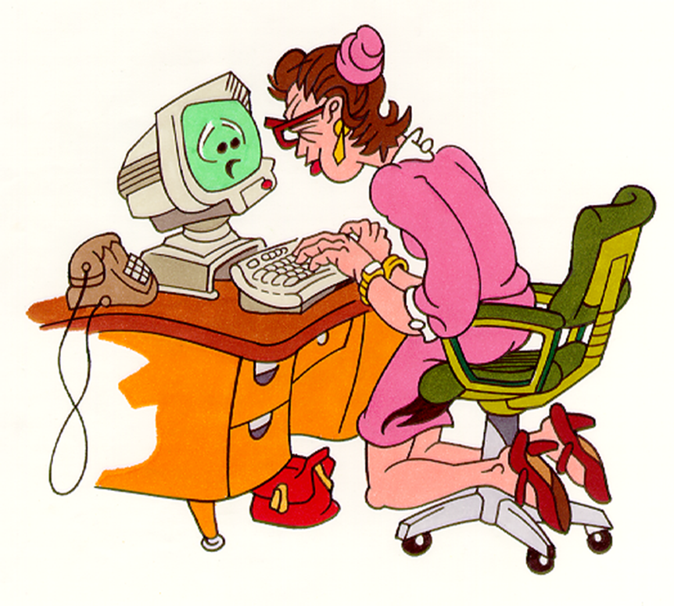
Common Ergonomic Issues

Slide 7
Common Ergonomic Trends
Knowledge of chair operations
Keyboard and mouse items
Full arm extension vs. neutral position

Slide 8
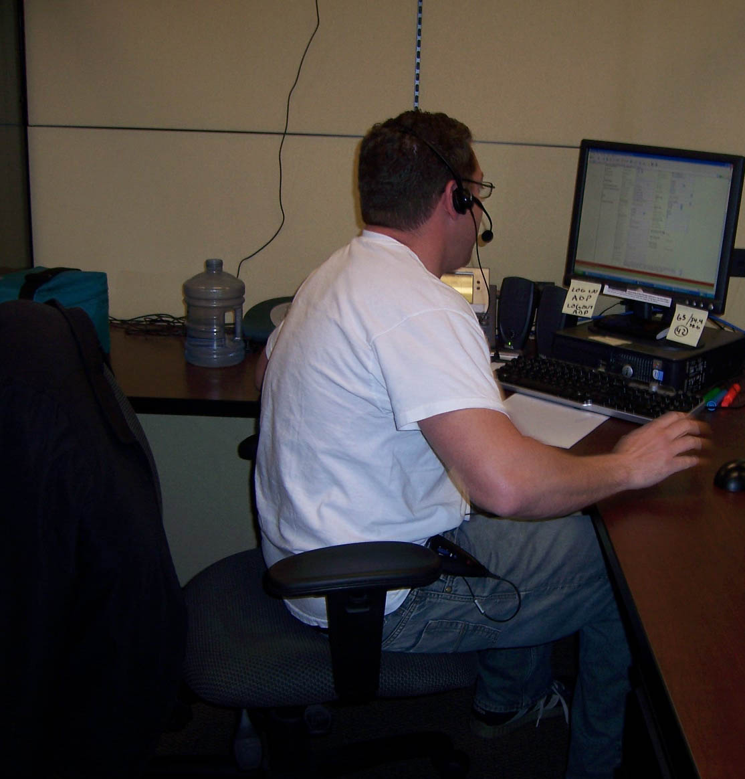
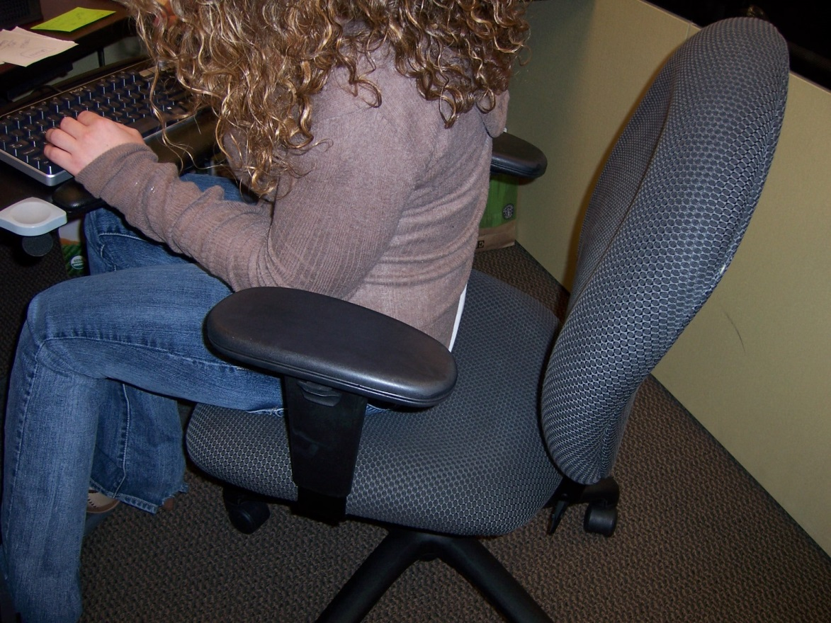
Sitting Improperly

Slide 9
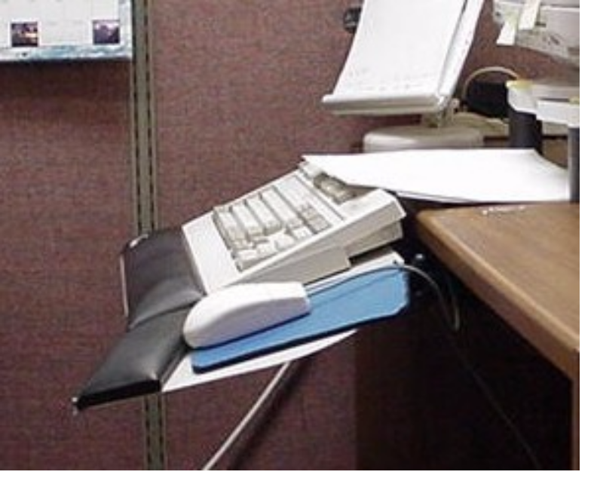
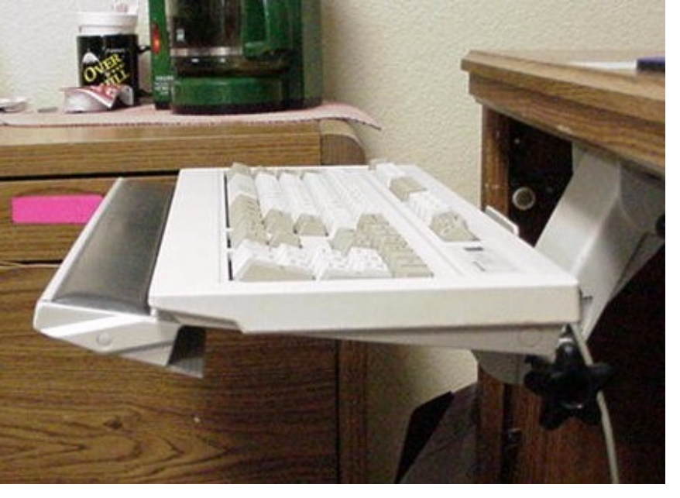
Keyboard Tilt

Slide 10
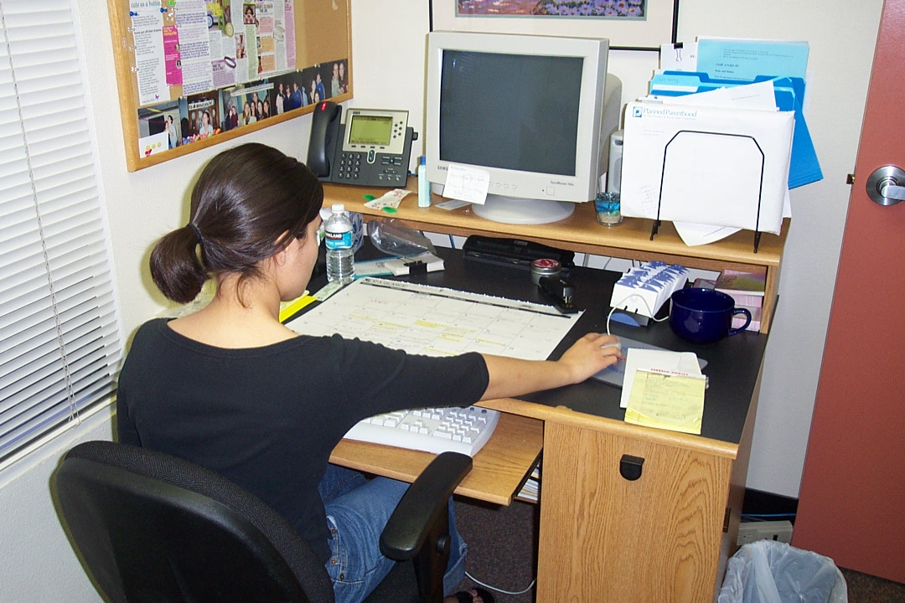
Full Arm Extension

Slide 11
New Hire Orientation
Attendees were asked to:
  Locate their department’s IIPP binder
  Find out who the Safety Rep for the department is
  Locate their department’s SDS binder
  Surprising responses

Slide 12
New Hire Orientation
Speak with person who provides department orientation
  Is there safety materials in the new hire packet?
    IIPP, Evacuation plan, who safety rep is
Can you (Department’s Safety Rep), meet with newly hired employees to discuss this material?

Slide 13
Active Shooter Video
Dept. Of Homeland Security
Run Hide Fight

Slide 14
Active Shooter Information
Implementing policy and procedures for the Administrative Building
Perform a security check of your department
  Security doors
  Access to the public
  ID badges

Slide 15
4th Quarter Meeting
Our next meeting will be November 19, 2014 at 10:00 am

Slide 16
Questions or Comments
Please contact me with any future topic or ideas that we can discuss in this meeting
Thank You

