Slide 1
County Safety Committee Meeting
3rd Quarter - 2013
Brad Aragon, CSP
Loss Prevention Specialist
Risk Management

Slide 2
Agenda
Introductions
Workers’ Comp Fraud Posters
Workers’ Comp Claims Updates
Cal-OSHA Activity
Slips Trips & Falls Presentation
Video
Supervisor Safety Training Course
Open forum

Slide 3
Workers Comp Claims
1/1 thru 8/1

Slide 4
Claims Trends
2010 thru 2013

Slide 5
Cal-OAHA Update
KMC mold complaint
  Resolved with only $400 in fines
  General violations that were already addressed or abated
Animal Control
  Initiated by a complaint, not an injury or accident
  Initial and follow up meetings
  Abatement projects
  Currently awaiting results

Slide 6

Slips, Trips, and Falls
Notes:
Slide Show Notes
Welcome to the training session about avoiding slips, trips, and falls at the workplace.
The Occupational Safety and Health Administration (OSHA) requires employers to provide a workplace that is free of recognized hazards, including slip, trip, and fall hazards.
In this training session, we will focus on the fall hazards associated with walking surfaces, work surfaces, and work platforms that expose employees to a potential fall to a lower level.
We will also examine basic ladder and stair safety as well as the prevention of slip and trip hazards.

Slide 7
Session Objectives
You will be able to:
  Identify slip, trip, and fall hazards at work
  Understand safety specifications and features of walking surfaces and openings
  Use stairs and ladders safely to avoid falls
  Avoid and eliminate slip and trip hazards
Notes:
Slide Show Notes
By the end of the training session, you will be able to:
Identify slip, trip, and fall hazards at work.
Understand safety specifications and features of walking surfaces and openings.
Use stairs and ladders safely to avoid falls.
Avoid and eliminate slip and trip hazards.

Slide 8
Injury Statistics
  265,000 nonfatal injuries from slips, trips, and falls annually result in one or more days away from work per incident
  Slips, trips, and falls result in 17% of all nonfatal workplace injuries per year, the highest injury rate of any regulated activity
Notes:
Slide Show Notes
According to the federal Centers for Disease Control and Prevention, 265,000 workers in the U.S. sustained nonfatal injuries from slips, trips, and falls in a recent year, each resulting in one or more days away from work.
These injuries represent 17% of all nonfatal workplace injuries, the highest frequency of injury of any single regulated activity.

Slide 9
Slip, Trip, and Fall Hazards
  Power cords, ropes, hoses across floors and walkways
  Clutter in walkways
  Floor and wall holes and openings
  Wet floors
Notes:
Slide Show Notes
Here is a list of common work conditions that can lead to slips, trips, and falls:
Power cords, ropes, and hoses across floors and walkways are common tripping hazards.
Open-sided floors and platforms are fall hazards.
Clutter on floors and in aisles are typical tripping hazards.
Floor and wall holes and openings are trip and fall hazards.
Open pits, tanks, vats, and ditches are fall hazards.
Wet floors are common slip and fall hazards.
Modify this slide to describe slip, trip, or fall hazards at your facility.
Ask trainees to describe their own experiences with slip, trip, and fall hazards, and to identify specific hazards that they are aware of.

Slide 10
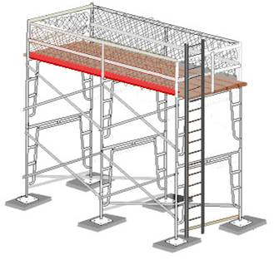
Open-Sided Floors and Platforms
  All floors and platforms 4 feet above ground
  must be guarded
  Standard guard rails are required
  Toeboards protect workers below
  Toeboards protect machinery below
Image credit: OSHA
Notes:
Slide Show Notes
Let’s discuss how to reduce or eliminate specific hazards.
Open-sided floors, walkways, or work platforms that are 4 feet or more above adjacent floor or ground levels must be guarded to prevent workers from falling to the lower level.
Standard guardrailing, or equivalent fall protection, on all open sides is required except where there is an entrance to a ramp, stairway, or fixed ladder.
Toeboards to protect employees that may work or walk below the aboveground walkway or work platform.
Toeboards will also protect moving machinery or equipment that could be damaged by materials falling from the aboveground walkway or work platform.
Modify, add, or delete subsequent slides to describe specific slip, trip, and fall hazards at your facility.

Slide 11
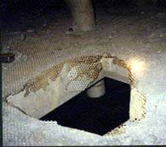
Guarding Holes and Openings
  Hole—measures 1 to 12 inches wide
  Opening—greater than 12 inches wide
  Guard with standard railing
  Cover the hole or opening
  Attend the hole or protect with toeboard
Image credit: MSHA.gov
Notes:
Slide Show Notes
A floor hole is any opening between an inch and 12 inches wide. A person cannot fall through a hole this small, but could step into the hole and be injured. Objects could fall through the hole. Holes include a belt hole, pipe opening, or a slot opening.
An opening is 12 inches or more wide in a floor, platform, pavement, yard, or any other walking or working surface. A floor opening is large enough for a person to fall through. Examples include a hatchway, pit, or manhole.
Every floor hole or opening that a person may accidentally step into or fall through must be guarded by standard railing with toeboard.
Covering the hole or opening is another option that will protect workers. Every floor hole into which persons cannot accidentally walk because of fixed machinery, equipment, or walls should be protected by a cover that leaves no openings more than 1 inch wide. The cover shall be securely held in place to prevent tools or materials from falling through.
While the cover is not in place, the floor hole must be attended in order to keep other workers away from the hazard, or the hole must be protected by a standard railing with toeboard.

Slide 12
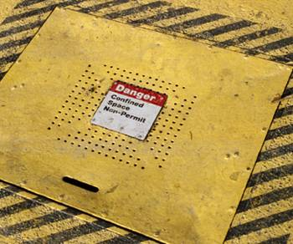
Guarding Stairway and Ladder Floor Openings
  Guard by railing on
  exposed sides
  Entrance may be open
  Recommend a swing gate
  Cover the opening
Notes:
Slide Show Notes
Guard stairway and ladder floor openings with a standard railing with toeboard on all exposed sides, except the entrance.
The entrance may be open as long as the passage through the railing is offset so that a person cannot walk directly into the opening.
Guard the passage through the railing with a swinging gate, or offset it to prevent someone from walking into the floor opening.
Another option is to have a hinged floor opening cover that is properly constructed and has adequate strength. When the stairway or ladder is not in use, the cover shall be closed. When the cover is not in use, the opening should be attended by someone at all times or protected on all exposed sides by removable standard railings.
Modify this slide to describe stairway and ladder floor openings at your facility, or delete or hide the slide if it does not apply.
Discuss stairway and ladder floor openings in your workplace.

Slide 13
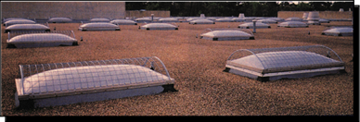
Guarding Hatchway and Chute Floor Openings
  Maintain a sturdy hinged cover
  Removable railing
  Fence off the area under the opening
  Use audible alarm when dropping materials through openings
  Guard skylights with screen or railing
Image credit:Ini.wa.gov/Safety
Notes:
Slide Show Notes
Hatchway and chute floor openings must be guarded.
A hinged floor opening cover can be used as long as it is properly constructed and has adequate strength to support people walking across the cover. When the opening is not in use, the cover must be closed, or the exposed sides must be guarded with railings.
A removable railing with toeboard can be installed on one or two sides of the opening. The other two sides must be guarded by fixed standard railings with toeboards. The removable railings are kept in place when the opening is not in use and should be hinged or mounted so they can be easily replaced, when necessary.
The area under floor openings should be fenced off. When this is not practical, the area should be marked with yellow lines, and warning devices such as ropes or ribbons should be installed.
When floor openings are used to drop materials from one level to another, audible warning systems should be installed and used to warn employees on the lower level.
Skylights must be guarded by a standard skylight screen or a fixed standard railing on all exposed sides.
Modify or delete this slide as it applies to your facility. Discuss how your company uses hatchways and chutes.

Slide 14
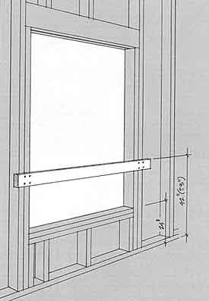
Wall Openings
  30 inches high and 18 inches wide
  A person could fall through
  If drop of more than 4 feet, guard with rail, roller, fence, door
  Install toeboard to protect against falling hazards
Image credit: OSHA.gov
Notes:
Slide Show Notes
Wall openings are holes or openings in walls that are at least 30 inches high and 18 inches wide in a wall or partition.
The wall openings are large enough for a person to fall through.
If the wall opening presents a hazard of falling more than 4 feet to a surface below, guard it with a railing, roller, picket fence, half door, or equivalent barrier.
A toeboard must be installed to protect employees working below the wall opening from falling materials.
Discuss potential wall opening hazards and protective measures at your facility.

Slide 15

Guardrails
  Top rail—42 inches
  Midrail—21 inches
  Toeboard—4 inches high
  Must withstand reasonable force to prevent worker from falling
Notes:
Slide Show Notes
Guardrails act as a barrier along any open edge to protect employees and objects from falling over the open edge to a lower level.
The top rail of the guardrails must be 42 inches high above the walking or working surface.
The midrail must be halfway between the top rail and the walking or working surface, or about 21 inches above the surface.
A 4-inch tall toeboard is used to help prevent an employee from stepping over the edge of the working surface and to prevent the employee from kicking tools or equipment over the edge where they could fall on an employee on the lower level.
The guardrailing must be able to withstand reasonable force and prevent an employee from falling to a lower level.

Slide 16
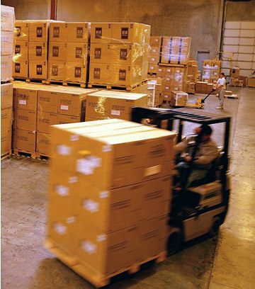
Aisles and Passageways
  Keep clear for material
  handling equipment
  Mark permanent aisles
  Heavy-traffic passage-
  ways must be equipped with pedestrian walkways
Notes:
Slide Show Notes
Sufficient clearance must be available for aisles, loading docks, doorways, and areas where turns must be made where mechanical handling aids such as forklifts, and electrical pallet jacks, are used. Keep aisles and passageways clear, with no obstructions that could create a hazard.
Permanent aisles and passageways should be marked. Marking is not limited to printed lines on the floor. Other marking methods include marked pillars, striping, flags, traffic cones, or barrels that are in good condition and that employees and vehicle operators can recognize.
Passageways with a heavy flow of vehicle traffic must be sufficiently wide to provide pedestrians a walkway that is separated from vehicle traffic, such as forklifts and other material handling equipment.
Discuss aisles in your workplace that are marked to indicate they are permanent. Consider bringing a map of your facility that shows permanent aisles.

Slide 17
Floor Load Rating
  Post load ratings
  Mark plates covering floor openings
  Mark aboveground walkways
  Never exceed load rating limit
Notes:
Slide Show Notes
Walking surfaces, especially suspended walkways, have weight limits for what can be safely loaded on them.
Load ratings must be marked and posted in such a way that employees can see the load rating.
Plates covering holes and openings in the ground should be marked with their load rating.
Aboveground walkways and working surfaces must also be marked with their load ratings.
Never exceed a posted load rating limit.

Slide 18
Walking Surfaces and Openings—Questions?
  Do you have any questions about open-sided floors, floor holes and openings, aisles, or floor load ratings?
Notes:
Slide Show Notes
Do you have any questions regarding open-sided floors, floor holes and openings, aisles, or floor load ratings?

Slide 19
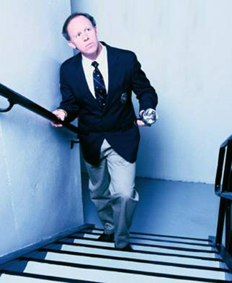
Use Stairs Safety
  Use handrails
  Walk—don’t run
  Inspect for slippery
  surfaces or damaged steps
  Do not put objects
  on steps
Notes:
Slide Show Notes
Now we’ll discuss safety procedures with stairs and ladders.
Hold onto the handrails when ascending or descending stairs. Even the most athletic person can potentially misstep, stub a toe, or otherwise trip on the stairs and fall. The handrail gives you that extra point of contact.
Walk up and down stairs. Running or jumping just increases the possibility of falling.
Inspect the steps for slippery surfaces, such as oil or grease. Check for damaged steps. Be careful on carpeted steps because they can also be slippery.
Avoid putting objects on stairs. Many people have the habit of putting objects that they intend to take upstairs later on the bottom steps of the stairs. However, someone else unaware of the object could fall or trip over it.

Slide 20
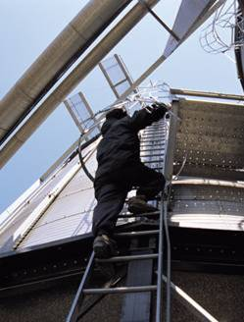
Use Fixed Ladders Safely
  Permanently attached
  Cages needed if climbing height greater than 20 feet
  Maximum unbroken
  length or height of 30 feet
  Use ladder safety devices
Notes:
Slide Show Notes
Fixed ladders are ladders that are permanently attached to a structure, building, or equipment.
Cages or wells are required if the climbing height is longer or higher than 20 feet.
Permanent ladders can only have a maximum length or height of 30 feet without being broken up by a platform.
Instead of cage protection, ladder safety devices may be used on tower, water tank, and chimney ladders over 20 feet in unbroken length. Ladder safety devices require the worker to wear a full-body harness with a lanyard attached to a device on the ladder. If the climber falls, the device automatically stops and locks, preventing the worker from falling a longer distance.
Modify, hide, or delete this slide as it applies to fixed ladders at your workplace.
Discuss the safety features and procedures for using fixed ladders installed in your workplace.

Slide 21
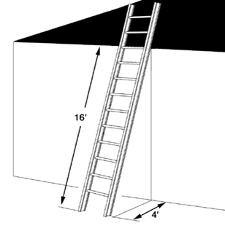
Set Up a Ladder
With Safety in Mind
  Put it on a level surface
  Angle the ladder properly—use the 4 to 1 rule
  Secure the bottom
  Extend 3 feet above
  the upper landing
Image credit: State of WA-WISHA Services
Notes:
Slide Show Notes
Place the ladder on a solid and level surface. Avoid putting the ladder on sloped surfaces or on gravel or dirt, which could give way and cause the ladder to fall.
Angle the ladder properly by using the 4 to 1 rule. Count the number of rungs from the floor to the top of the ladder or the support point of the ladder. Then divide this number by 4 to determine how many feet the bottom of the ladder should be from the wall or other support. For example, if you are leaning a ladder against the wall and you have extended the ladder 16 rungs, then the bottom of the ladder should be at least 4 feet away from the base of the wall (16 divided by 4 equals 4 feet).
Secure the bottom of the ladder or have someone hold it for you. Although the ladder may have antislip feet, securing the bottom gives you that extra protection.
When using the ladder to gain access to an upper landing, extend that ladder at least 3 feet, or 3 rungs, above the upper landing so that you still have ladder to hold onto when transferring from ladder to the upper landing and back to the ladder again.
If you will be using the ladder in one place a number of times during the day, also secure it at the top to prevent it from falling backward or to the sides.

Slide 22
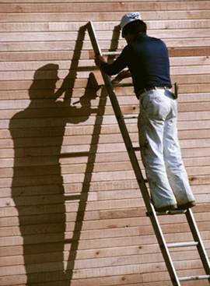
Climb Ladders Safely
  Face the ladder
  Climb with both hands
  Use a tool belt
  or bucket hanger
  Keep your weight
  centered
  Don’t stand on the
  top two rungs or steps
  of a stepladder
Notes:
Slide Show Notes
When climbing or descending, always face the ladder. It is much more difficult to maintain your balance and hold on when your back is toward the ladder.
Climb with both hands. Do not attempt to hold tools or other objects in your hands when climbing ladders. When working on a ladder to paint or do other projects, always keep at least one hand on the ladder.
Use a tool belt or bucket hanger to carry and store tools or other necessary equipment.
Keep your weight centered on the ladder. Do not lean off to either side of the ladder.
When using an extension ladder, do not stand on the top four rungs because you cannot maintain a grip with your hands when standing this high on the ladder. When using a stepladder, do not stand on the top two steps (including the top one).

Slide 23
Inspect Ladders
  Make sure rungs are in good condition and clean
  Make sure ladder locks function correctly
  Use a nonconductive ladder around electrical equipment
  Ladder feet should be antislip material
Notes:
Slide Show Notes
Before every use, the ladder should be inspected quickly to make sure it is safe to use.
The rungs of the ladder should be in good condition and not bent or otherwise damaged. The rungs should also be clean and free of grease, oil, or other contaminants that may cause them to be slippery.
Check the ladder locks on extension ladders to ensure they are functioning correctly and holding well.
When working on or near electrical equipment, the ladder must be nonconductive. Use a fiberglass ladder. Never use an aluminum ladder.
Make sure the ladder has feet that are made of rubber or some other antislip material.

Slide 24
Stairs and Ladders—
Any Questions?
  Any questions about safety procedures for stairs and ladders?
Notes:
Slide Show Notes
Are there any questions about safety procedures for stairs and ladders?

Slide 25
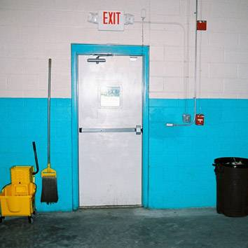
Keep Walking and Working Surfaces Clear and Clean
  Keep workroom floors
  clean and dry
  Maintain a clean and orderly work area
Notes:
Slide Show Notes
Keep workroom floors, walkways, and other walking or working surfaces clean and dry in order to eliminate slip hazards and prevent injuries. Maintain gratings and drainage to remove liquids, and install mats or raised platforms where wet processes are used.
Prevent tripping-related injuries by keeping floors, walkways, work platforms, and passageways free from trip hazards, such as protruding nails, holes, loose boards, debris, tools, materials, and other objects.

Slide 26
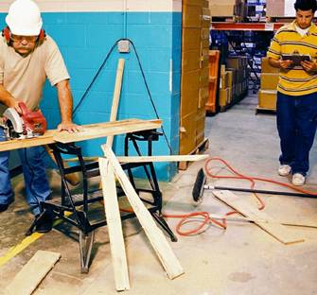
Eliminate Trip Hazards
  Pick up tools, materials,
  and trash
  Pick up or walk around obstructions
  Report dangerous walking and working surfaces
  Keep file drawers closed
  Keep power cords out of walkways
Notes:
Slide Show Note
Housekeeping plays a key role in preventing trips. Take the time to pick up tools, materials, and trash. Clean up straps and bands from boxes or bundles. They can easily get wrapped up in a person’s legs and cause a fall. If you have to work in a walkway, put some cones or barricades around your tools and materials so employees are more aware of the hazards and can walk or drive around your work area.
Do not walk through the middle or on top of obstructions in your work area. If possible, pick up the obstructions and put them away. If not, walk around them.
Report dangerous walking and working surfaces, such as damaged flooring, uneven surfaces, loose boards, tears in carpeting, protruding nails, etc., so they can be repaired to eliminate the trip hazard.
Keep file drawers closed. Many times in an office environment, people are walking around while reading paperwork or thinking about something else and they are not looking for or expecting open file drawers.
Avoid stretching cords across walkways or stairwells, unless they are covered. If cords or air hoses must go across high traffic areas, tape them down to the floor and put a cone or warning sign over them.
Discuss trip hazards that are found in your workplace.

Slide 27
Eliminate Slip Hazards
  Clean up liquids
  Sweep up debris and dust
  Stop and repair leaks
  Install absorbent around wet processes
  Use warning signs or cones
Notes:
Slide Show Notes
Clean up spills and leaks of liquids right away. Water and oil should be cleaned up with rags, mops, squeegees, floor absorbent, etc. Chemical spills or leaks should be reported so that properly trained personnel can clean up the chemical. Remember, do not clean up a chemical spill unless you have been trained.
Sweep and pick up debris and dust. Do not just step over or walk by slip hazards. Take the time to pick up or clean up the hazard.
Repair leaks in machinery, piping, and equipment that can contribute to slip hazards.
Install absorbent or liquid barriers around wet processes, such as splashing metal-working fluids in machine shops, parts cleaning, or other processes that involve liquid chemicals. Absorbent or other barriers will prevent these liquids from flowing into walking areas and causing slip-related injuries.
Post warning signs, cones, or barricade tape around slip hazards or, if necessary, stand guard to prevent unknowing or unaware employees from entering the hazardous area until the slip hazard has been cleaned up.
Discuss slip hazards that are found in your workplace.

Slide 28
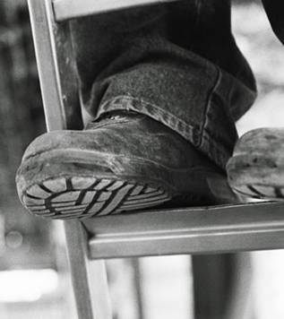
Wear Slip-Resistant Shoes
  Street shoes not intended for slip resistance
  Soft rubber sole
  for slip resistance
  Sole tread with channels
  Still need to walk carefully
Notes:
Slide Show Notes
Proper footwear can play a large role in preventing slip-related injuries. Remember, street shoes or athletic shoes are not intended to provide slip resistance in the work environment. For example, shoes that provide good traction on a basketball court may not provide good traction in a work environment that is subject to slip hazards from water, oil, or chemicals.
Slip-resistant shoes should have soft rubber soles that grip the surface of the floor. However, the soles should not be too soft or they will wear down quickly.
The soles of slip-resistant shoes should have tread with channels that carry the water, oil, chemical, or other contaminant out from under the shoe, which will allow the ridges on the sole to come in firm contact with the floor.
Remember that wearing slip-resistant shoes does not eliminate the possibility of slipping. You must still recognize slip-related hazards and walk carefully in areas with wet floors.
Discuss the footwear the different people in your class are wearing. Encourage everyone to purchase good footwear with slip-resistant soles.

Slide 29
Be Alert, Use
Common Sense
  Be aware of the hazards
  Pay attention to where you are going
  Adjust your stride according to the
  walking surface
  Make wide turns at corners
  Don’t block your vision when carrying items
Notes:
Slide Show Notes
Be alert to all the potential slip, trip, and fall hazards.
Workers must pay attention to where they are going. Keep an eye out for potential slip, trip, and fall hazards.
Adjust your stride according to the walking surface. If the surface is dry and rough, you can probably take long and quick strides. If the floor appears to be slippery, take short and slow steps. When walking on a ramp, take slow steps and test your traction.
Make wide turns at corners. If you try to take a sharp corner and plant your foot to cut and turn, that foot could be planted on a slippery surface and cause your feet to slide right out from under you.
When carrying objects, do not carry so many items that your forward vision is blocked. Make sure you can always see the floor in front of you, especially when traveling up and down stairs or ramps.

Slide 30
Slip and Trip Safety—
Any Questions?
  Any questions about slip and trip hazards of walking and working surfaces?
Notes:
Slide Show Notes
Do you have any questions regarding slip and trip hazards of walking and working surfaces?
Let’s wrap up the class with a quiz.

Slide 31
Key Things to Remember
  Check for unguarded openings
  Keep walkways free of hazards
  Use stairs and ladders safely
  Prevent slip and trip hazards
Notes:
Slide Show Notes
Here are some key things to remember as you walk around all work areas:
Check your workplace for unguarded floor openings, open-sided floors or platforms, ladder and stair openings, wall openings, etc.
Keep walkways clear of obstructions and free of recognized hazards.
Ensure stairs have proper rails and fixed ladders have cages. Use stairs and ladders safely.
Prevent slip and trip hazards by maintaining excellent housekeeping.

Slide 32
Video
Slips Trips & Falls

Slide 33
Supervisor’s Training Course
Class will run approximately 2 hours
  Presentation, Team Exercises, Homework
  Several topics will be covered at different classes
  6 people per class
  First course will be Incident Investigation
  Contact me if you are interested

Slide 34
Questions & Comments
Next meeting will be:
Wednesday, November 13,2013

