Slide 1
County Safety Committee
3rd Quarter Meeting
Brad Aragon, CSP
Loss Prevention Specialist
Risk Management
Office of County Counsel

Slide 2


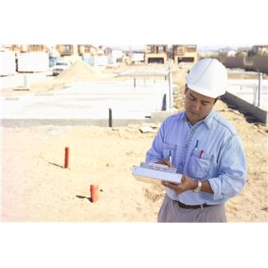
Agenda
TARGET SOLUTIONS
WORKERS COMP UPDATE
VEHICLE ACCIDENTS UPDATE
CAL-OSHA ACTIVITY
VIDEO
OPEN FORUM

Slide 3
TARGET SOLUTIONS
Plan to delete overdue assignments
Changing a user’s email
No more monthly overdue assignment e-mails from TARGET SOLUTIONS
Notification options for Assigned Courses
User updates

Slide 4
Target Solutions User Update
Total registered users in the system – 6,044
Active Users – 4,225
Inactive Users – 1369
Offline Users – 450
**Offline users are people who established an account but never logged in to use the program

Slide 5
Workers’ Comp Injury update
Overall the County is continuing to decrease the number of reported injuries.

Slide 6
Workers’ comp Injury Comparison
01-01 thru 08-01

Slide 7
Workers’ comp Injury Comparison
01-01 thru 08-01
This represents a:
39% decrease from 2008
32% decrease from 2009
32% decrease from 2010
22% decrease from 2011

Slide 8
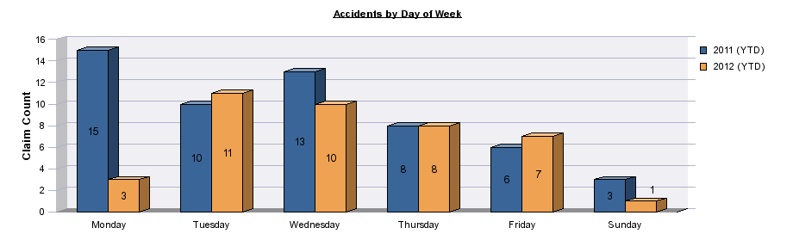
Vehicle Accidents – Day of Week

Slide 9
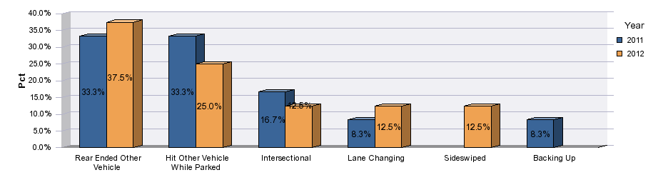
At Fault Vehicle Accidents

Slide 10
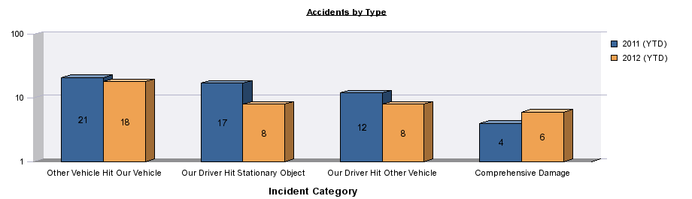
Vehicle Accident by TYPE

Slide 11
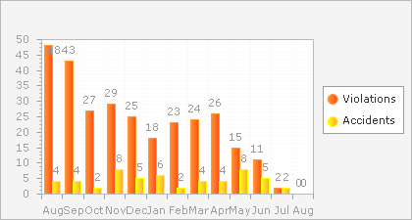
Updated DMV Data

Slide 12
Cal-osha activity
In 2012 there have been 2 active inspection/investigations by Cal-OSHA
Both have been complaint generated
No final violations have been issued at this time

Slide 13

Count the BLACK Dots

Slide 14
Safety Video
Understanding Office Safety

Slide 15

The update newsletter will go out shortly after the meeting to provide members who could not attend a recap of the items covered

Slide 16
Open forum
Personal Protective Equipment
Ergonomics
Heat Related Illness

