Slide 1
County Safety Committee
2nd Quarter - 2017
Brad Aragon, CSP
County Safety Officer
Risk Management

Slide 2
Agenda
Cal-OSHA complaints/citations.
Claims History.
Heat Illness Prevention.
Workplace Fatigue
Vehicle Accident Reporting
Importance of Documentation
Target Solutions

Slide 3
Cal-OSHA Activity
One complaint of irritant smoke.
  Complaint addressed
2 Citations for Heat Illness related claims.
  Injuries
  Areas of improvement
  Appeals process

Slide 4
Workers Comp Claims History
Workers Comp Claims Trend - Annually

Slide 5
Workers Comp Claims History

Slide 6
Claims Information - 2016 and 2017

Slide 7
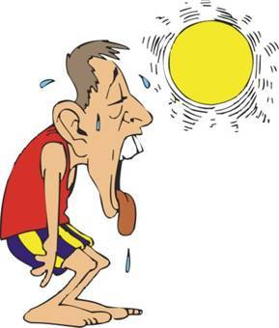
Heat Illness Prevention
Written Program
  Importance of a documented program, safety meetings, trainings, tailgates
Basic items of your Heat Illness program
  Available water, Available shade, Communication, Emergency procedures
Importance of Acclimitization
  Especially this spring/summer
  Fluctuations in temperatures
Employees working alone
  Communication is required

Slide 8
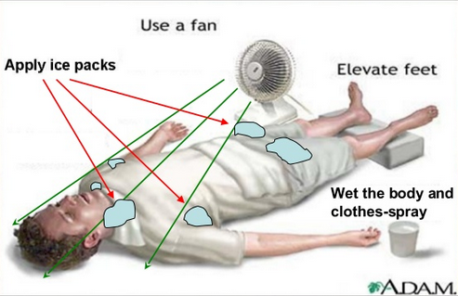
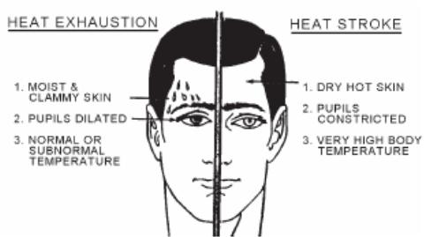
Heat Illness Prevention Facts

Slide 9

Workplace Fatigue
Growing concern of employees suffering fatigue while at work
  Driving drowsy, forgetting procedures, taking shortcuts
Estimated that 54% of people wake up tired. That means they are going into work tired.
Did you wake up tired this morning??
Why? What caused this?
How many hours of sleep are recommended for adults?

Slide 10
Workplace Fatigue Prevention
Sleep – Get plenty of it – try for 8 hours per night
Little Breaks - stretch, look out the window
Eat well – always have some type of breakfast
Exercise - a little can help reduce fatigue
Pause – evaluate yourself for possible fatigue

Slide 11
Workplace Fatigue Prevention
Handout discussion

Slide 12
County Vehicle Accident Reporting
You can send the report and any other supporting documentation to Risk Management electronically. This will satisfy the copy requirements.
Important that every vehicle incident be reported in a timely manner.
Forms are located at CountyNet website, under FORMS tab. This is a PDF fillable form.

Slide 13
County Vehicle Accident Reporting
https://countynet.co.kern.ca.us/

Slide 14
Documentation
Importance of documenting all safety related activities.
Verifying that the event took place
Safety committees, safety meetings, tailgates, training sessions
Sign in sheet, who led the meeting, the topic, bullet points as to what was covered

Slide 15
Target Solutions On-Line Training
Current departments using the system
Frequency of use
Feedback from departments

Slide 16
Next Meeting
August 16, 2017
10:00 am
3rd Floor Multi-Purpose Room, County Administrative Building

