Slide 1
County Safety Committee Meeting
2nd Quarter 2016
Brad Aragon, CSP
County Safety Officer
Risk Management Department

Slide 2
A Safety Culture
A safety culture can be seen by observing:
    “What happens, how people respond, and how people perform their work when no one is looking.”

Slide 3
The Power of Groups
People will follow the group if they perceive that everyone else is doing the same thing.
Even if it doesn’t appear to be the right way or the safe way to do it.
Fear of not fitting in, not being a team player are all motivating factors to this type of behavior.
This type of behavior breeds an unhealthy and unsafe workplace culture. Policy and procedures are not followed because ”every one else is doing it”

Slide 4
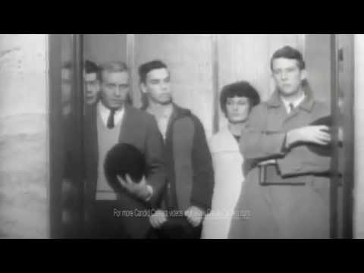
The Power of Groups

Slide 5
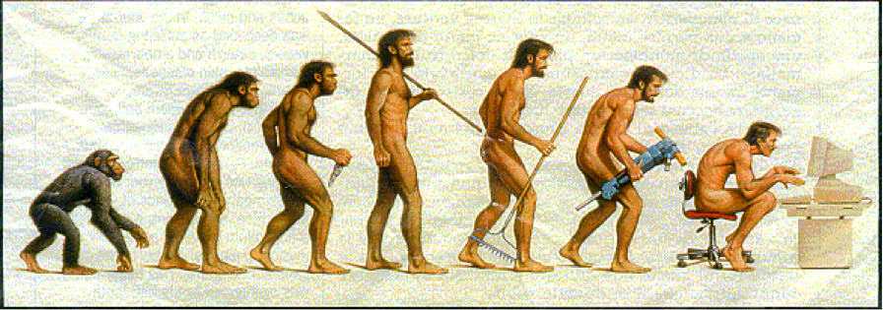
The Ergonomic Evolution

Slide 6

Ergonomics – Text Neck

Slide 7
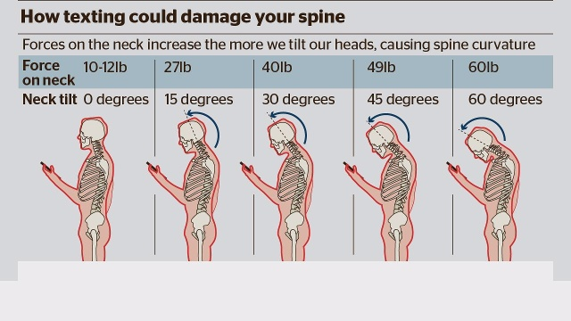
Ergonomics – Text Neck

Slide 8
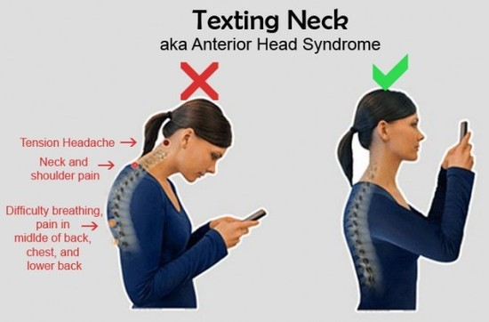
Text Neck – Look Familiar?

Slide 9
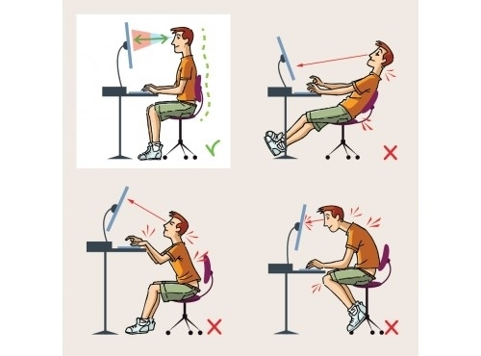
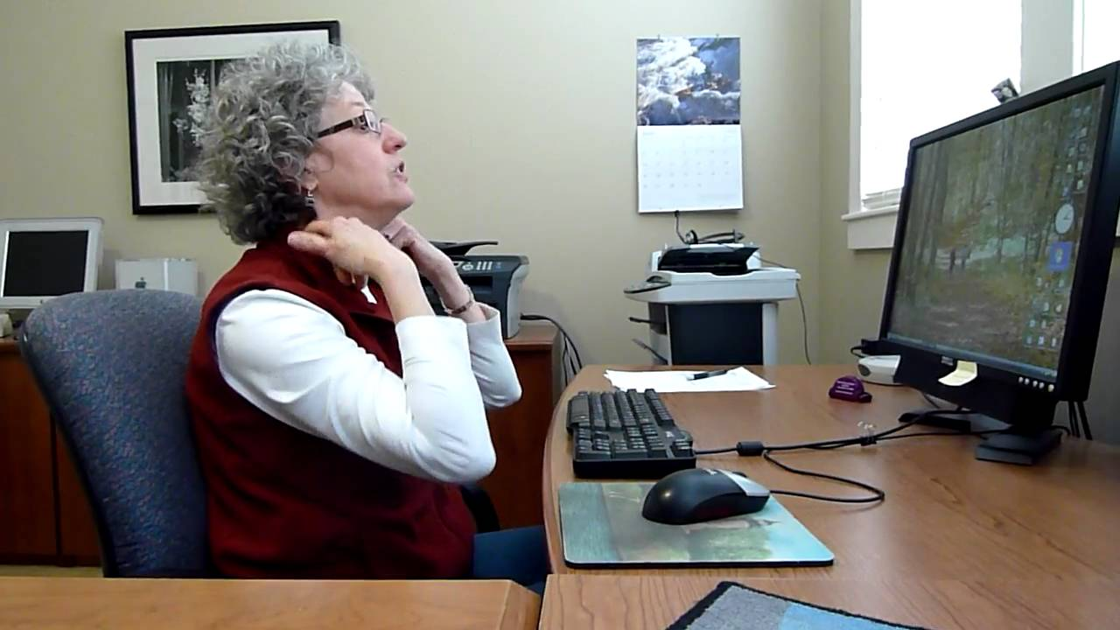
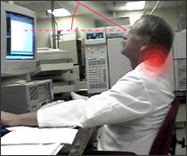
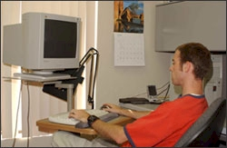
Monitor Height

Slide 10
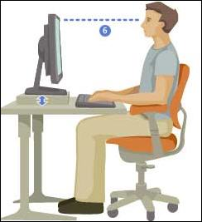
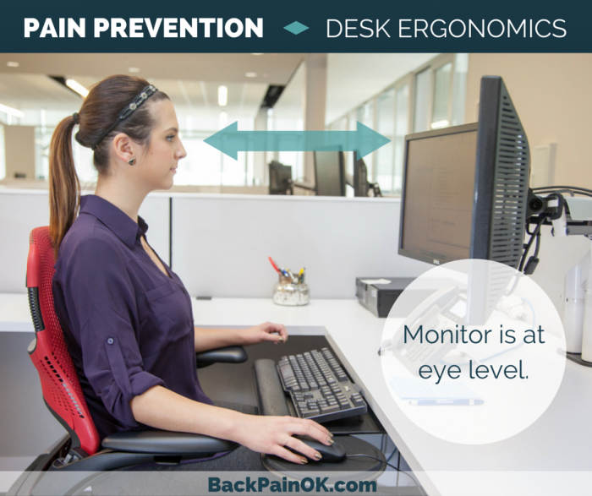
Monitor Height
Eye level is at approximately the top 1/3 of the screen

Slide 11
Injury Illness Prevention Program IIPP
The program must contain the 8 required elements
Identify the responsible person
Communication
Hazard Identification (Inspection)
Hazard Correction
Accident Investigation
Training & Instruction
Compliance
Recordkeeping

Slide 12
First Aid Kits
Cal-OSHA General Industry Safety Orders states:
Subchapter 7. General Industry Safety Orders
Group 2. Safe Practices and Personal Protection
Article 10. Personal Safety Devices and Safeguards
§3400. Medical Services and First Aid
(b) In the absence of an infirmary, clinic, or hospital, in near proximity to the workplace, which is used for the treatment of all injured employees, a person or persons shall be adequately trained to render first aid. Training shall be equal to that of the American Red Cross or the Mine Safety and Health Administration.
(c) There shall be adequate first-aid materials, approved by the consulting physician, readily available for employees on every job. Such materials shall be kept in a sanitary and usable condition. A frequent inspection shall be made of all first-aid materials, which shall be replenished as necessary.

Slide 13
First Aid Kits
Proposed timeline
Have letter signed by consulting physician by July 1, 2016
See samples I provided
I will follow up with the group at this time to check on the status of the letters.
August 1, 2016 copies of letters should be placed in every first aid kit.

Slide 14
Heat Illness Prevention
Water
Education & Training
Shade
Temperature Triggers
Review of new regulations

Slide 15
Workers Comp Claims Trends
1-1 to 5-1

Slide 16
Claims By Primary Body Parts

Slide 17
Causes of Claims

Slide 18
future Meetings
August 17, 2016
3rd floor , County Administrative Building
10:30 am
November 16, 2016
3rd floor , County Administrative Building
10:30 am

