Slide 1
County Safety Committee
2nd Quarter 2013
Brad Aragon, CSP
Loss Prevention Specialist

Slide 2
Today’s Agenda
Workers’ Comp claims update
Heat Illness Prevention
Ergonomic tips
Cal-OSHA updates
Hazard Communication Program changes
  Globally Harmonized System
Safety quiz

Slide 3
Claims Data Update

Slide 4
Claims Data Update
Some of the contributing departments to the reduction in total claims:
2012 2013
  Animal Control 13 5
  Fire 43 29
  KMC 47 27
  Sheriff 56 42
  Aging & Adult 4 1
  Parks 3 1

Slide 5

Heat Illness Prevention
Agenda
How the body cools itself
Acclimatization
Signs & Symptoms
Importance of Hydration
General Information

Slide 6
Acclimatization
Letting your body get comfortable with the temperature
It may take several days to get fully acclimatized
Be aware of any symptoms during the first “Hot Spell” we receive
Look for symptoms among your co-workers

Slide 7

Hydration
Why is hydration so important?
Types of hydration
Frequency to drink fluids
Feeling thirsty!!
Signs of dehydration

Slide 8

Signs & Symptoms of
Heat Related Illness
Heat Exhaustion
Heat Stress
Heat Stroke

Slide 9
Ergonomics
Making the workplace fit the person, not the person fitting into the workspace
Sitting in your chair comfortably, instead of just sitting on your chair
I can be in this position for a little while, but do I want to be in this position for
  ___ hours ____days ____months ____year

Slide 10
Ergonomics
Ergonomic Self-checklist
http://www.co.kern.ca.us/rm/safety/safety.asp
Employees can use the self checklist to help them understand what the workstation evaluation is aiming at
It includes:
  Monitor, chair, mouse, and other equipment

Slide 11
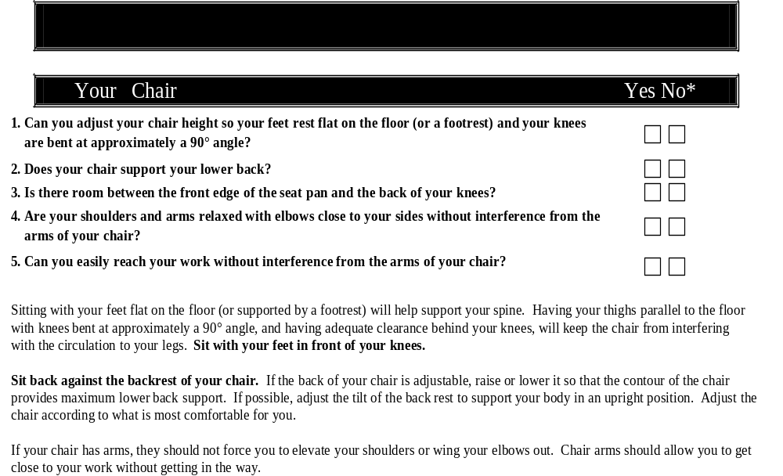
Ergonomics

Slide 12
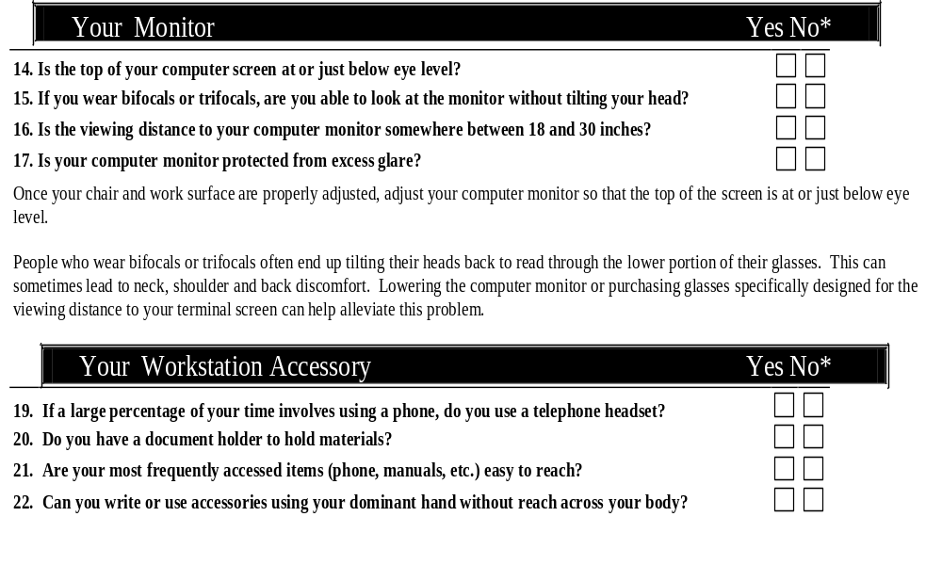
Ergonomics

Slide 13
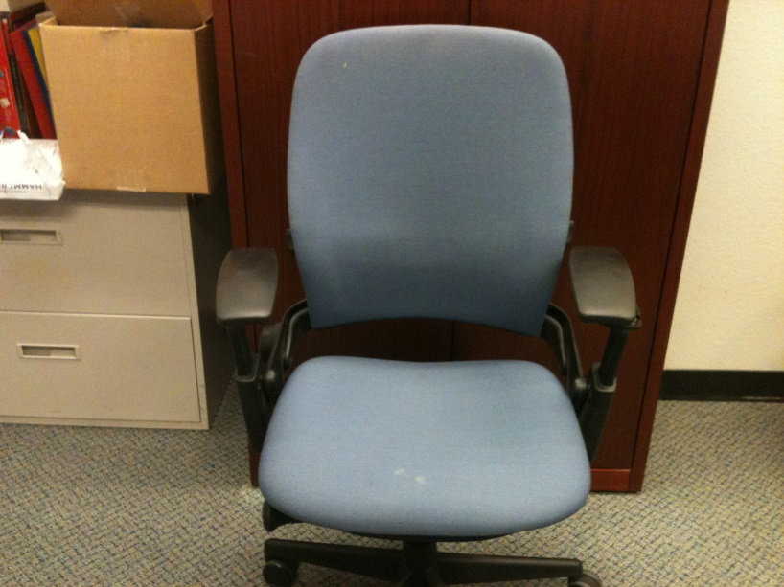
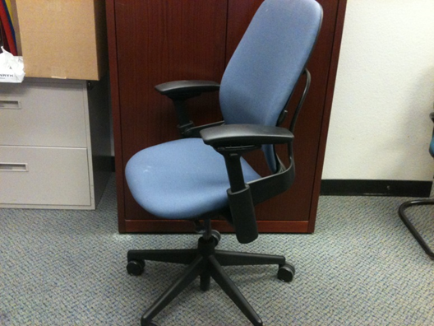
Can you adjust your chair?

Slide 14
Cal-OSHA Activity - 2013
1 site inspection in 2013
Due to a complaint of air quality
Risk management and department response
Information requested and provided to Cal-OSHA
Outcome

Slide 15
Globally Harmonized System
OSHA revised its Hazard Communication Standard (HCS) to align with the United Nations’ Globally Harmonized System of Classification & Labeling of Chemicals (GHS)
Two significant changes contained in the revised standard require the use of new labeling elements and a standardized format for Safety Data Sheets (SDS), formerly known as Material Safety Data Sheets (MSDS)
The new label elements and SDS requirements will improve worker understanding of the hazards associated with the chemicals in their workplace.
OSHA is phasing in the specific requirements over several years.

Slide 16
Globally Harmonized System
The first compliance date is December 1, 2013. By that date, employers must have trained their workers on the new label elements and the SDS format.
Label training requirements
  Product identifier
  Signal word
  Pictogram
  Hazard statement
  Precautionary statement
  Name and address of chemical manufacturer

Slide 17
Globally Harmonized System
Sample Label
  Review the sample label handout
Sample Pictograms
  Review pictogram handout
Sample Safety Data Sheets
  Review SDS handout

Slide 18
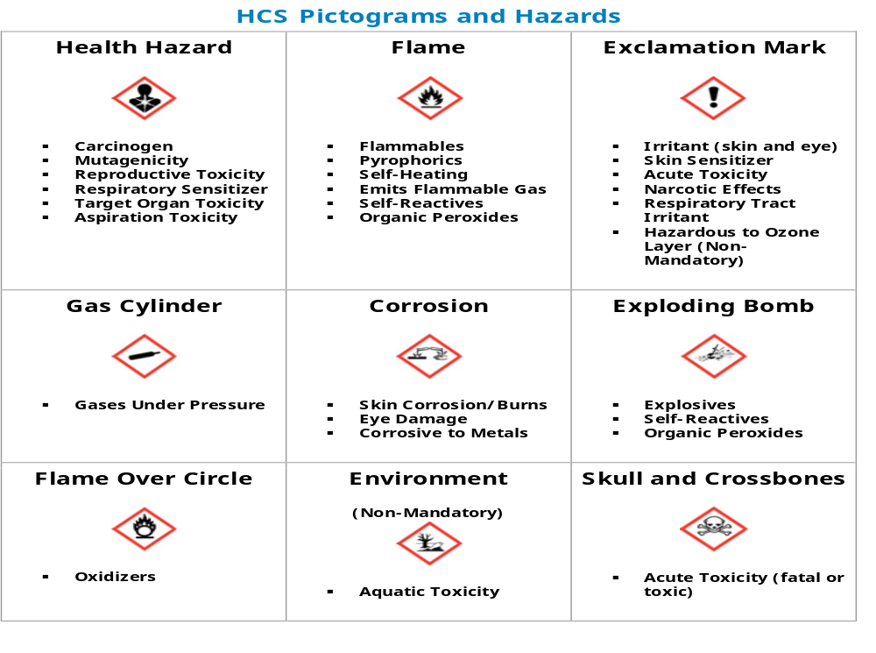

Slide 19
Safety Quiz
Give yourself 3 points for every “usually or yes” response
Give yourself 2 points for each “once in a while” response
Give yourself 1 point for each “never or no” response
Over 58 points – Excellent safety attitude, good habits
47-58 - Good, Look to change 5 of your once in a while responses to usually
36-46 – Lucky person if you have never been in an accident. Review your “never” answers
Under 36 – You may be an accident waiting to happen. You may not hurt yourself, but put other at risk working with you

