Slide 1
County Safety committee – 1st QTR, 2020
Brad Aragon, CSP
Kern County Risk Management

Slide 2

New Cal-OSHA Reporting Rules
See Handout
Hospitalization
Amputation
Commission of a crime
MVA – construction zones
Medical Episode

Slide 3
Risk Management’s Claims Dashboard
A program that makes workers’ comp data more visible and easily understood
Ability to drill down several levels to examine trends and red flags
Using metrics to help direct safety efforts to specific areas of concern
Attempting to be more proactive to help reduce workers’ compensation claims

Slide 4
Claims Dashboard
Total Claims History
2014

Slide 5

Claims Analysis
Top 10 Occupations by Total Claims
Detention Deputy
Fire Captain
Office Services Technician
Deputy Sheriff (4 & 5 & 7)
Human Services Technician
Fire Engineer (8 & 9)
Juvenile Corrections

Slide 6


Claims Analysis
Claims by Gender from 2014-2019
57% 43%

Slide 7


Claims Analysis
Claims by Age from 2014-2019

Slide 8
Claims Dashboard
Incident Rate History
Incident Rate = Number of Injuries / Total Hours Worked x 200,000
2019 Incident Rate
555 Claims/13,123,913 Hours x 200,000= 8.46

Slide 9

Motor Vehicle Accidents – 2015-2019
Average At Faults – 50
Average Not-at-Faults – 42
Average Unoccupied - 6

Slide 10

Motor Vehicle Accidents 2019
Most Common At Fault accidents
Backing into something
Rear-ending another vehicle
Turning into another vehicle
Parking lot hazards
Most Common Not at Fault accidents
Being rear-ended
Other car reversed into County vehicle
Parking lot contact

Slide 11
HOW TO NOT CRASH
* SLOW DOWN
* Safe following distance (cushion of safety)
* Provides more reaction time & larger field of view
* PAY ATTENTION
* No cell phones, makeup, hair, reading novels, etc.
* Stay aware of potential dangers (peds, other cars, road hazards, etc.)
* Be prepared to react (cover the brake, check escape routes)
* SLOW DOWN

Slide 12
If being alert & prepared saves even ½ second
Speed: mph = ft. / sec. | Less ½ sec. by being alert / prepared
70 mph = 103 ft. / second | Stopped 51 feet sooner
65 mph = 95 ft. / second | Stopped 47 feet sooner
55 mph = 81 ft. / second | Stopped 40 feet sooner
45 mph = 66 ft. / second | Stopped 33 feet sooner
35 mph = 51 ft. / second | Stopped 25 feet sooner
25 mph = 37 ft. / second | Stopped 18 feet sooner

Slide 13
EFFECT OF SPEED ON STOPPING DISTANCE
STOPPING DISTANCE consists of three factors:
* Perception Time By lower speed & staying alert
* Reaction Time By preparation: Anticipating threats,
Covering brake & looking for escape routes
* Braking Distance By lower speed & proper car maintenance
Perception & reaction time (the time it takes to recognize a threat and do something like turn the wheel or apply the brake) varies, depending on the individual and the circumstances, approximately 0.75 to 2.5 seconds.

Slide 14
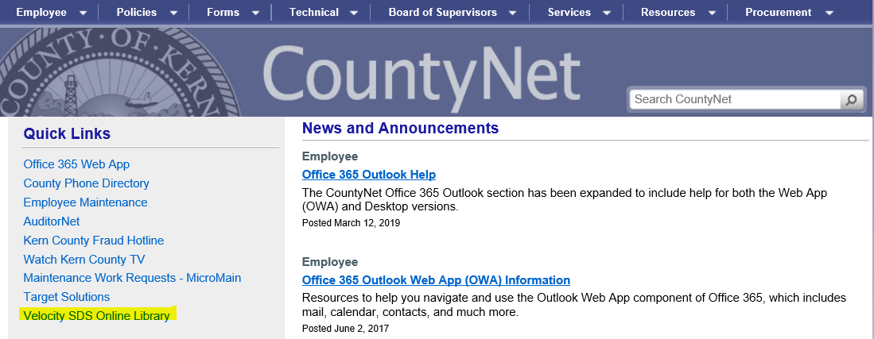
Electronic SDS Information
Velocity SDS Online Library
Located on County Net page
Ability to look up items in general or by department

Slide 15
Log 300-300A
Remember: Log 300A should be posted and last year’s should be taken down
Place them in a highly visible and accessible area.
Break rooms or areas near the All-in-One poster
Thank you for providing me a copy of your log 300 and 300A forms

Slide 16
All-In-One Poster Update
The revised All-in-One posters have been distributed to all departments.
Please replace the old version

