Slide 1
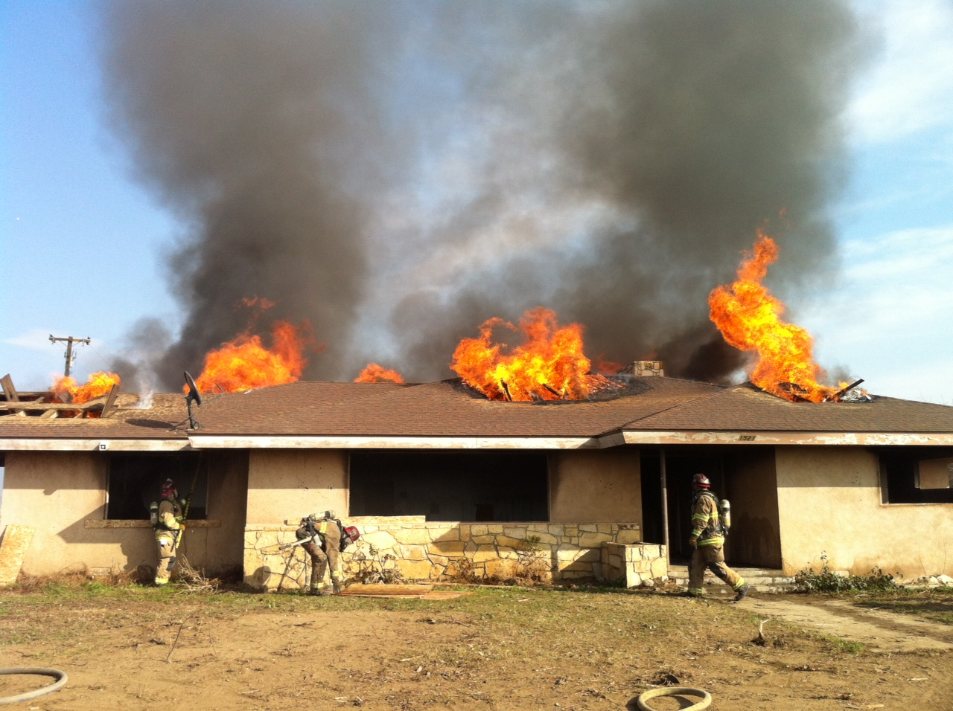
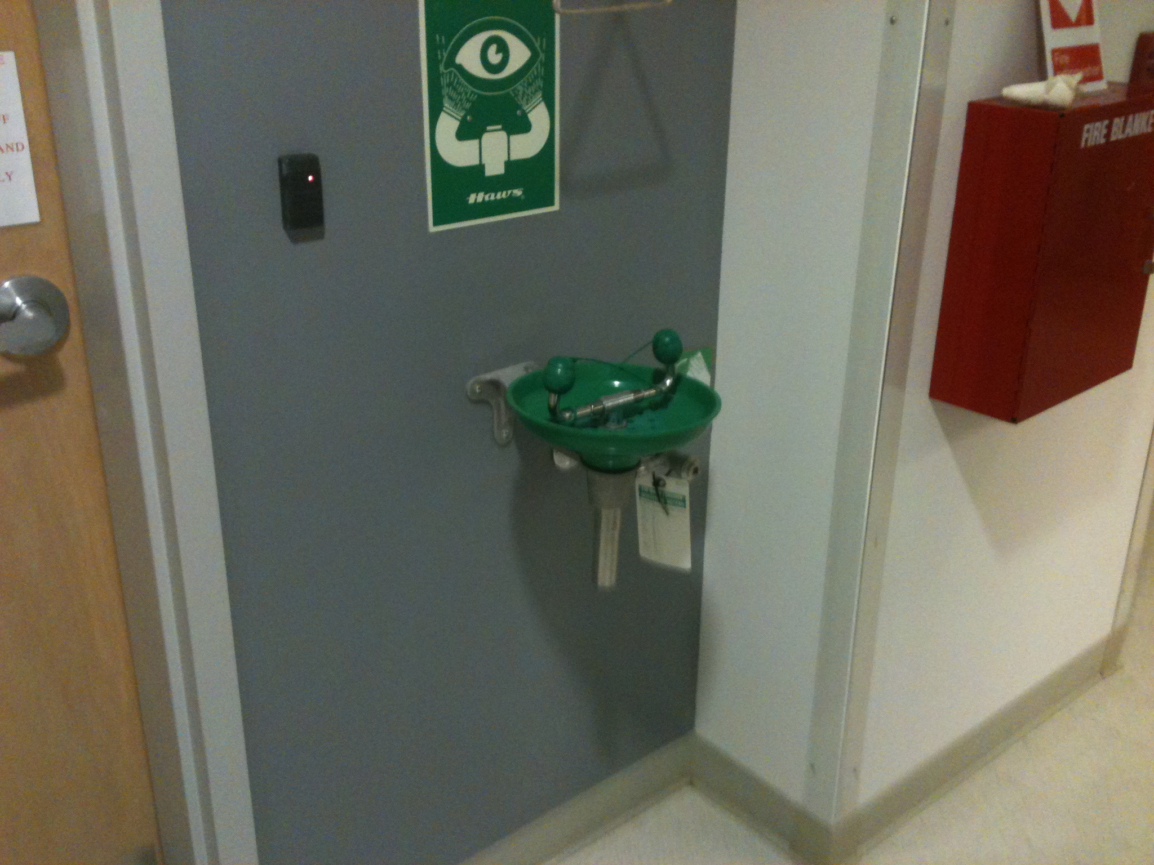
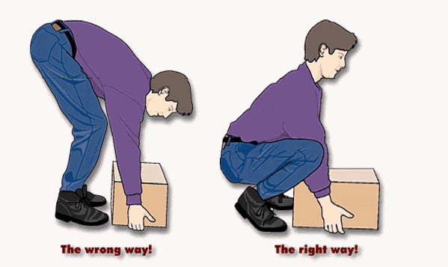
County Safety Committee Meeting
1st Quarter - 2017

Slide 2
Agenda
Log 300 data
Claims History
Incident Rate review
180 Degree Approach
Driver Information
Parallel Parking Video

Slide 3
Log 300 Information
Thank you for getting the Log 300 and 300A completed.
Remember to post the summary – Log 300A
I will be reviewing the data and meeting with departments that have above average numbers.

Slide 4
Log 300 Data

Slide 5
Log 300 Summary Data – 2016
Total County

Slide 6
Log 300 Summary Data - 2016

Slide 7
Log 300 Injury Data - 2016

Slide 8
Total Claims History 2012-2016

Slide 9
Incident Rate Comparison

Slide 10
Incident Rate Comparison
State & Local Government
For 2015, California state and local government reported an Incident Rate of 6.8. Kern County’s was 6.7
For 2014, California state and local government reported an Incident Rate of 7.0. Kern County’s was 7.4

Slide 11
180-Degree Approach to Safety
Approaching a situation from the opposite direction and from a different perspective
Can be used for both work and personal situations.
Ask yourself, “What would it take to ruin something?”
Health example
Next ask yourself, “How many of these things on the list am I doing?”

Slide 12
180-Degree Approach to Safety
Specific work examples:
How can I make my workplace less safe or secure?
How many of these thing am I doing or are happening at my workplace?
Come up with ways to eliminate elements of the failure list
This is a good approach to identifying weak areas because humans notice and react more strongly to negative events than positive ones.

Slide 13
Top 10 States with the Worst Drivers
10 – Arizona
9 – Washington
8- Colorado
7 – North Dakota
6 – South Carolina -#3 in speeding, #7 in fatalities
5 – Nebraska
4- Maine
3 – Virginia – worst for speeding, but not in the top 10 for fatalities
2 – California - #9 speeding,#2 for DUI
1 –Utah - #2 for accidents and speeding, #9 DUI

Slide 14
1 Year Snapshot of County Driving Incidents

Slide 15
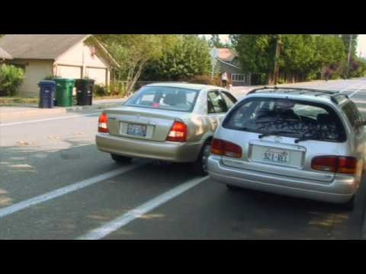
Parallel Parking

Slide 16
Next Meeting
May 17, 2017
10:00 AM
3rd Floor Multi Purpose Room,
Administration Building

