Slide 1
County Safety Committee
1st Quarter - 2016
Brad Aragon, CSP
Kern County Risk Management

Slide 2
Today’s Agenda
Motor Vehicle Accidents (MVA’s)
Log 300 and 300A update
Active Shooter update
County claims review
Accident Investigation

Slide 3
County Vehicle Accident History 2015

Slide 4
County Vehicle Accident History 2014

Slide 5
At Fault MVA’s by Department 2015

Slide 6
At Fault MVA’s by Department 2104

Slide 7
MVA Breakdown

Slide 8
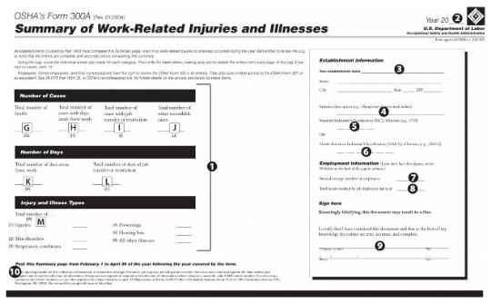
Cal OSHA Log 300 A
- The Annual Summary should be posted

Slide 9
Active Shooter Update
The County is moving forward to ensure that all departments have an Active Shooter plan in place and that training and a drill be conducted.
Some key items of the plan include:
  A general announcement over the building’s public address system using a code word to alert all employees
  Established safe rooms where staff can hide during the event
  Procedures to follow during the event
  Post-event procedures (all clear code, known person alerting the staff)

Slide 10
Reported Claims Data
1/1 to 12/31

Slide 11
Incident Investigation
The incident investigation is a process that helps determine what happened and how the incident occurred. It is not a method of assigning blame to an individual, even if operator error is the main cause.
What types of incidents do you investigate now?
  Slips-Trips, Vehicle, Reported w/c comp injuries?
Do you investigate the incident at all or just receive and file the report?

Slide 12
Incident Investigation
Root Cause – Underlying condition that will, once corrected, prevent similar incidents from occurring
Direct Cause – Condition or behavior that was immediate cause of incident
Determining which of the 2 causes you want to pursue will help guide the investigation

Slide 13
Incident Investigation
Key Elements of the Investigation
  Witnesses –
    Saw or heard anything “Ear Witnesses”, People who may know of the incident
  Asking questions
    The 5 why’s of the incident
    Open ended questions
  Fixing the problem – Abatement
    Placing work orders for repairs
    Communicating the incident to management

Slide 14
Things to Remember
Post the Log 300A summary
Investigate incidents – both big and small
Discuss good driving habits at your next department safety meeting
Start thinking about Heat Illness Prevention for those departments with outdoor work

Slide 15
Next Meeting
May 18th 2016
3rd floor conference room
County administrative Building

