Slide 1
2nd Quarter
County Safety Committee Meeting
Brad Aragon, CSP
Loss Prevention Specialist
Risk Management

Slide 2
Today’s Agenda
Target Solutions Update /Demo
DMV Pull Program
County Vehicle Accident Review
County Workers’ Comp Claims Review
Heat Illness Prevention Review
Awareness Test
Next Meeting – August 15, @ 10:00

Slide 3
Target Solutions
Target Solutions has a new look and features
Review of the log in & username process
Feedback from users
Live look

Slide 4
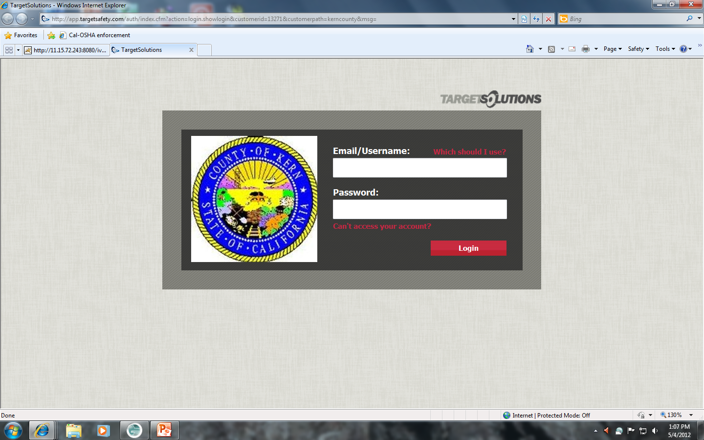
Target Solutions – Log-In page

Slide 5
Target Solutions Use by Dept.
AG Weights- 49 Aging&Adult – 120
Air Quality – 10 Airports – 8
Animal Control – 38 Assessor – 109
Auditor/controller – 78 Board of Sup – 10
Board of Trade – 5 Bldg Inspect – 24
CCS – 47 Child Support – 189
Clerk/Brd – 7 Code Compliance – 7
Comm./Econ Devel – 12 Coroner - 3

Slide 6
Target Solutions Use by Dept.
CAO – 19 County Counsel – 7
DA Forensic – 46 DHS – 1486
Devel. Srvcs – 20 DA – 186
Elections – 20 EMS – 5
ETR – 116 Eng/Survey – 30
Environ Health – 53 Farm & Home – 28
Fire – 12 General Srvc – 92
Gen Srvs Constr – 13 Fleet - 20

Slide 7
Target Solutions Use by Dept.
Grand Jury – 2 GS Abatement – 3
ITS – 49 KCERA – 1
KMC – 260 Library – 110
Mental Health – 464 Parks – 36
Personnel – 21 Planning – 43
Probation – 441 Pub Defend. – 43
Public Health – 234 Recorder – 27
Risk Mgmt – 11 Roads – 89
Sheriff – 427 Treas Tax - 35

Slide 8
Target Solutions Use by Dept.
Veteran’s – 6 Waste Admin – 24
Waste DAC – 24 Waste OPS – 49
Waste TRD – 31 Waste Water – 19
Total Users = 5,322

Slide 9
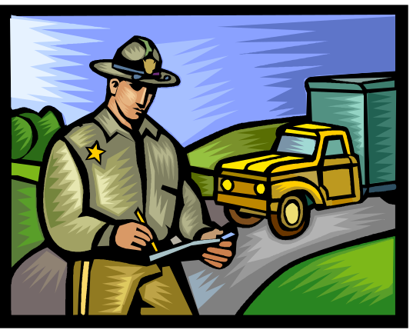
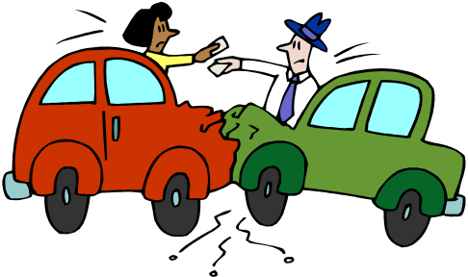
DMV PULL Program Results
Violations of drivers who are enrolled in the system are significantly down
Why???
Accidents remain at a fairly constant level

Slide 10
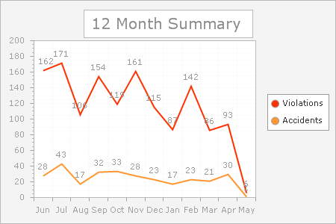
DMV Pull Program Data

Slide 11
County Vehicle Accidents –By Dept.
1-1-2012 thru 5-1-2012
Aging & Adult – 2
Waste Mgmt. – 3
DHS – 2
General Serv. – 2 Total - 18
Animal Control – 2
D A - 2
Environ. Health – 2
Library – 1
ETR – 1
Ag Comm. - 1

Slide 12
County Vehicle Accidents 2011
Same time period of 1/1/2011 to 5/1/2011
  Total accidents – 21
  This represents a 14% reduction from 2011 to 2012
Full year of results for 2011
  Total accidents – 93
  2012 goal to maintain this % reduction - 80

Slide 13
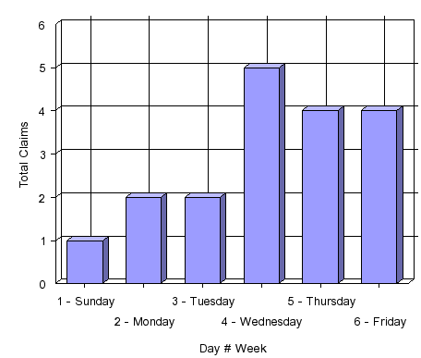
County Vehicle Accidents-Day of Week 1-1-2012 thru 5-1-2012
1 - Sunday 1
2 - Monday 2
3 - Tuesday 2
4 - Wednesday 5
5 - Thursday 4
6 - Friday 4
Total: 18

Slide 14
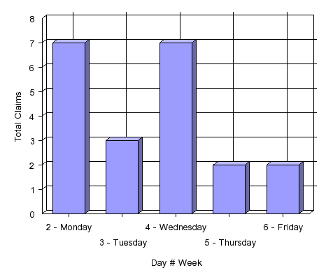
County Vehicle Accidents -Day of Week 1-1-2011 thru 5-1-2011
7 - Monday
3 - Tuesday
7- Wednesday
2 - Thursday
2 - Friday
Total: 21

Slide 15
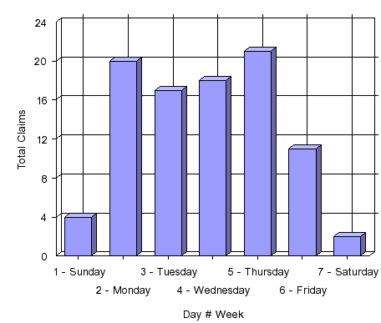
County Vehicle Accidents 2011
Day of Week
Day of Week
1 - Sunday 4
2 - Monday 20
3 - Tuesday 17
4 - Wednesday 18
5 - Thursday 21
6 - Friday 11
7 - Saturday 2
_{Total:} ₉₃

Slide 16
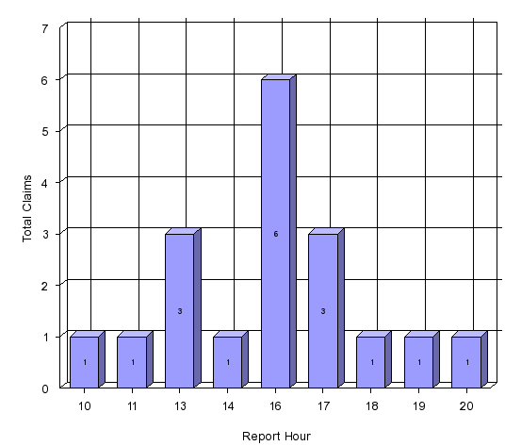
County Vehicle Accidents-Time of Day
1-1-2012 thru 5-1-2012

Slide 17
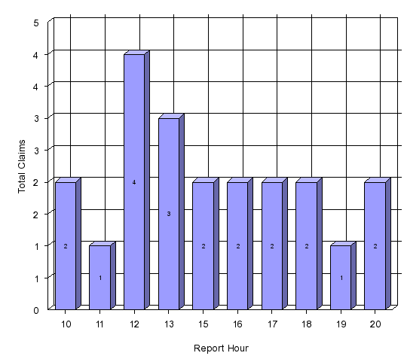
County Vehicle Accidents –Time of Day
1-1-2011 thru 5-1-2011
Claims Percentage
10 AM 9.52%
11 AM 4.76%
12 PM 19.05%
1 PM 14.29%
3 PM 9.52%
4 PM 9.52%
5 PM 9.52%
6 PM 9.52%
7 PM 4.76%
8 PM 9.52%
Percentage: 100.00%

Slide 18
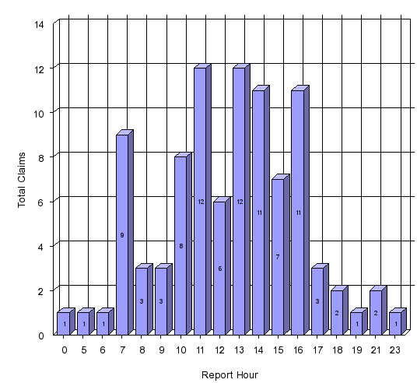
County Vehicle Accidents 2011
Time of Day
Time of Day
12 AM 1.06%
5 AM 1.06%
6 AM 1.06%
7 AM 9.57%
8 AM 3.19%
9 AM 3.19%
10 AM 8.51%
11 AM 12.77%
12 PM 6.38%
1 PM 12.77%
2 PM 11.70%
3 PM 7.45%
4 PM 11.70%
5 PM 3.19%
6 PM 2.13%
7 PM 1.06%
9 PM 2.13%
11 PM 1.06%
Total: 94 100.00%

Slide 19
Workers’ Comp Claims 1/1 thru 5/1
2011 – Total of 231 claims during this period
2012 – Total of 159 claims during this period
A reduction of 72 claims which = 31% reduction
What do you attribute this to:
  Less employees
  Safer work practices
  Luck
  Other????

Slide 20
Workers’ Comp Claims –2008 to 2011

Slide 21
Workers’ Comp Claims –2008 to 2011

Slide 22
Heat Illness Prevention
Who hear has had any type of Heat Illness?
Does it have to be over 100 degrees to become ill?
Who can get heat illness symptoms?

Slide 23

Heat Illness Prevention
Agenda
How the body cools itself
Acclimatization
Signs & Symptoms
Importance of Hydration
General Information

Slide 24
Acclimatization
Letting your body get comfortable with the temperature
It may take several days to get fully acclimatized
Be aware of any symptoms during the first “Hot Spell” we receive
Look for symptoms among your co-workers

Slide 25

Hydration
Why is hydration so important?
Types of hydration
Frequency to drink fluids
Feeling thirsty!!
Signs of dehydration

Slide 26
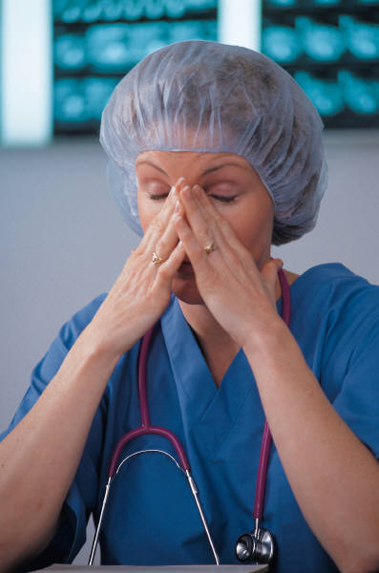
Signs & Symptoms of
Heat Related Illness
Heat Exhaustion
Heat Stress
Heat Stroke

Slide 27
Questions & Comments

Slide 28

Follow up Newsletter
Follow up to:
Questions that did not get answered at the meeting
A brief recap to those who were unable to attend
Points of interest that came up during committee discussion

Slide 29
AWARENESS TEST

