Slide 1
1st Quarter
County Safety Committee Meeting
Brad Aragon
Loss Prevention Specialist
Risk Management

Slide 2
Agenda
Review of 2012 claims data
Accident Investigation
Cold and Flu video
Posters/Log 300 Summary
TARGET Solutions
Quiz

Slide 3
Claims History
2008-2012

Slide 4
Claims % Change

Slide 5
Average Total County Employment 2008-2012

Slide 6
Average Total County Employment 2008-2012

Slide 7

Vehicle Accident History

Slide 8
County Vehicle History
2012 Day of the Week

Slide 9

2012 Vehicle Accidents
Time of Day

Slide 10
Accident Investigation
Reason to conduct the investigation
  To find facts – not faults
  To prevent from repeating the same incident
  To comply with IIPP regulations

Slide 11
Investigation Methods
  The 5 WHY’s
    Asking why the event happened repeatedly
Peeling the Onion
  Peeling back each layer of the event
The 5 W’s
  who, what, when, where, why

Slide 12
Accident Investigation
Library Example
  Bookcase that fell onto employee
  Apply 5 WHY’s
  Apply 5 W’s
  Results

Slide 13
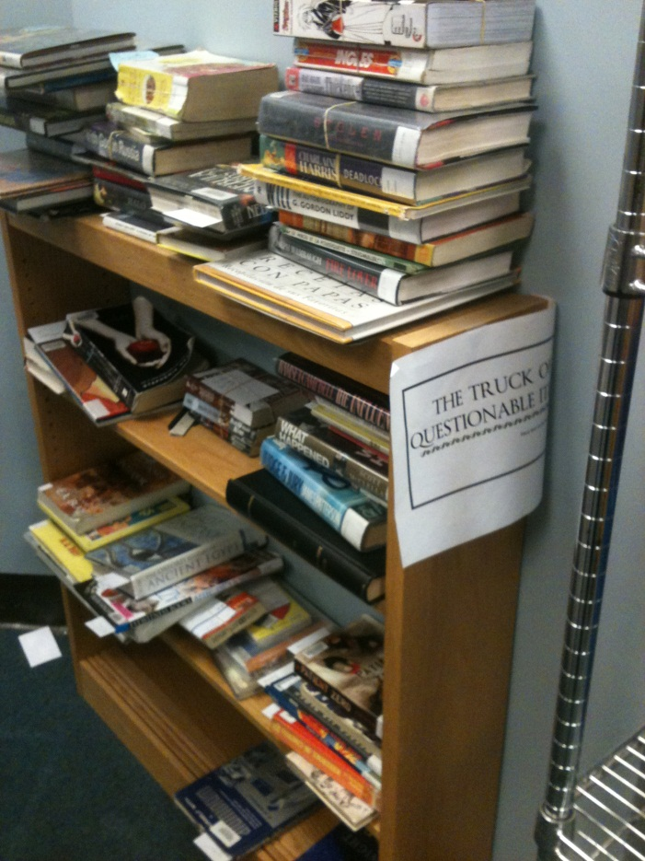
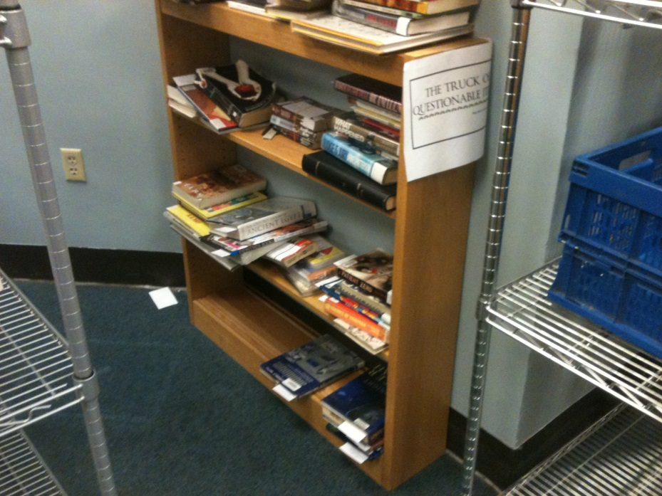
Accident Investigation
Results

Slide 14
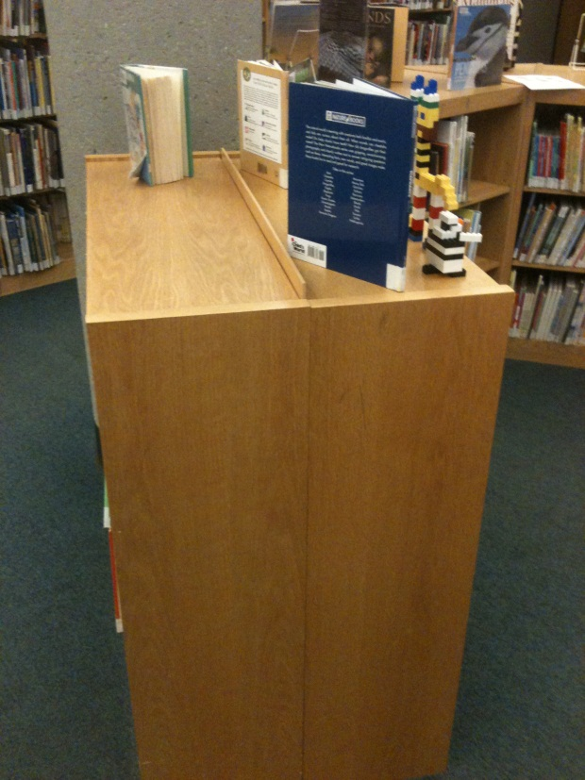
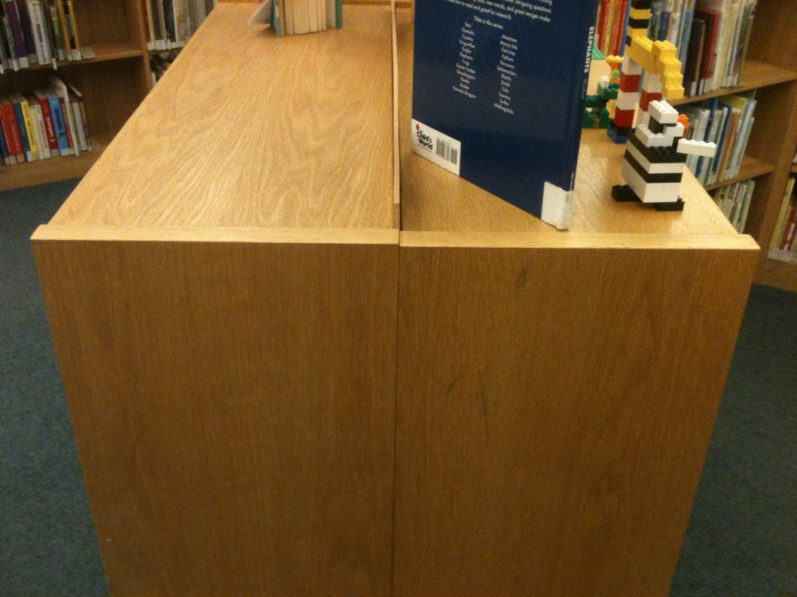
Accident Investigation
Results

Slide 15
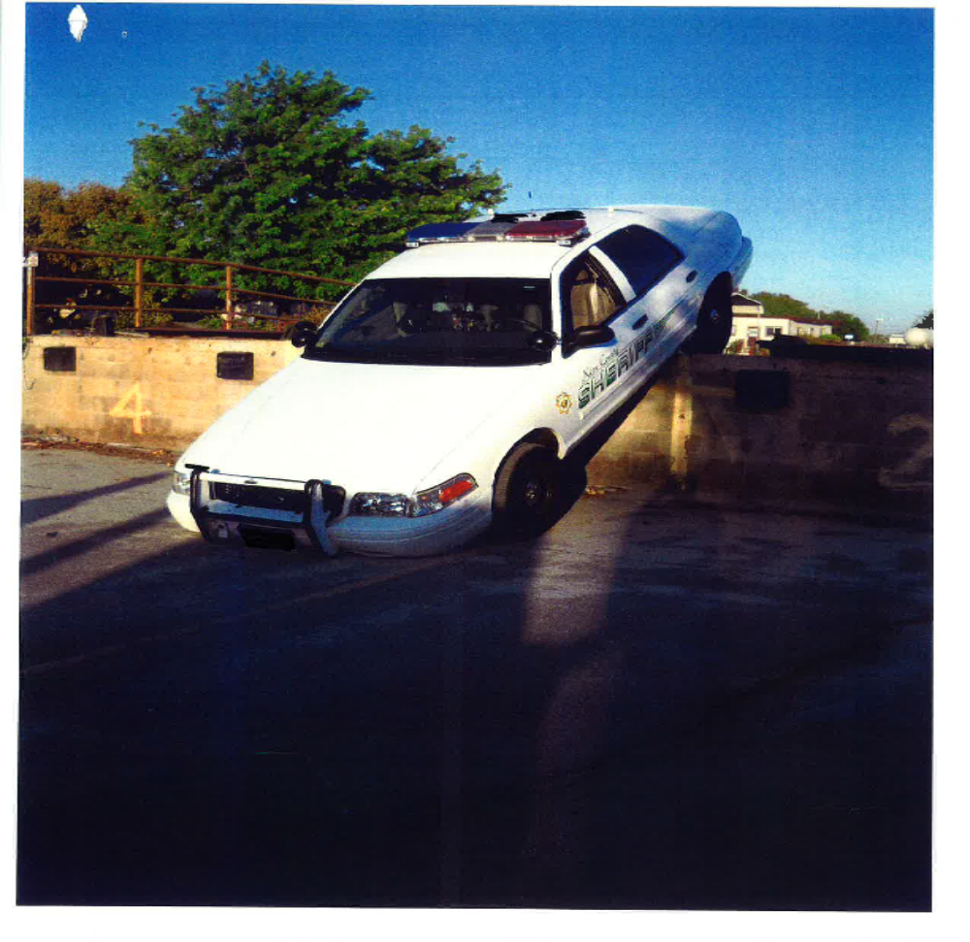

Slide 16
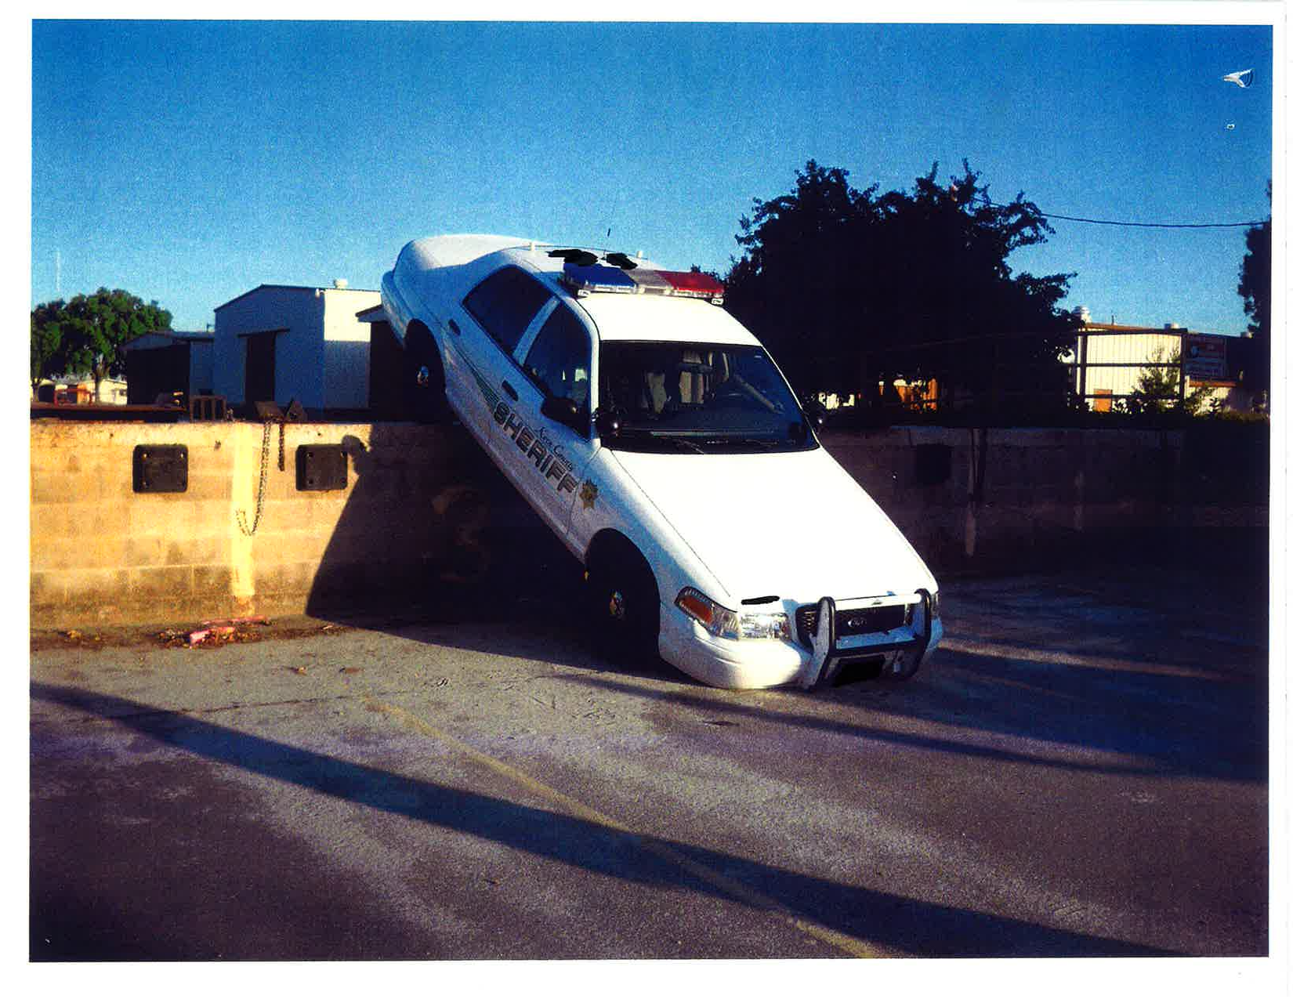

Slide 17
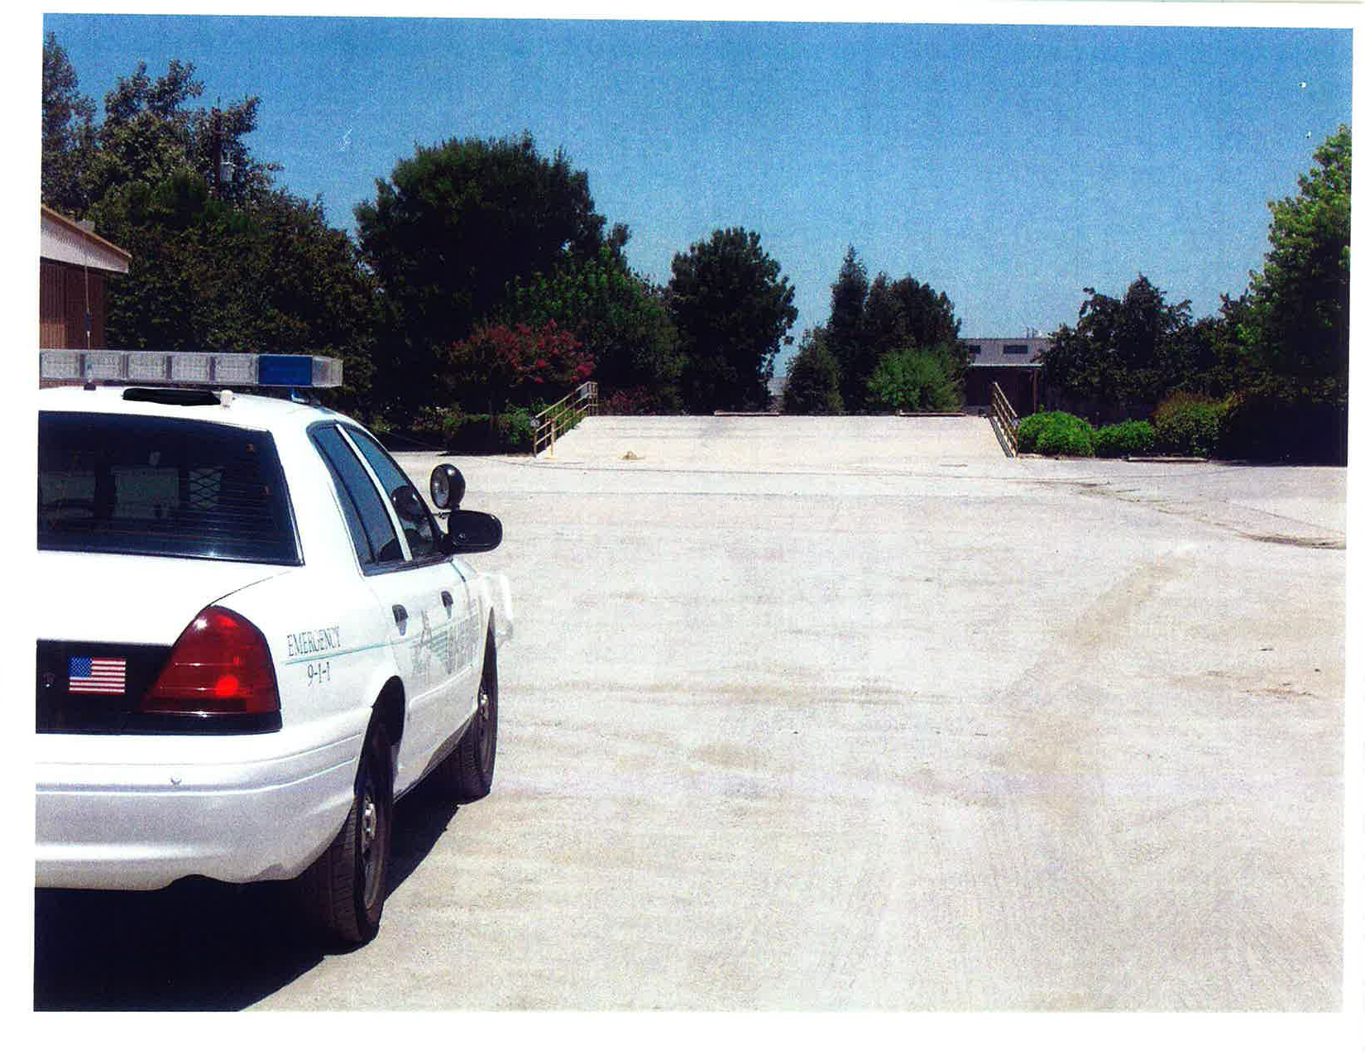

Slide 18
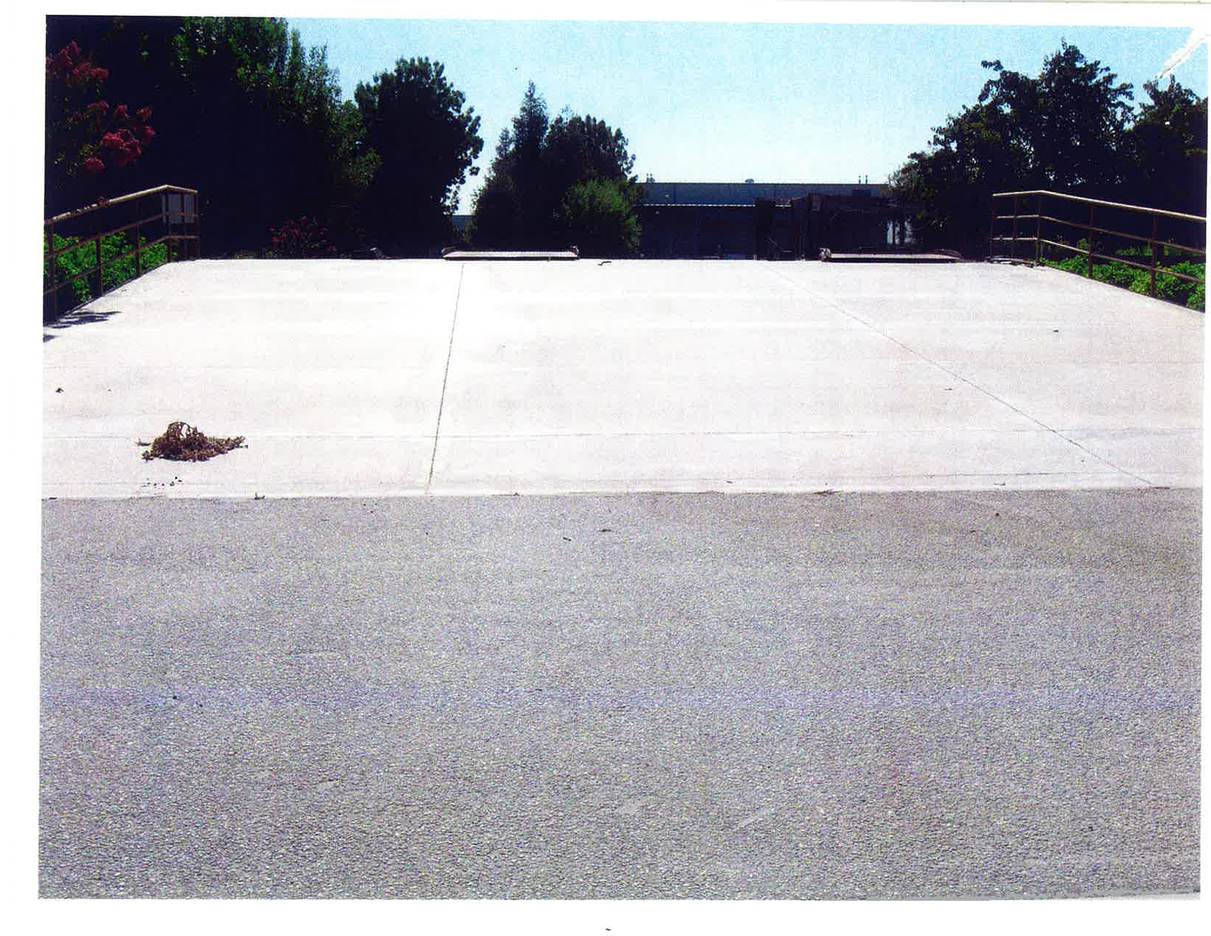

Slide 19
Cold & Flu Prevention
If you are sick, stay home
Think of your co-workers’ health
Be sure you are well before you return
Short video

Slide 20
Posters/Log 300 Summary
All posters have been distributed
Log 300 annual summaries are required to be posted until April 30, 2013
Can remain up for the year
Ensure they are signed by an executive

Slide 21
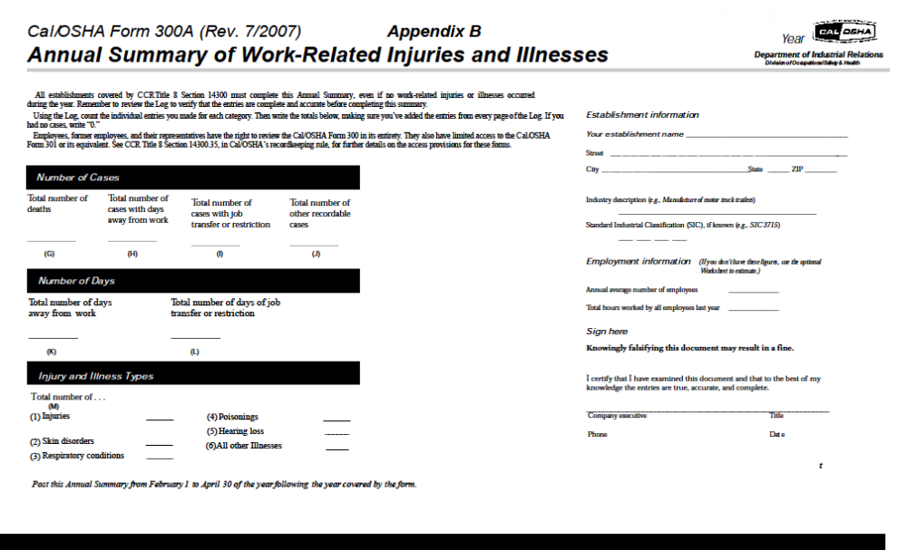
Log 300 Summary

Slide 22
TARGET SOLUTIONS
2012 Update

Slide 23
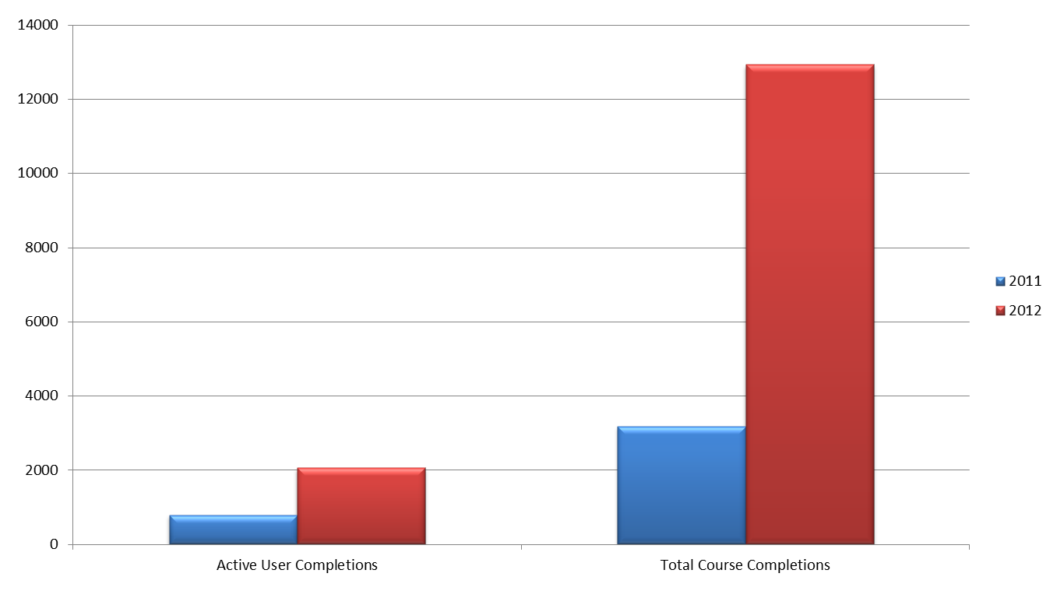
2012 Increases from 2011:
Active Users Completing 1+ Course- 162% Total Course Completions- 307%

Slide 24
County’s Top 10 Courses in 2012 = 12,929
Back Injury Prevention – 1,485
Fire Prevention Safety – 1,328
Office Safety – 1,316
General Office Ergonomics –1,197
Avoiding Slips, Trips, and Falls – 1,185
Workplace Stress – 1,159
Driving Safety – 1,142
Adjusting to Changing Driving Conditions – 1,057
Slips, Trips, & Falls Prevention – 686
Fleet Program Distracted Driving – 256

Slide 25
QUIZ
Time

Slide 26

Roundtable
Comments - Questions

