Slide 1

Self-Haul
Public Information Meeting

Slide 2

SUMMARY
Public Works presented plans for the implementation of SB 1383 requirements throughout the unincorporated areas of Kern County at Public Hearings held in May and December of 2023.
  December 2023 – Proposed 14 new Universal Collection Areas
    3 cart service for residential properties within UCAs, paid for via property taxes
  Prop 218 process
    Successful Prop 218 protests in 6 areas
    No successful Prop 218 protest in 8 areas
      Ridgecrest, Rosamond, Outer Taft, Outer Metro, Arvin, Delano, Shafter, NW Metro
  Board of Supervisors recognized 6 successful protests and took no action on the other 8 unsuccessful areas
CalRecycle reported that Kern County is the only jurisdiction to have any
successful Prop 218s to date

Slide 3
UPDATE
Due to the public’s overwhelming opposition, the Board of Supervisors did not approve the Universal Collection Area proposals. Due to these factors, Public Works negotiated with CalRecycle and they have now approved residential self-haul for the remaining 8 areas as an acceptable alternative to the three-cart collection service
  Allows residents to self-haul their source separated trash and organics to a county waste facility for collection and recovery
Census tracts are still mandated to comply with SB1383

Slide 4
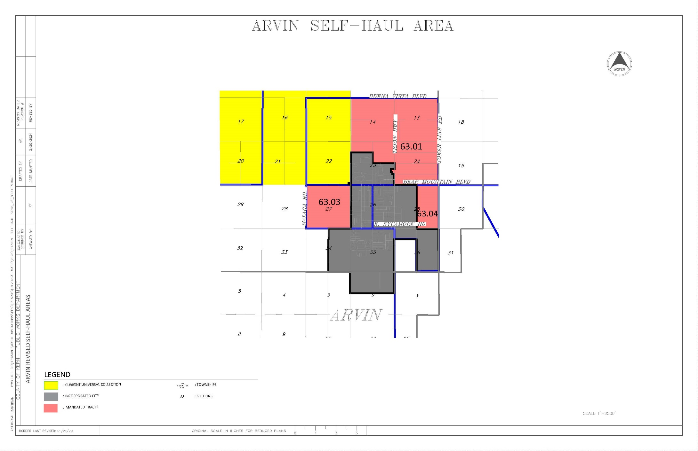
ARVIN AREA
S.D. #4

Slide 5
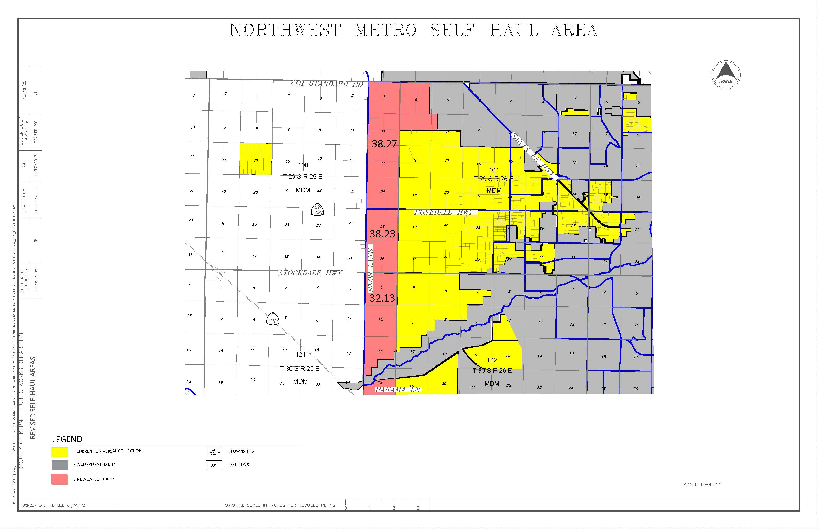
NORTHWEST METRO AREA
S.D.s #1 & 4

Slide 6
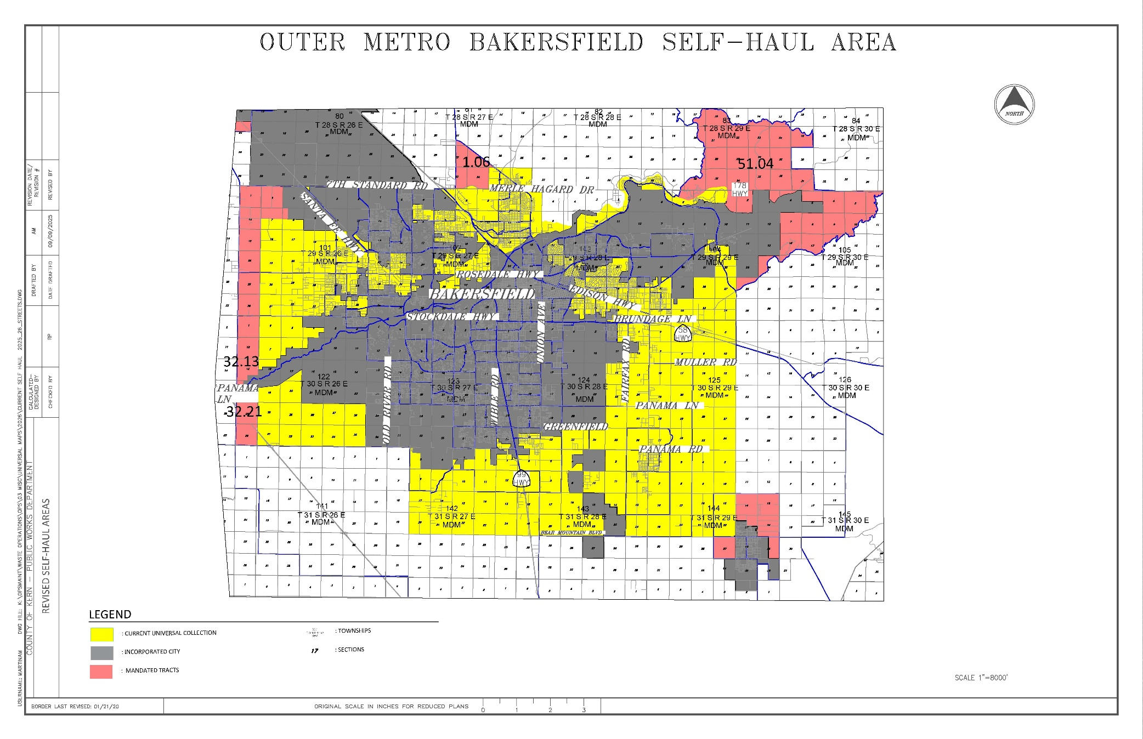
OUTER METRO AREA
S.D.s #1, 3, & 4

Slide 7
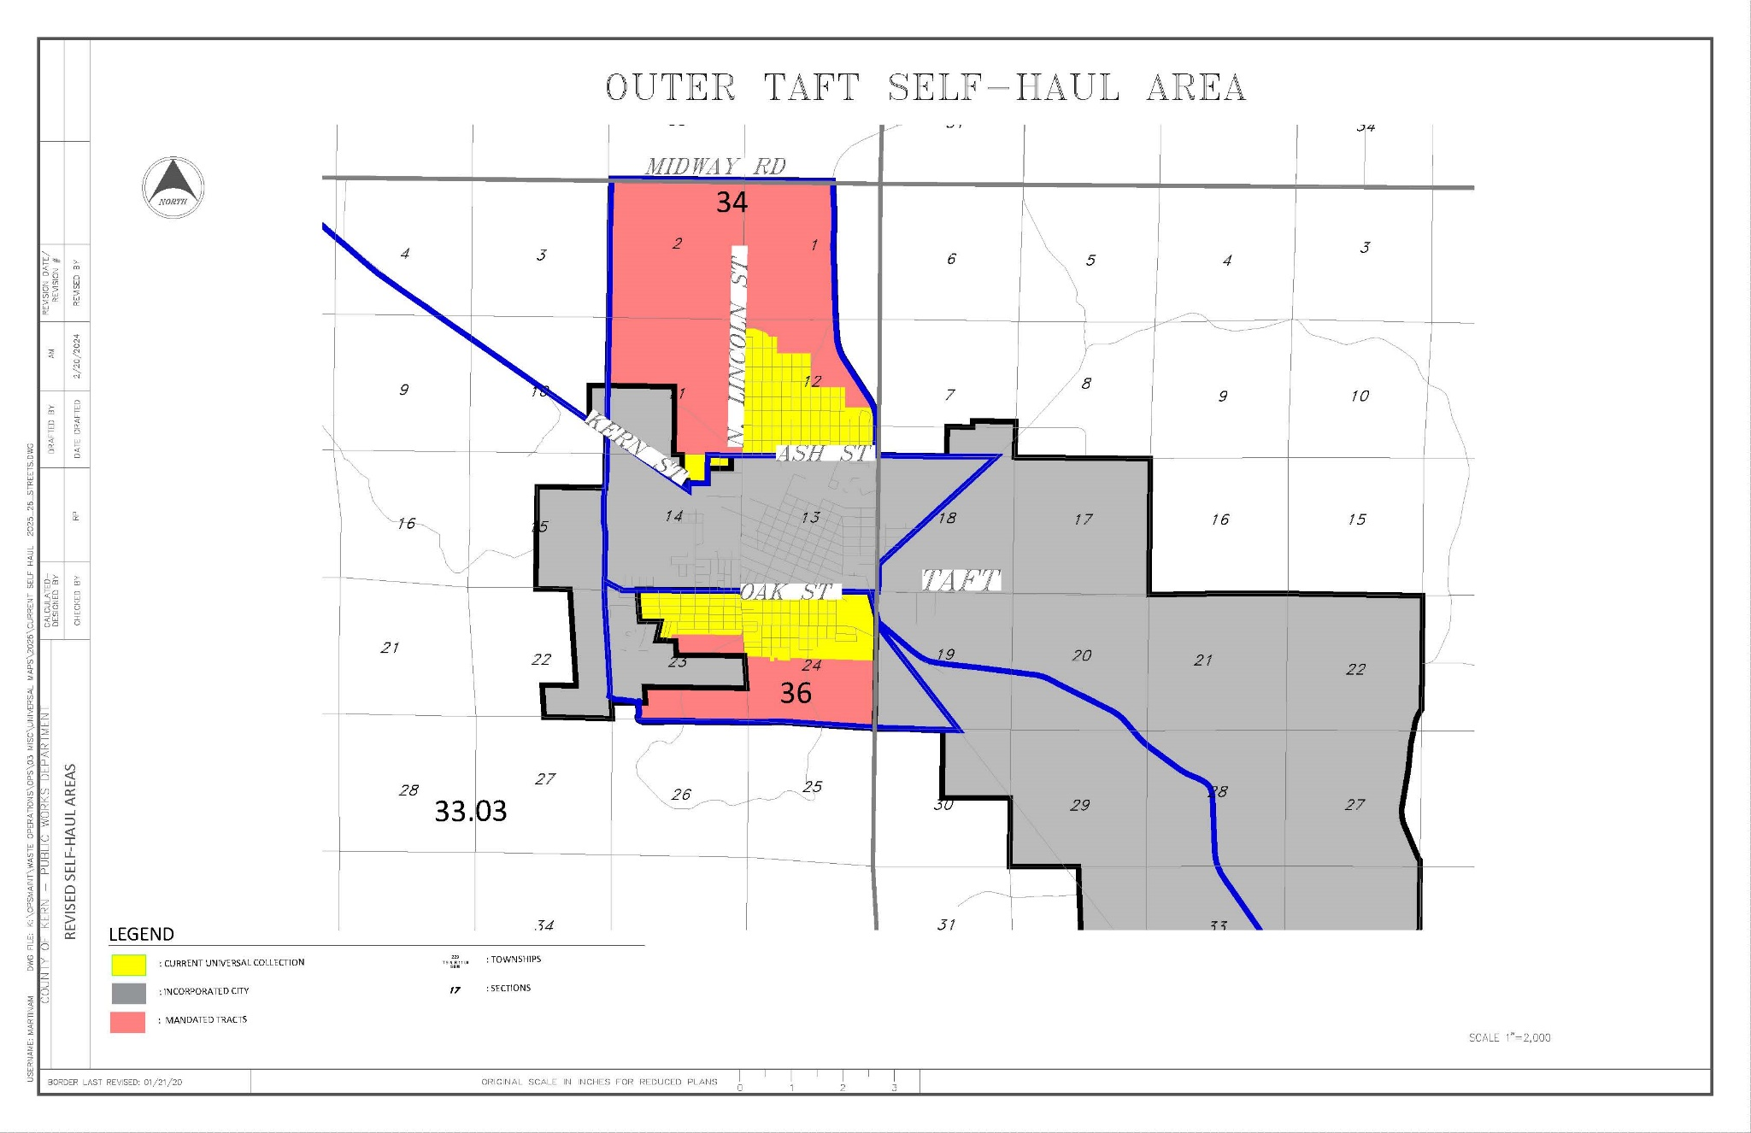
OUTER TAFT AREA
S.D. #2

Slide 8
NEXT STEPS
Self-Hauling: Source separate your trash and bring into a County waste facility
If you prefer to employ the Franchise Hauler to provide collection service, you can continue to do so
  Cannot place any organic waste in your regular trash cart – will need to self-haul or subscribe to additional carts. Haulers occasionally check carts for contamination
  Will be able to subscribe to three carts: Trash, Recycling & Organics
  Contact your local franchise hauler or waste@kerncounty.com to obtain service and rate information

Slide 9
REQUIREMENTS FOR SELF-HAUL
Must self-haul organics to a County Facility
  Transfer Station or Diversion Area at a Landfill
Must separate and recycle all organic waste types
Must deposit source separated materials in appropriate containers or area at the facilities
Must be disposed on a regular basis (1 – 2 weeks)
Residents self-hauling their own trash are not required to record or report any information on volumes

Slide 10
SEPARATING YOUR WASTE
Trash Items - Food wrappers, pet waste, plastic bags, diapers, dishware, hoses, film plastics, and foam products (Styrofoam, packing peanuts).
Recycling Items – Clean cardboard and paper, shipping boxes, glass, metal cans, plastic containers, jars, and metal.
Green Waste Items – Food and food scraps such as fruits, vegetables, meat, bones, coffee grounds, breads, miscellaneous scraps and peelings. Plant material such as grass clippings, flowers, brush, branches, and wood. Food-soiled paper and cardboard products such as paper towels and plates, napkins, pizza boxes, and donut boxes.

Slide 11
SELF-HAULING
Click on the link below
https://youtu.be/ouswzGWD65U

Slide 12
OPTIONAL BACKYARD COMPOSTING
County to provide backyard composting bins and kitchen pails at no charge
  Grant received from CalRecycle
  Compost to be used for your own purposes
What can I compost?
  Yard waste, such as fallen leaves, grass clippings, weeds, garden plants remnants, and kitchen scraps, such as fruit and vegetable scraps, coffee grounds, tea leaves, and breads.
What goes in the Compost Pile?
  Browns, such as woody materials, dried yard debris, chopped branches and twigs, bark, straw, sawdust, coffee filters, tea bags, shredded paper, and paper products.
  Greens, such as fresh yard trimmings, fresh grass clippings, fruit and vegetable scraps, coffee grounds, tea leaves, and breads.

Slide 13
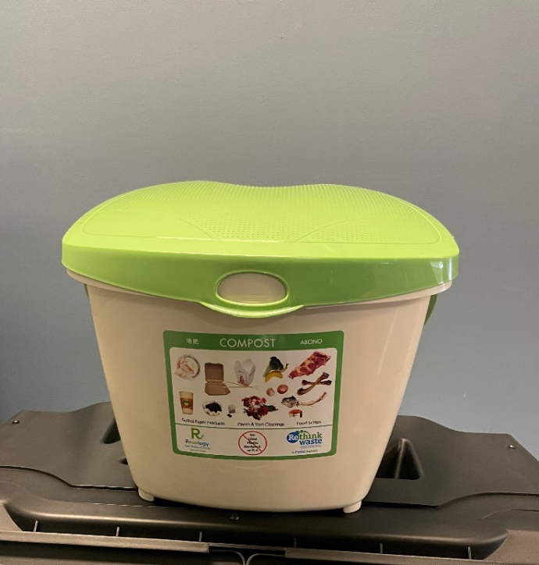
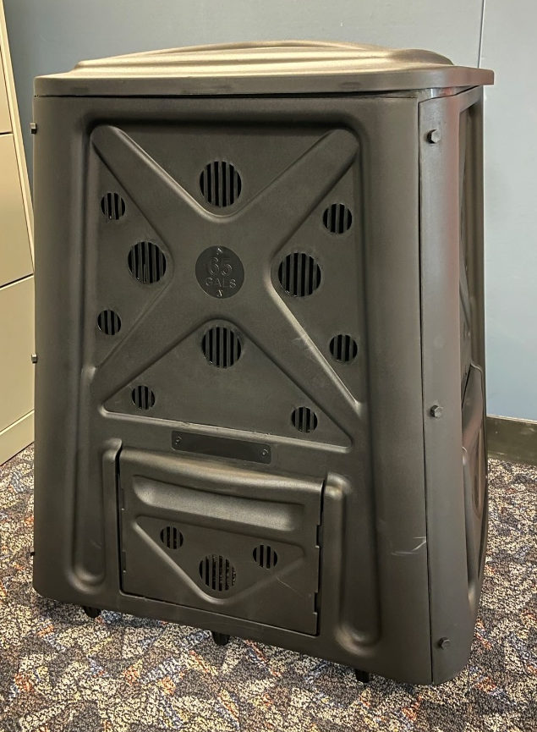
COMPOSTING PAIL & BIN

Slide 14
BACKYARD COMPOSTING
Click on the link below
https://youtu.be/Z18qEzwiRts

Slide 15
SOLID WASTE FEES
No charge for any type of solid waste collection will be on your tax bill
Land Use Fee remains on your tax bill – $185.52 per year
  Funds all the solid waste facilities, programs and infrastructure
  Will increase by CPI for two more years

Slide 16
QUESTIONS
&
COMMENTS

