Slide 1








Welcome to Resource Family Orientation
Handprint Artwork by Kern Foster Children ☺
If this slideshow does not begin automatically, please press F5 to begin.
View this slideshow by clicking your mouse to advance forward or by using your arrow keys.
.

Slide 2


Kern County Department of Human Services
Opportunities, Options & Empowerment
Our Vision:
Every child, individual, and family in Kern County is safe, healthy, and self-sufficient.
Our Mission:
We partner with children, individuals, families and the community to provide customer centered services.
We work to ensure safe, protected and permanent homes for children.
We actively assist individuals as they prepare for employment.

Slide 3

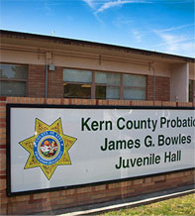

Juvenile Probation
Placement-Foster Care
Placement Officers are responsible for the supervision and placement of Wards of the Court whose care has been vested with the Probation Department. These youth reside in out-of-home care including; group homes/STRTP, foster homes, and Resource Family Approval homes. In addition to ensuring that the orders of the Court are followed, Placement Officers are responsible for adhering to state and federal policies and procedures in assuring the placement and safety of the youth. Our Mission is rehabilitation, reunification and/or Permanency.

Slide 4

Who are the Youth in Foster Care?
Probation Foster Youth
Youth are typically 13-17 years old
Similar to Child Welfare, if these youth do not have a suitable home, care, custody and control can be vested with the Probation Department.
When this happens, the youth is identified as a foster youth and is eligible for all foster care services and support.
While deemed a Ward of the Court, most just need a Resource Family for stability and success.
If you are interested in being a Resource Family for a Probation Youth, please let the Social Workers or Deputy Probation Officer know

Slide 5

What is the
Purpose of Foster Care?
The purpose of foster care is to keep children safe while in out-of-home care with a primary goal of returning them safely to their parent/guardian.
Concurrently, child welfare services are provided to ensure a child has a permanent home if they cannot return to their parent/guardian.

Slide 6


Who can foster or adopt?
Single or Married
All races, ethnicities, ages or gender identities
Related or unrelated

Slide 7
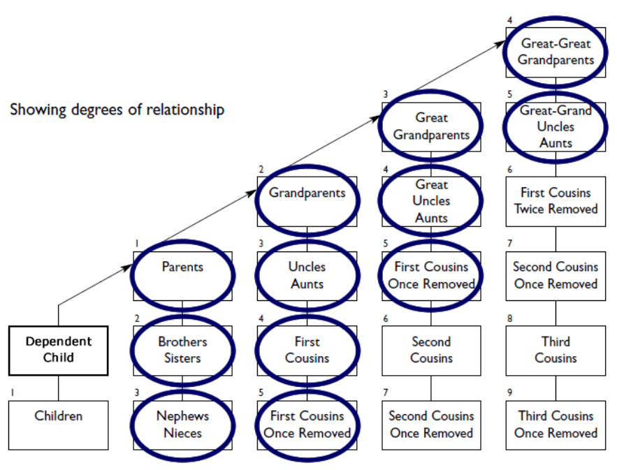
What about relatives?
Related
Preferential Relatives
  Relatives have priority for placement until disposition of case
  After these relatives, the preference is for family friends or others that the child has an relationship with
  If placement with a relative/family friend is not possible the goal is for children to maintain contact with family if possible.
5th Degree

Slide 8

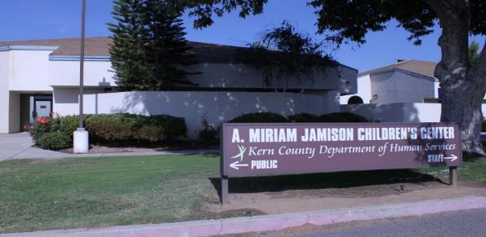
What is a Resource Family Home?
Emergency Foster Care
  Immediate, short term care
  Children under age 5
Indian Child Welfare Act (ICWA)
  Children with tribal affiliation placed with members of the tribe
Ongoing Care
  Children, youth & sibling sets of all ages
  Temporary or Permanent
Specialized Care
  Mental, Physical & Behavioral Needs
  Additional training & funding

Slide 9


Why be a Resource Parent?
Being a resource parent is as challenging
as it is rewarding
Opening your home to a child, youth or sibling group may make a positive difference in their lives
If this sounds interesting to you, then it’s time to explore the idea of becoming a resource parent…

Slide 10


Why are Children in Foster Care?
Dependent Children of the Court (Under WIC 300)
Removed due to child maltreatment by parent or guardian
Goal is reunification with parents or maintain stable placement for permanency
Wards of the Court
(Under WIC 600)
Removed due to delinquent behavior and the home is not suitable
Goal is rehabilitation, reunification and permanency
Both agencies want the same outcome:
Permanency

Slide 11

Who are the Children in Foster Care?
Children who may have experienced:
  Neglect or abandonment
  Physical, emotional or sexual abuse
  Victims of Human Trafficking
All age groups: 0-17 years
  Small & large sibling groups
Teen parents with their babies
Babies born with prenatal drug or
alcohol exposure
Special Medical Needs children

Slide 12

Who are the Children in Foster Care?
Cultural Considerations
Race & Ethnicity
Religion
Nationality
LGTBQ Youth
  Lesbian, Gay, Transgender, Bi-Sexual & Questioning
Native American & Eskimo
  ICWA (Indian Child Welfare Act)

Slide 13

Who are the Children in Foster Care?
Youth Preparing to Live Independently
Independent Living Program – Transitional Living Plans
Foster Youth need your help to prepare for Independent Living!
Employment
College
Self Reliance
Ongoing Positive Relationships

Slide 14

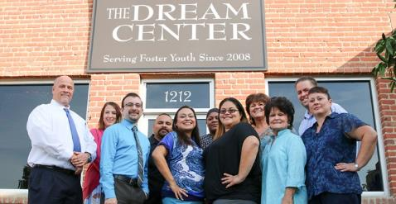
Non-Minor Dependents (NMD)
Assembly Bill (AB) 12
Young adults may leave foster care at age18, but receive services until age 21
NMDs need your help!
  Mentoring/family connections
  Housing
  Guidance with college or vocational training
Dream Center Services
Notes:
These young adults still need continued care and family connections. Foster parents can provide a place to live, or a place to visit, or mentoring on getting jobs, finding homes, college, etc. Whatever a young adult needs to prepare to become independent.

Slide 15

What do Children in Foster Care Want?
Foster Children & Youth want to stay connected to family and . . .
Love their parents and want to be together as a family
Need a caring home with unconditional love
Want to feel safe in a home that supports personal growth and
identity (cultural sensitivity & religious freedom)

Slide 16
Roles of Resource Parents and Agencies
Resource Parent
Child Protective Services (CPS) Social Worker
Juvenile Probation Officer
Resource Family Approval Social Worker

Slide 17


What is the Role of a Resource Parent?
Encourage reunification with parents/guardians
Be ready to provide a permanent
home when reunification is not possible
Give children/youth a safe, stable
and nurturing environment
Encourage and supervise school participation & attendance

Slide 18


What is the Role of a Resource Parent?
Help children/youth cope with trauma of abuse and separation from his/her home
Mentor the child’s birth parents
  When possible and appropriate
Maintain family connections
  When in a child’s best interest
  Encourage and support visits with
  birth family
  Even after adoption is finalized

Slide 19

What is the Role of a
CPS Social Worker (SW)
Juvenile Probation Officer (PO)
Each child is assigned a CPS SW or PO:
Arrange and make placement decisions
Monitor a child in foster care
Case manager for the child and family
CPS SW/PO is Resource Parent/Family’s link to the agency and court.

Slide 20
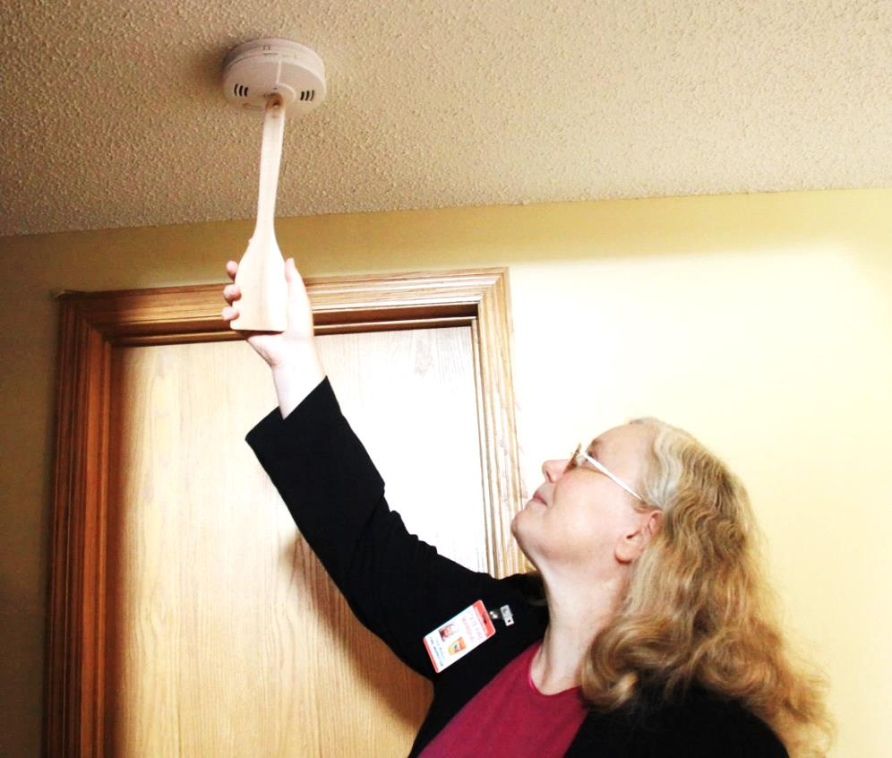
What is the Role of a
Resource Family Approval Social Worker (RFA SW)?
Each Home has an RFA SW:
Process Applications
Make Approval Decisions
Monitor for Compliance with State Regulations
RFA SW is your link with
California Department of
Social Services (CDSS).
Checking the smoke alarm

Slide 21
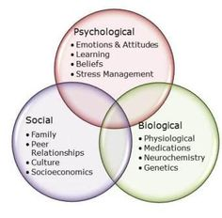

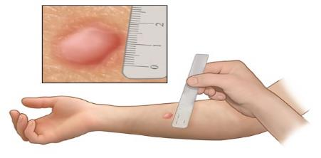
Applicant Qualifications & Requirements
Must be at least 18 years of age
Must be in good physical and mental health
Willing to assist youth in preparing for adulthood
Use effective parenting skills with children who have been victims of abuse/neglect.

Slide 22

Juvenile Court Process
Child Protective Services: Child Dependency
Juvenile Probation: Wards

Slide 23
Child Welfare Court Process
A youth is removed from his/her parent(s) or guardian(s) due to substantiated allegations of child abuse or neglect.
Detention Hearing – Court decides if a child will remain in foster care while it is determined if allegations are true and what the plan for the family will be.
Jurisdictional/Dispositional Hearing – Allegations are found true, found partly true, or found untrue. If any are found true then it is determined whether Family Reunification, Family Maintenance, Another Planned Permanency Living Arrangement (AAPLA) or Adoption is the appropriate plan for the family
Review Hearings – Every 6 months to evaluate progress of the parents in their case plan or the child in his/her permanency plan if parents are not receiving services
366.26 Hearing – Determine the appropriate permanency plan of Adoption, Guardianship, Fit and Willing Relative, or APPLA

Slide 24

Juvenile Probation Court Process
What is different for care vested wards?
A youth is arrested for committing an offense and temporarily detained in Juvenile Hall
W&IC 600 Detention Hearing – Continues detention in Juvenile Hall
W&IC 600 Dispositional Hearing – Care, Custody and Control is taken and youth is ordered a rehabilitation plan. An appropriate placement for the youth is sought.
W&IC 600 Permanency Hearings – Every 6 months to evaluate progress of youth’s rehabilitation and progress toward reunification and/or permanency.

Slide 25

What are a Child’s Permanency Options?
Goal is for a child to reunify with their parent/guardian(s) whenever possible.
If a child cannot be returned home after 12-24 months, the law requires that a permanent plan be made for the child.
You may be given the option of providing a permanent home for a child or assisting a child in moving to a permanent home.
  Permanency Options:
  Adoption
  Legal Guardianship
  APPLA
  (Another Planned Permanency Living Arrangement)
  AB-12 placement for ages 18-21
81.5 million Americans have considered adoption.
*If just 1 in 500 of these adults adopted, every waiting child in foster care would have a permanent family.- Dave Thomas Foundation

Slide 26
Resource Family Approval
Comprehensive Assessment
From Orientation to Written Report

Slide 27
…Starts with
RFA Comprehensive
Assessment Process
1: ORIENTATION
2: Complete online APPLICATION
Training & CPR/First Aid
Family
Evaluation
Home Inspection
3: Complete COMPREHENSIVE ASSESSMENT
Health Questionnaire,
References &
Other Activities
Background Checks and
Fingerprints
RFA is Approved
or Denied within 90 days
Based on the comprehensive assessment
Due Process
if denied

Slide 28
State of California’s Written Directives for Resource Family Approval (RFA)
California Department of Social Services (CDSS) is the state authority responsible for establishing and maintaining standards for resource family homes and child care institutions. http://www.cdss.ca.gov/inforesources/Resource-Family-Approval-Program
Resource Families are approved per the CDSS Written Directives.
Once approved, a Resource Family is eligible to care for related and unrelated children in out-of-home placement.
An approved Resource Family is approved for adoption or legal guardianship as well as ongoing fostering.

Slide 29

RFA Comprehensive Assessment Process
HOME ENVIRONMENT ASSESSMENT
BACKGROUND CHECKS
All adults (18 years and older) residing, or regularly present, in the home must complete:
  Criminal Record Statement & Out of State Disclosure (adults in home)
  Live Scan (fingerprinting) – criminal history can possibly be exempted
  Child Abuse Central Index (CACI), Megan’s Law check, and Department of Motor Vehicles (DMV)
  Does not include foster youth who turn 18 while residing in home or non-minor dependent (NMD) in a Assembly Bill (AB) 12 placement

Slide 30

RFA Comprehensive Assessment Process
Home Environment Assessment
Home Safety Inspection
Home and grounds inspection checklist (in packet)
  Living space
  Ability to care for and supervise children
Capacity generally limited to 6 children/Non-Minor Dependents (18 years - 21 years old) per home
  Capacity may be lower and will be determined by your RFA social worker in consultation with you

Slide 31

Home Environment Assessment
RFA Comprehensive Assessment Process
Home Inspection:
Living area (fireplace/heater, carpets, and furniture clean and in good repair)
Bedrooms (linens, lighting, furniture, closet/drawer space)
Kitchen area (food, knives, cleaning supplies)
Bathrooms (safe, clean, & operating)
Yard (free from hazards & debris)
Guns/weapons & ammunition (safely stored)
Pool/bodies of water (made inaccessible)

Slide 32

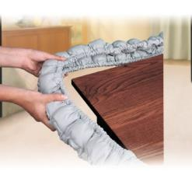



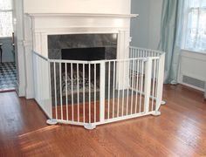

Home Environment Assessment
RFA Comprehensive Assessment Process
Preparing for a Home Inspection
Child Proof Your Home
Install safety devices
Prevent access to dangerous items!
First Aid Kits
First Aid Kit
First Aid Manual
PET Recommendations
Vaccinations
License

Slide 33

Home Environment Assessment
RFA Comprehensive Assessment Process
Preparing for a Home Inspection
To help you prepare for the Home Inspection…
The following slides provide:
Examples of homes with hazards to a child’s health/safety.
Examples of homes ready for inspection.

Slide 34
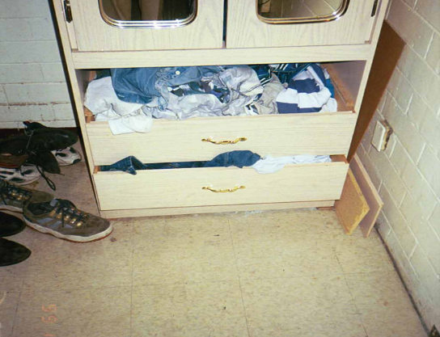
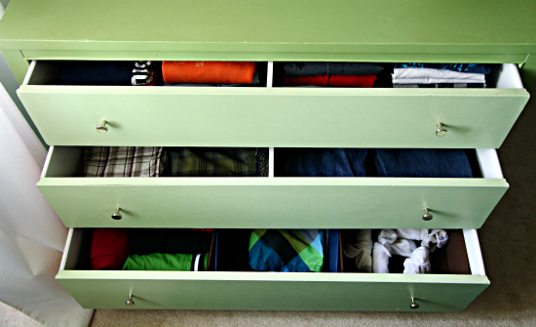

NOT Acceptable
ACCEPTABLE
Broken drawers, unsafe electrical outlet
Clean, safe, organized, plenty of space

Slide 35
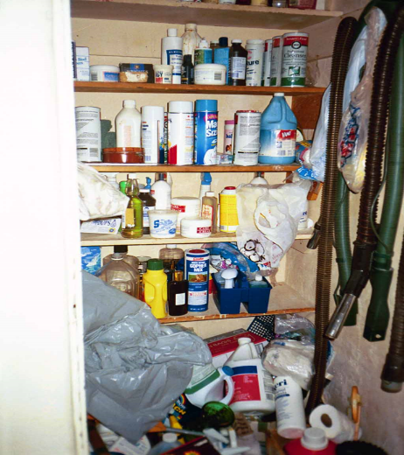
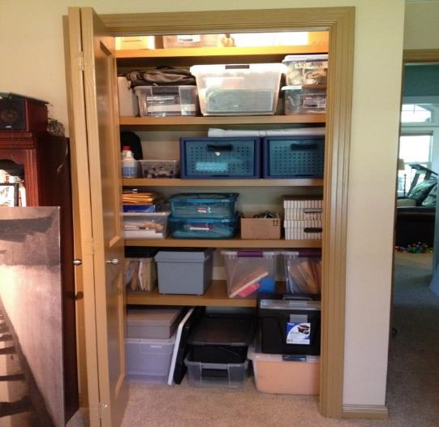

NOT Acceptable
Chemicals & poisons
in child’s reach
ACCEPTABLE
Clean, safe and organized

Slide 36
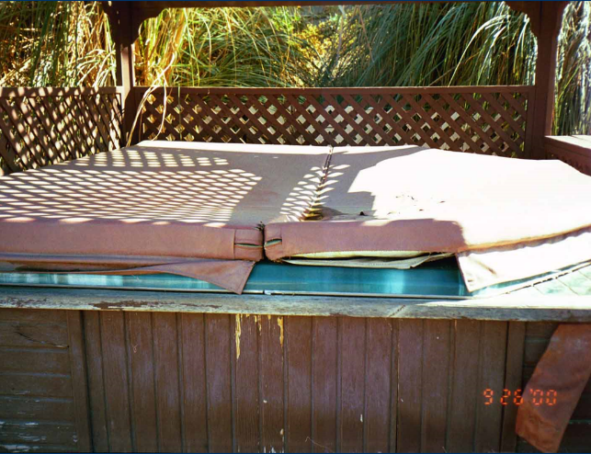
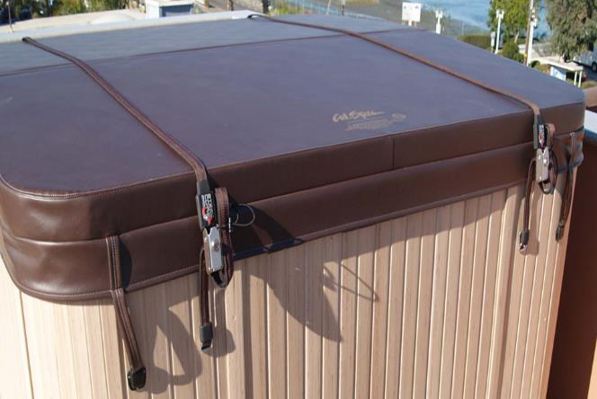
NOT Acceptable
ACCEPTABLE
Gives a child
access to body of water
Cover fits, ties prevent unsafe access to body of water

Slide 37
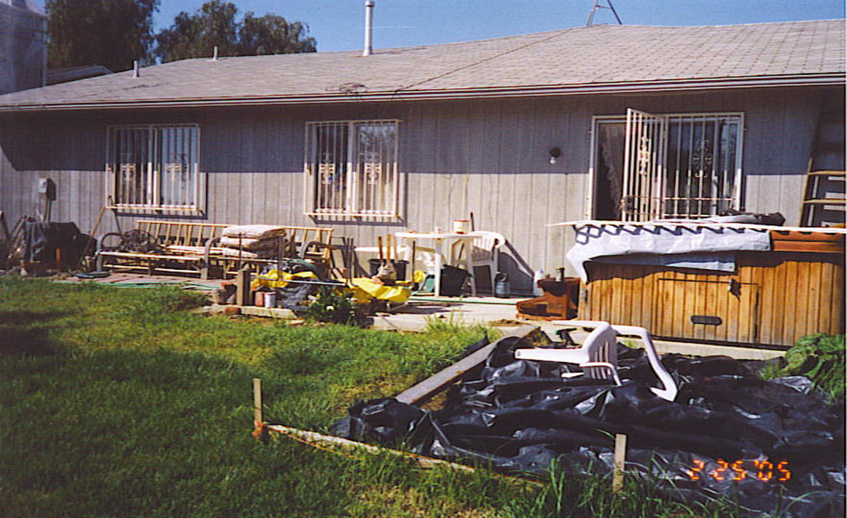
Think –
SAFETY!
Open pit, loose tarp, broken chair, parts on bench, hot tub uncovered, poison on porch, ladder against wall, window access blocked

Slide 38
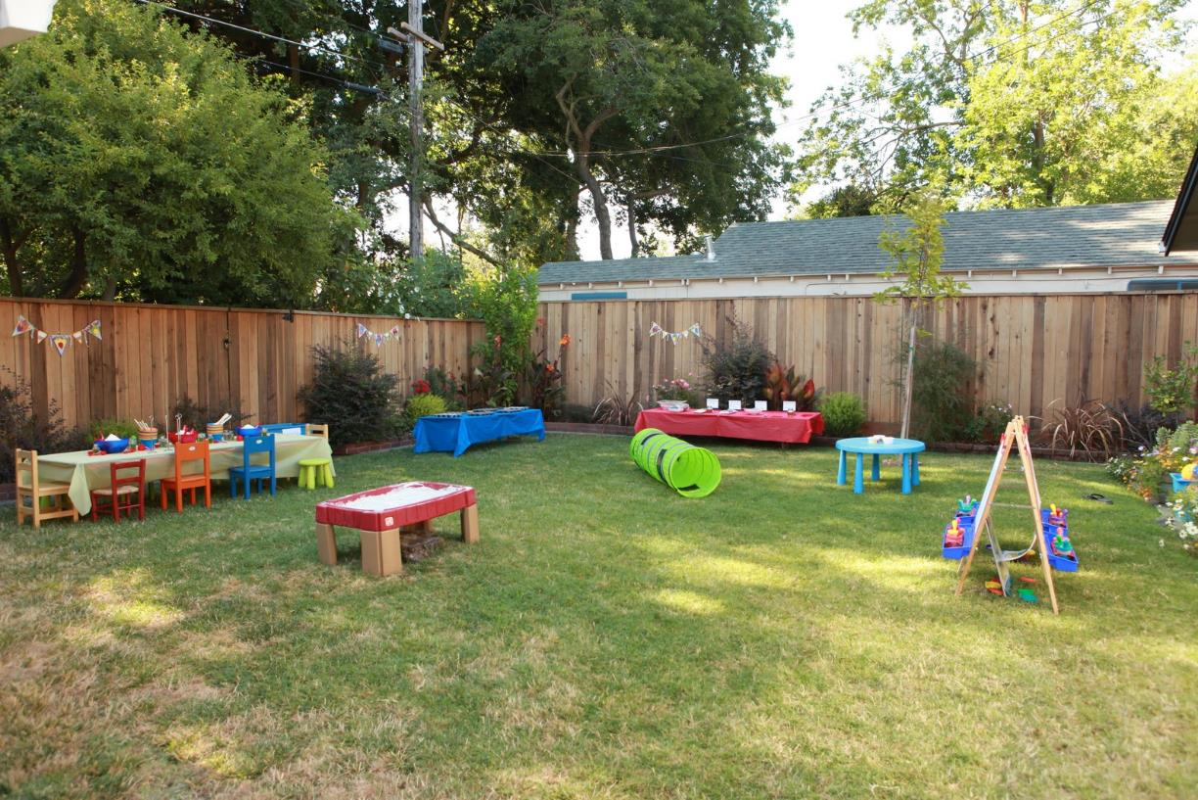
Safe. Welcomes play!

Slide 39
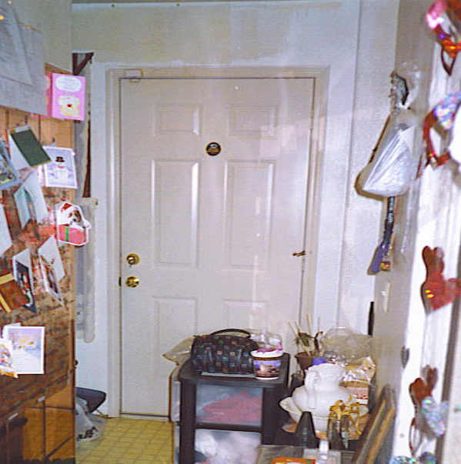
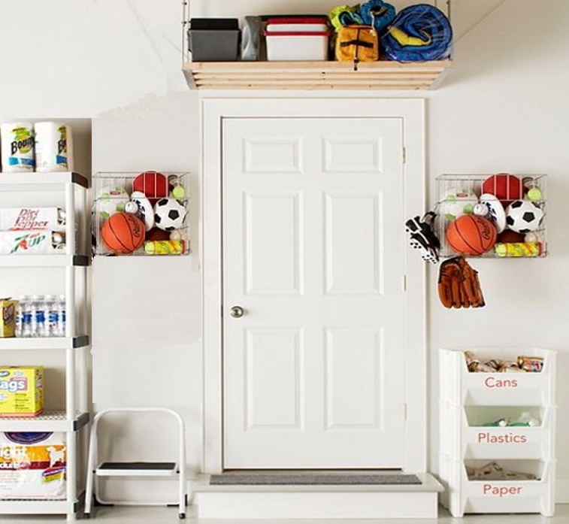
NOT Acceptable
ACCEPTABLE
Blocked door, items hanging or stored in child’s reach
Clean/safe access to sports items and recycling.

Slide 40
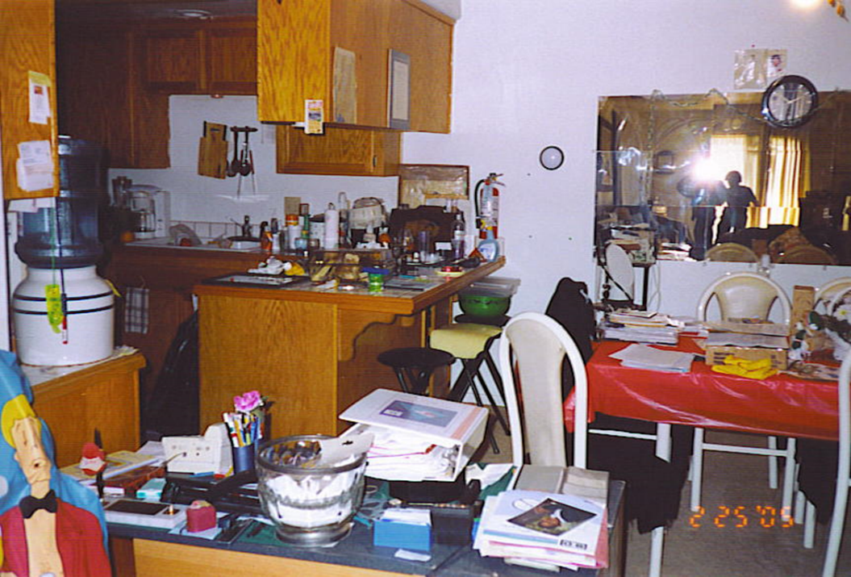
Think – SAFETY!
Unsafe items in child’s reach, counters & tables too cluttered to clean or use

Slide 41
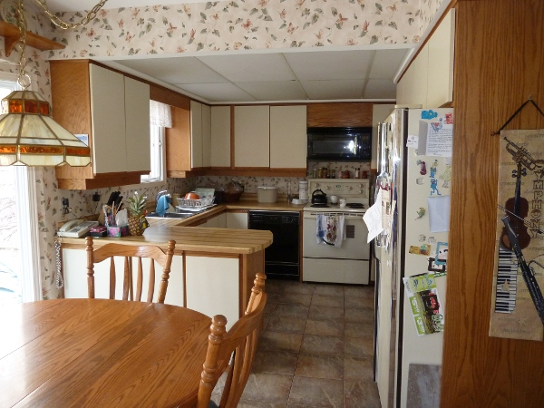
Safe storage,
clear access,
clean table &
counter

Slide 42


Think – SAFETY!
Drowning risk, child unsupervised

Slide 43
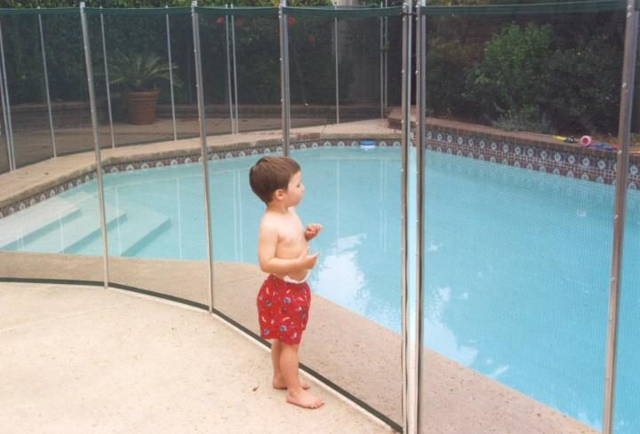


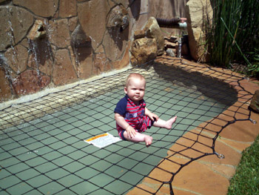
GOOD POOL SAFETY
Examples of Fencing
See-through fencing
Protective covers prevent accidental access to body of water
  Dependent children under 10 years of age; minor and NMDs who are developmentally, mentally or physically disabled; a minor or NMD parent’s child who is under ten years of age or developmentally, mentally, or physically disabled.
Examples of Covers
Exception: Exits alarms on doors &windows when fence or cover not structurally possible.
Cover Ponds & Fountains Too!

Slide 44


RFA Comprehensive Assessment Process
Training Requirements
FREE CPR & First Aid* (661-319-1836)
Initial and every 2 years for approved home/family
  *CPR/First Aid must be completed within 90 days of RFA Approval
FREE Pre-Approval Training (661-395-4991)
  12 Hour Course – Certificate provided upon completion
FREE Annual Training (661-395-4991)
  8 hours required annually

Slide 45

RFA Comprehensive Assessment Process
Requirements for Applicants
Health Questionnaire
    Each Applicant must submit a Health Questionnaire.
      Applicants Medical History and Medications
  As deemed necessary, the county reserves the right to require an applicant to complete a health screening from a health professional to verify the applicant is in good physical health.
    Health screening from a health professional may be used if not more than one year prior to the date of the application.

Slide 46

RFA Comprehensive Assessment Process
Family Evaluation
A minimum of 2 in-person conversations with applicants
(most often in the home):
  One individual interview of each applicant
  One joint interview with both applicants (if applicable)
  A minimum of one separate face to face interview with all other persons residing in the home (example: other adults and children).
  These conversations allow for more thoughtful matches of children and families
        *If an applicant refuses to participate in an interview, the County shall deny the application*

Slide 47
RFA Comprehensive Assessment Process
Permanency Assessment
Willingness and suitability to provide permanency (foster, adoption, legal guardianship) to a child or non-minor dependent at the time of undergoing RFA process.
Please note: While RFA includes a general permanency assessment, when specific child's case goes to adoptions, there may be additional requirements to assess suitability as a prospective adoptive parent for that child. You may collect the documents below and provide them to the RFA social worker for future use in an adoption.
    May include Health Screening, TB tests for all adults in the home, marriage certificate, and divorce decree

Slide 48


RFA Comprehensive Assessment Process
Provide 2-3 References
Of your good character and ability to provide a safe environment
Ask co-workers, neighbors and close friends
We will contact your references by phone, mail and/or email

Slide 49

RFA Comprehensive Assessment Process
Final Written Report
Summary and analysis of the comprehensive assessment and a determination of applicant’s capacity to foster
Agency and applicant receive a copy
Provides approval or denial of application

Slide 50
Funding Benefits
Emergency Caregiver Funding: Emergency Assistance is available for relatives that are caring for relative children on an emergency or compelling reason placement.
Foster Care funding is reimbursement provided to a caregiver on a monthly basis to care for a child placed in a resource home. Medi-Cal is available.
Approved Relative Caregiver Funding Option is a program for approved relative caregivers with whom an eligible child is placed that will be able to receive a payment equal to the basic foster care rate. Medi-Cal is available.
Adoption Assistance Program (AAP) Payments provides financial and other supports to help adoptive families meet the basic and unique needs of children in care, including Medi-Cal and monthly payments until age 18. In some circumstances, if the youth has a disability, the AAP payments and Medi-Cal may continue to age 21.
Kinship Guardianship Assistance Payment (Kin-GAP) Program offers financial assistance and Medi-Cal for a child who is placed with an approved relative legal guardian. The payment cannot exceed the amount the child would have received if he/she remained in foster care.
For funding to care for a specific child, please speak
to the child’s assigned placement social worker.

Slide 51


Resource Family Application
If Your Application is Denied
  You will receive a notice of action and instructions for appealing the decision.
    If the decision is not appealed on or before the due date, the action will be final
Reasons to deny may include, but are not limited to:
  Inability to cooperate or failure to meet requirements.
  Non-exemptible criminal record or child abuse allegations of a serious nature.
  Home did not meet Buildings & Grounds standards, per RFA Written Directives and Health & Safety Codes.

Slide 52

Adoptions Process
Court Process
Finalization

Slide 53

Adoption Court Process
Disposition or Reunification Review Hearing
  Court terminates REUNIFICATION SERVICES to Parents
  Sets Selection and Implentation 366.26 Hearing within 120 Days
120 Day Child Assessment
  Prior to 366.26 hearing, Adoption social worker determines child’s best interests for permanency (adoption, guardianship, or another planned permanent living arrangement)
  Visitation with parents continues
  Court report supports recommendation to terminate parental rights and identifies prospective adoptive parent or legal guardian
Selection and Implentation 366.26 Hearing (Adoption/Guardianship)
  Court terminates PARENTAL RIGHTS & visitation (for adoption cases)
  Court orders legal guardianship to be established and case is closed
  Parents may appeal within 60 days
  Post Permanency Review every 6 months
    Court continues dependency & services until adoption is finalized
  Placement and child’s needs are monitored
Adoption is Finalized
Court dependency is terminated and the case is closed

Slide 54

Adoption Process
Caregiver requirements needed to finalize adoption
  Must be at least 10 years older than child (exceptions)
  Pre-adoption/post adoption services are available
    Including Adoption Assistance Program assistance, and Medi-Cal, until the child is 18 (or up to age 21 if certain conditions are met)
    Social Worker remains assigned
    Counseling, case management, and support groups are available
  Must provide verification of all marriages & dissolutions
  Must address child support, inheritance issues, etc.
  Must address plan for post-adoption sibling visitation, if applicable

Slide 55

Adoption: Questions You Should Ask
To ensure the child coming into your home has the best possible chance of adoption, ask these questions before accepting a foster care placement:
Have the parents lost previous children to adoptions?
  Often the court will not order reunification.
  These children usually have a greater likelihood of adoption.
Have relatives come forward requesting placement of the child?
  The Department always attempts to place with relatives initially
  Relatives have preferential consideration if they apply for placement before the disposition hearing.
Did the parents claim Native American Heritage & Does ICWA apply?
  Agency will make ACTIVE EFFORTS to place the child with a relative or Native American family/Tribe.
***Anyone seriously considering adoption should also investigate private adoptions which may have less risk but also may be quite costly.

Slide 56

Adoption Process
Finalization Process
All of children’s records are given to adopting parents
Caregiver signs adoption assistance documents
Legal documents are signed and approved
Child may have new legal name
Child now has a forever home!
You may be contacted about participation at Child Family Team Meetings if child’s siblings come into care after adoption finalization

Slide 57

POST-APPROVAL
Overview of important regulations from California Department of Social Services’ Written Directives

Slide 58

  Post Approval Responsibilities
Annual Updates
*Approved Resource Families are assessed annually*
RFA Social Worker will remain your ongoing worker and will schedule:
  Home environment check
  Annual Training Completed
  RFA Written Report update
Update for Relocation
  Always notify RFA Social Worker AND Placement Social Worker when planning to move and provide new address
    Home inspection must be approved in advance, and no more than 30 days from date of address change, or funding may be terminated

Slide 59

Post Approval Responsibilities
Post Approval Training (661-395-4991)
8 hours annually (online and in-person)
CPR & First Aid (every 2 years)
Resource Parent must report:
Injury or illness requiring emergency medical attention or hospitalization
Report any suspected child abuse/neglect (661-631-6011)
ANY unusual incident or absence (including runaway)
  Contact RFA social worker AND
  Contact child’s placement social worker

Slide 60

Post Approval Responsibilities
General Requirements
  Ensure children receive ongoing medical, dental and educational services
  Maintain first aid supplies
  Maintain children’s records and keep confidential
  Two telephone numbers and, if available, two email addresses for 24-hour contact. Telephone service must be working at all times:
    Can be cellular, internet, or landline
    Shall be accessible to a child/NMD unless prohibited by court order (reasonable restrictions must be approved by the placement worker)
  Emergency telephone numbers in a prominent location in the home

Slide 61
Post Approval Responsibilities
General Requirements
Maintain a hard copy emergency binder in the home containing
  Child/NMD’s information, including, name, date of birth and any medical conditions;
  Contact information for the child/NMD’s social worker and placement agency;
  24 hour contact information for the county child welfare agency or probation department.
You may ask the child/NMD’s social worker for a “We CARE” binder for each child/NMD placed in your home.

Slide 62
Post Approval Responsibilities
General Requirements
Comfort Calls
  Per Welfare and Institutions Code Section 308(a) the bio- parents SHALL be given a phone number the child can be reached at
  The phone number listed as your primary contact will be provided, unless you provide an alternate
  Goal: To make a connection and work as part of the same team for the child.
    Ask about child’s medical needs, allergies, favorite foods, routines, favorite shows, nicknames, etc…

Slide 63


Post Approval Responsibilities
ABSOLUTELY NO CORPORAL PUNISHMENT!
Spanking another parent’s child is physical assault!
Foster children have suffered physical and emotional abuse; spanking repeats the abuse!
PROHIBITED . . . . . .
  Spanking,
  hitting,
  slapping,
  hair pulling,
  pinching,
  kicking, etc.
No corporal punishment of birth child
in front of foster child.

Slide 64

Post Approval Responsibilities
Discipline is necessary!
Consider other approved strategies:
  Time out
  Remove Privileges
  Positive Discipline
  Behavioral Management
  Counseling – Whole Family

Slide 65

Post Approval Responsibilities
SMOKING PROHIBITED
Resource Family Homes are SMOKE FREE!
An approved/licensed/certified care provider:
  Shall not smoke or permit any other person to smoke inside the home.
  May not smoke on the outdoor grounds of the home when a child is present.
  Shall not smoke or allow smoking in any motor vehicle regularly used to transport a child.
NO SECOND HAND SMOKE

Slide 66

Post Approval Responsibilities
OCCASIONAL SHORT-TERM BABYSITTER
Resource parent may arrange for the occasional use of a short-term babysitter (less than 24 hours at a time)
For care exceeding 24 hours at a time:
  On an occasional basis only
  Caregiver must be 18 or older
  Cannot exceed 72 hours without social worker or probation officer approval
Respite care, temporary care of the child in another home, can occasionally be provided but must be approved, in advance, by the child’s social worker or probation officer.

Slide 67


Post Approval Responsibilities
EXTRA CURRICULAR ACTIVITIES
Provide opportunities for and encourage a child’s participation in group sports, clubs, school activities, etc.
  Include your foster child in family vacations
  and weekend trips
  Create a Life Book
    Scrapbook a child’s stories, photos, artwork
  Encourage journaling
  Allow your foster child to dream!

Slide 68

Post Approval Responsibilities
  PERSONAL RIGHTS OF FOSTER CHILDREN
  A Resource Parent shall ensure that each child is accorded the following personal rights:
  Safe, healthful and comfortable accommodations
  Independence appropriate to the child’s age, maturity and capability
  Free from corporal or unusual punishment
  Unless prohibited by a court order, or placement agency, a child may acquire, possess and use his/her own cell phone
In Packet

Slide 69
Post Approval Responsibilities
Resource parents are held to the
“Reasonable and prudent parent standard”
Making sensible decisions that protect the child while at the same time encouraging their emotional and developmental growth.
Encourages considering the best interest of the child at all times.
In making decisions about the child consider the following:
  (1) Age, maturity, and developmental level of a child.
  (2) Nature and inherent risks of harm of the activity.
  (3) Best interests of a child based on information about the child such as their developmental level or behavioral tendencies.

Slide 70

Post Approval Responsibilities
A County shall monitor Resource Families as follows:
  Conduct annual updates and be available to answer questions or address concerns.
  Investigate complaints against, or made by, a Resource Family.
  When needed, work with a Resource Family to develop plans to correct identified concerns.
  Ensure Resource Families are treated with dignity and respect.
Brochure in Packet

Slide 71

Post Approval Responsibilities
Approval may be rescinded for:
  False or misleading statements to maintain approval
  Violation of any applicable law or the Written Directives
  Conduct threatening the health and safety of child/NMD
  Using Child/Youth/NMD funds/property/services for personal
  benefit or in a way not consistent with the child’s best interests
If your approval is rescinded:
  You will receive a notice of action and instructions for appealing the decision
    If the decision is not appealed on, or before, the due date, the action will be final

Slide 72
RFA Application
eAdopt Online Application
5 Step Process
Important Information
Due Process
Assistance Available

Slide 73

Resource Family Application Process
Kern County uses the eAdopt web based system
  Online application process
  Assigned via email
  Assigned to an RFA social worker who will assist you through the process
  Options for assistance:
  If no computer, or internet access, your assigned RFA social worker will assist you with the process
  A worker of the day is also available to help with the application

Slide 74
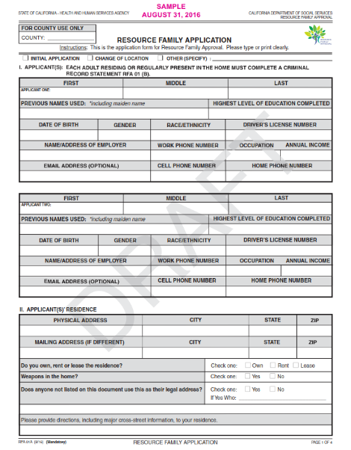
Resource Family Application Process
E-Adopt web based system
  Provide your e-mail address at end of Orientation
  Receive temporary password
  Create your profile
  Complete the application
    State requires an original signature on the application
  Follow your application progress online
  If no computer access, a paper copy will be made available or a computer kiosk is available at Columbus Center

Slide 75
Resource Family Application Process
5 Steps to Completing the Application Process
Step 1 – Attend Orientation.
Step 2 – Receive online eAdopt temporary password to log-in, create your profile and complete an application and other forms.
Step 3 – Complete all clearances and training (fingerprints, background checks, health questionnaire, CPR-1st aid* and pre-service training).
Step 4 – Pass background checks and schedule a home & grounds inspection.
Step 5 – Complete family interviews for the family evaluation. A final written report of the family evaluation will have a decision to approve or deny your application.
The application process takes about 90 days to complete and is dependent upon your active participation.

Slide 76

Resource Family Application Process
Every application is unique!
Time frames for completion and approval vary . . .
  Some applications are processed faster…
  Some go more slowly…
  Depends on an applicant’s circumstances and how quickly they complete the required steps such as training or providing required documentation

Slide 77

Resource Family Application
What you need to know!
Approval is not granted automatically.
  An applicant’s comprehensive assessment must meet
  Written Directives to be approved.
Receiving approval does not guarantee a child will be
placed in your home.
  A child’s social worker or probation officer makes placement decisions.
  Placement decisions are made in the child’s best interests.
  Process within 90 days

Slide 78

Resource Family Application
DUE PROCESS
If a Resource Parent, applicant,
or individual receives a:
  Notice of denial or rescission of approval,
  Notice of exemption denial or rescission,
  Notice of exclusion,
that person may appeal the decision by
requesting a state hearing.
*If the decision is not appealed on, or before, the due date, the action will be final*

Slide 79

Resource Family Application Process
If this seems
overwhelming,
we are here
to help you!
RFA staff are available to answer your questions and help you access eAdopt on a visitor computer.
Call (661) 873-2800 to ask for the RFA worker of the day.
Walk-in or call ahead before visiting the Columbus Center at 3711 Columbus St. during business hours: 7:30 am – 4 pm.

Slide 80
Our Children Need YOU!
Siblings want to stay together, to reside in the same home.
Older children & youth need permanent homes
as much as younger children!
Thank you for attending Resource Family Orientation!

Slide 81
Thank you for attending!
Handprint Artwork by Kern Foster Children ☺

