Slide 1

Respiratory Virus
Season: Local Data
Insights and Community Risk
Factors
Paul Rzucidlo Assistant Division Director of
Health Services 2024.10.22

Slide 2

Understand the Sources of Surveillance Data: Describe the various sources of surveillance data for respiratory viruses, including laboratory reporting, syndromic data, and wastewater monitoring.
Interpret Local Respiratory Virus Data: Analyze local data insights on respiratory virus trends and their impact on community health.
Understand how population composition affects risk of severe disease.
Navigate Available Data Products and Dashboards: Understand where to access and interpret information from CDPH and KCPHD.

Slide 3


●
Clinical Sentinel Laboratories and Respiratory Laboratory Network - These laboratories report the number of laboratory- confirmed influenza and other respiratory virus detections and isolations on a weekly basis.
Syndromic data from the Sentinel Provider Program
  A partnership between clinicians, local health departments (LHDs), the California Department of Public Health (CDPH), and the Centers for Disease Control and Prevention (CDC) to conduct surveillance for influenza-like illness (ILI).
Admission data from Kaiser
  Historically only Northern California
Death Certificates
Wastewater

Slide 4
●
Laboratory reporting for COVID, RSV, and influenza
  Facilities certified under CLIA must report all non-waived
testing results including positive and non-positive results for all Nucleic Acid Amplification Tests (NAAT) and non- NAAT Tests.
  Facilities conducting testing with a CLIA Certificate of Waiver are not required to report these results.
Provider reporting
  COVID – Report hospitalizations and deaths
  Flu – Deaths in lab confirmed cases less than 18 years of
age and any novel strain
  RSV – Deaths in lab confirmed cases less than five years of age.

Slide 5




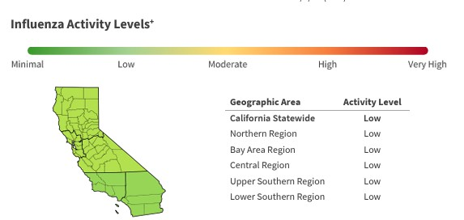

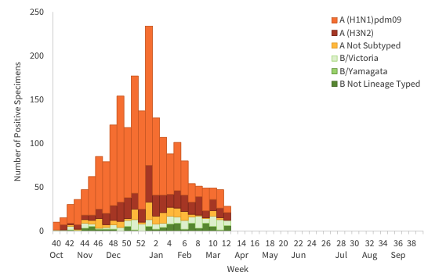
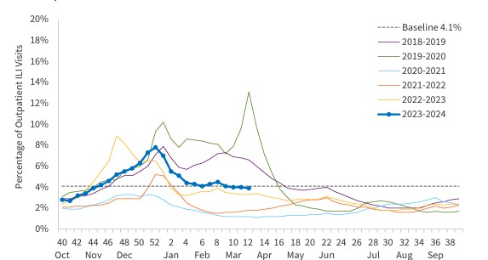
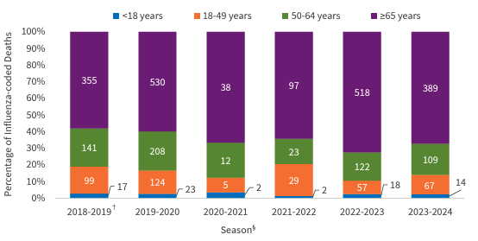
–
●
Report can be found on CDPH’s flu website: https://www.cdph.ca.gov/Programs/CID
/DCDC/pages/immunization/flu-
reports.aspx

Slide 6




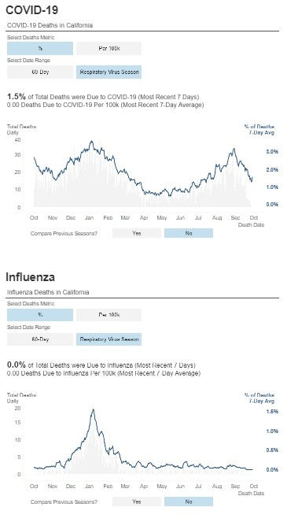
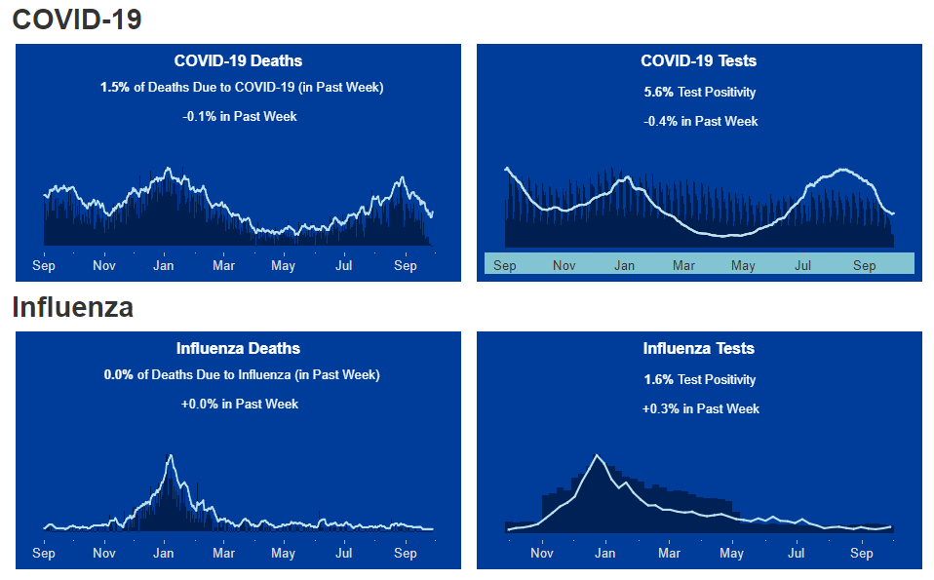
–
●

Slide 7


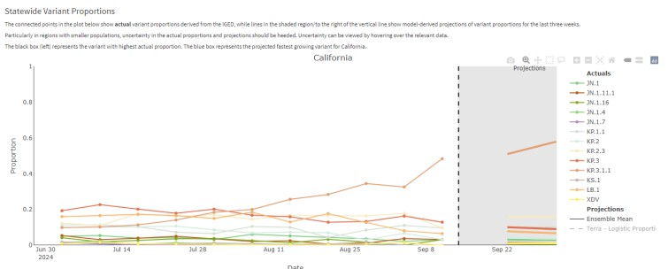



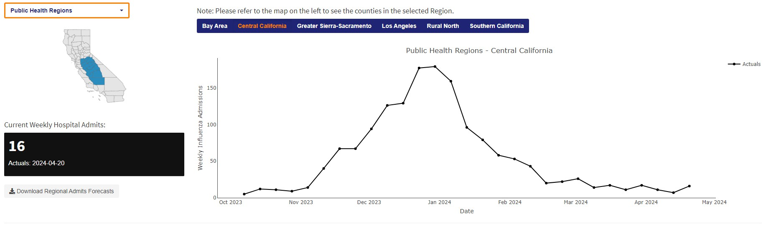
–
●

Slide 8



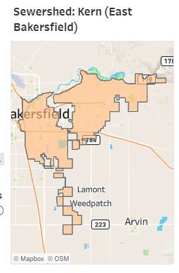
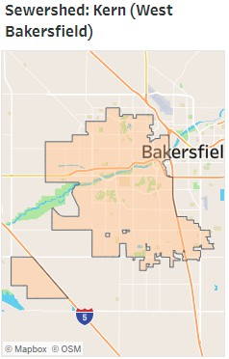
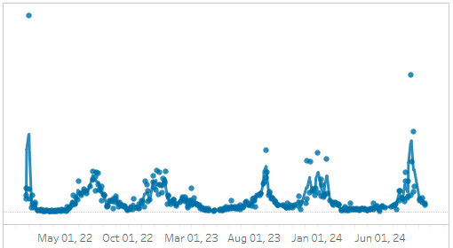
–
●

Slide 9
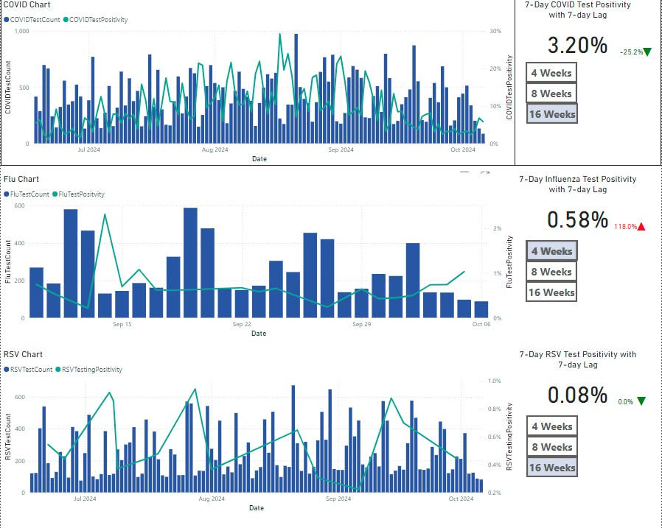
–
●

Slide 10











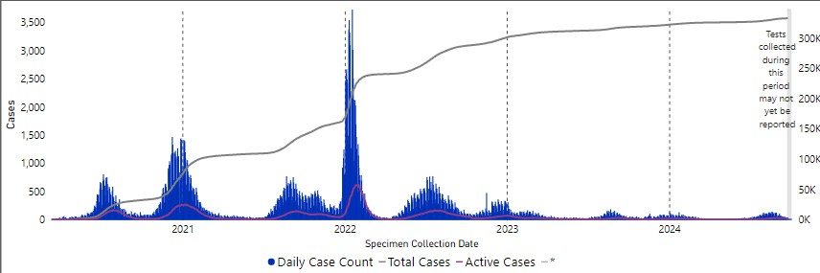



●
●

Slide 11




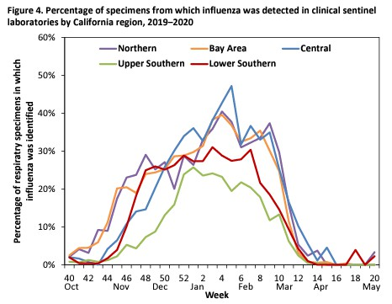
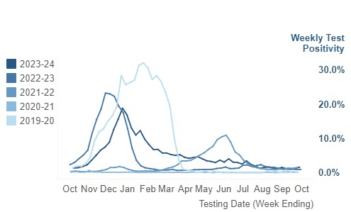
●
●
Usually moves from minimal activity at the end of October and increases through January, dropping off towards the end of March.
●

Slide 12


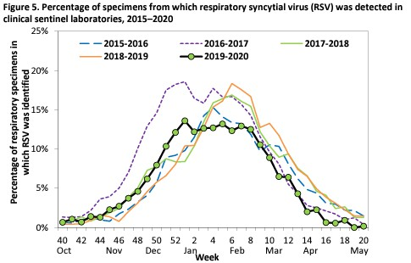
●
●
●

Slide 13


●
65+ for influenza and COVID and 75+ for RSV
Less than 2 for influenza and RSV
Chronic organ diseases
Obesity
Smoker or Former Smoker
Pregnancy
Weakened Immune Systems
Asthma

Slide 14

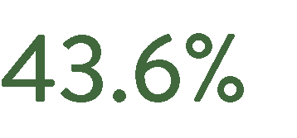

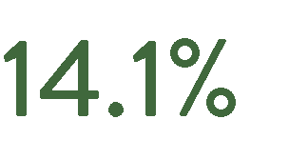


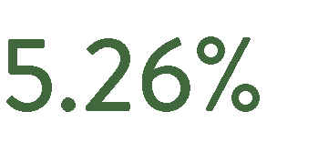
●
●
●
●
●
●
●
●

Slide 15


●

Slide 16
Questions?

