Slide 1


Slide 2
Welcome to
Kern County Environmental Health Services
Presenter:
Ellie Bojorquez
Public Health Project Specialist

Slide 3
We want you to be successful! That is why we offer this workshop to you and ALL of your staff!
We encourage you to send any new employees to this workshop.

Slide 4
Massage Establishment Workshop
The content herein is to provide you with the knowledge of the requirements to successfully operate a Massage Establishment.

Slide 5
Inspections
Inspections are conducted to:
Help ensure conditions are sanitary for you, your staff, and your customers.
Provide and maintain a safe environment for massage services.
Ensure the safety of those providing and receiving services.
Provide information and/or resources to safeguard the success of your business.
Prevent the spread of communicable diseases.

Slide 6


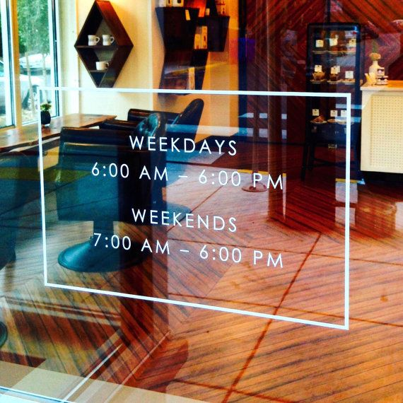
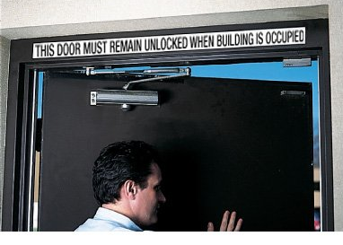
INSPECTIONS
Exterior Doors Unlocked
Business Name Posted Outside
Operating Hours between 7:00 a.m.-10:00 p.m.

Slide 7

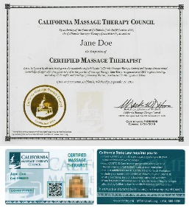
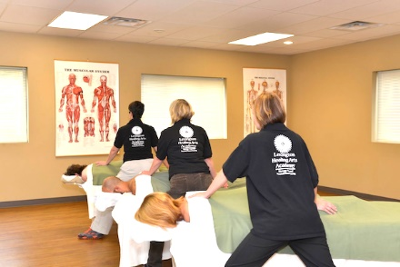

INSPECTIONS
CAMTC Cert Posted in Reception
No Alcohol or Drugs Onsite Proper Attire
CAMTC Cert Posted in Work Stations or on Massage Practitioners

Slide 8




INSPECTIONS
Residential Occupants not Permitted
Building Maintained Properly
Permit Owner/Manager Onsite
Proper Ventilation & Lighting

Slide 9
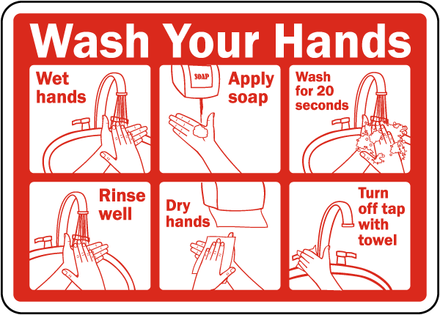

Sanitizing & disinfecting
Infection Control
Use soap dispensers
Provide & maintain first aid kit
Wash/Dry hands between each client
Dry hands with single-use paper towels

Slide 10

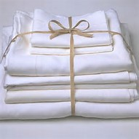


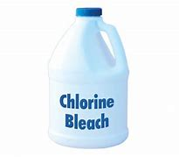
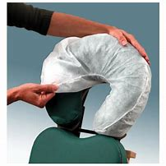
Sanitizing & disinfecting
Place used linens in closed container
Wash linens in HOT water & detergent
Use clean washed linens for each client
Place soiled linens in sealed container
Replace all used linens between each client

Slide 11
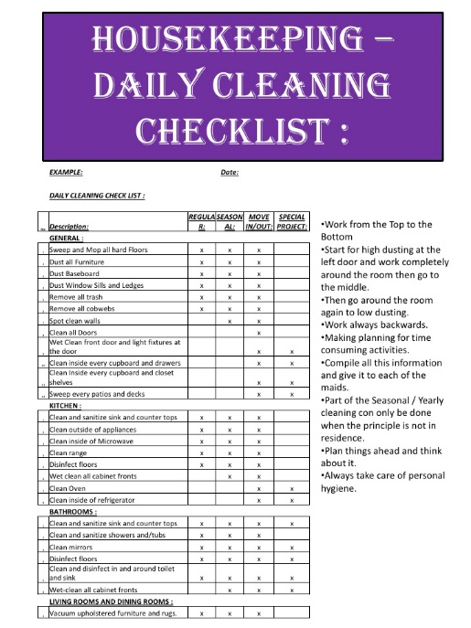


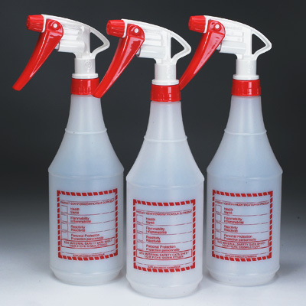
Sanitizing & disinfecting
Label ALL bottles with content inside
Provide and maintain first aid kits
Clean and disinfect between each customer
Document cleaning frequencies
Use Bleach to disinfect (100 ppm)

Slide 12
Record Keeping
Owner is required to keep a current file of ALL employees at the establishment.
Files are to contain:
True names & Aliases for employees
Date of Employment
Age
Phone Numbers
Birth Date
Email Addresses
Color of Hair & Eyes
Social Security Number
Home Address
Date of Termination

Slide 13
Record Keeping
Record of Client Services to be maintained for two (2) years and to include:
    Date and Hour of each Treatment
    Client’s Name
    Client’s Address/Phone Number
    Practitioner Who Provided the Service

Slide 14
Prohibited Conduct
Personal knowledge of any violation of this section shall not be required to be shown where a massage establishment permit is suspended or revoked.
No Owner or Manager on Premises during Business Hours | Advertising Services Prohibited by Law
Exposing genital parts | Touching genital parts
Massaging while in presence of someone of the opposite sex | Allowing anyone to administer a massage without a valid CAMTC Certificate

Slide 15
Administrative Penalties
Each violation is assessed a fine and permit suspension or revocation.
1st Offense for the Establishment Owner Operating without a Permit
$250 fine per day
180 Day Permit Suspension
2nd Offense for the Establishment Owner Operating without a Permit
$500 fine per day
Business Owner and Property Permanently Ineligible for Permit

Slide 16
Administrative Penalties
Each violation is assessed a fine and permit suspension or revocation.
1st Offense for Employing ANYONE Under the Age of 18
$0
60 Day Permit Suspension
2nd Offense for Employing ANYONE Under the Age of 18
Up to $500
Permit Permanently Revoked

Slide 17
Administrative Penalties
Each violation is assessed a fine and permit suspension or revocation
Solicitation Charges OR Convictions
$1,500
Permit Permanently Revoked
Trafficking Charges OR Convictions
$1,500
Permit Permanently Revoked
BUSINESS LOCATION AND BUSINESS OWNER OF MASSAGE ESTABLISHMENT BECOME PERMANENTLY INELIGIBLE FOR A MASSAGE ESTABLISHMENT PERMIT.

Slide 18
Administrative Penalties
Each violation is assessed a fine and permit suspension or revocation
1st Offense Business Owner Employing Practitioner w/no CAMTC Certificate
$500 per Practitioner
None
2nd Offense Business Owner Employing Practitioner w/no CAMTC Certificate
$1,000 per Practitioner
60 Day Permit Suspension

Slide 19
Administrative Penalties
Each violation is assessed a fine and permit suspension or revocation
1st Offense Residents Occupying Premises
$500
None
2nd Offense Residents Occupying Premises
$1,000
30 Day Permit Suspension

Slide 20
Administrative Penalties
Each violation is assessed a fine and permit suspension or revocation
1st Offense Practitioner(s) Improperly Attired
$250 per Practitioner
None
2nd Offense Practitioner(s) Improperly Attired
$500 per Practitioner
60 Day Permit Suspension

Slide 21
Administrative Penalties
Each violation is assessed a fine and permit suspension or revocation
1st Offense Practitioner Practicing Massage w/o Valid CAMTC Certificate
$250 Fine
2nd Offense Practitioner Practicing Massage w/o Valid CAMTC Certificate w/in 24 Months
$500 Fine
3rd Offense Practitioner Practicing Massage w/o Valid CAMTC Certificate w/in 24 Months
$1,000 Fine

Slide 22
Administrative Penalties
Each violation is assessed a fine and permit suspension or revocation
1st Offense Operating After 10:00 p.m. & Before 7:00 a.m.
$500
30 Day Permit Suspension
2nd Offense Operating After 10:00 p.m. & Before 7:00 a.m. w/in 24 Months
$1,000
60 Day Permit Suspension
3rd Offense Operating After 10:00 p.m. & Before 7:00 a.m. w/in 24 Months
$1,500
60 Day Permit Suspension

Slide 23
Administrative Penalties
Each violation is assessed a fine and permit suspension or revocation
1st Offense of Any Other Penalty
Up to $500
None
2nd Offense of Any Other Penalty w/in 24 Months
Up to $1,000
60 Day Permit Suspension
3rd Offense of Any Other Penalty w/in 24 Months
Up to $2,000
60 Day Permit Suspension

Slide 24
KERN COUNTY PUBLIC HEALTH SERVICES ENVIRONMENTAL HEALTH DIVISION
Ellie Bojorquez
Public Health Project Specialist
Massage Program
661-868-0298
bojorqueze@KernCounty.com

Slide 25

QUESTIONS?
Thank you for attending!

