Slide 1



Fall 2022 Treatment perception survey (tps) overview

Slide 2


About the Report
Counties are required to administer the Treatment Perception Survey (TPS) as part of the Drug Medi-Cal Organized Delivery System (DMC-ODS) waiver evaluation. Administration of the TPS also fulfills the county’s External Quality Review Organization (EQRO) requirement related to conducting a client satisfaction survey using a validated tool. The collected information is utilized to measure consumers’ perceptions of access to services and quality of care, and to evaluate and improve the consumer experience. The TPS is administered in the Fall of each year and includes Adult and Youth versions in both English and Spanish.
168 Adult TPS’s and 11 Youth TPS’s were completed by consumers in October 2022, for a total of 179 completed surveys. The overall satisfaction rating is 95%.

Slide 3


TPS Standards
Data Source:
Treatment Perception Survey
Numerator:
The sum of consumers who responded “Strongly Agree” or “Agree” to the twelfth question of the TPS, which is, “Overall, I am satisfied with the services I received.”
Denominator:
The number of responses to the twelfth question of the TPS, excluding responses of “Not Applicable.”

Slide 4
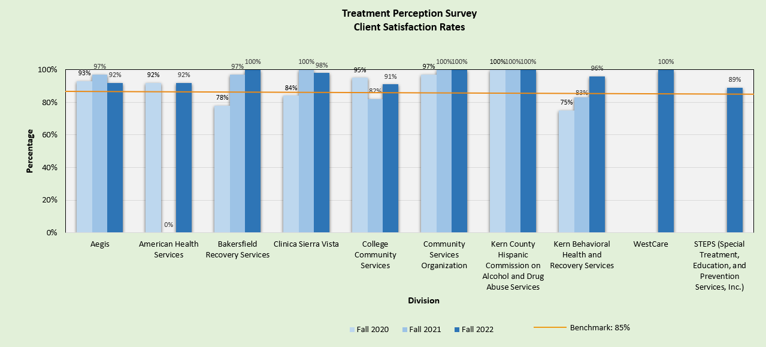
Overall Satisfaction Rates

Slide 5
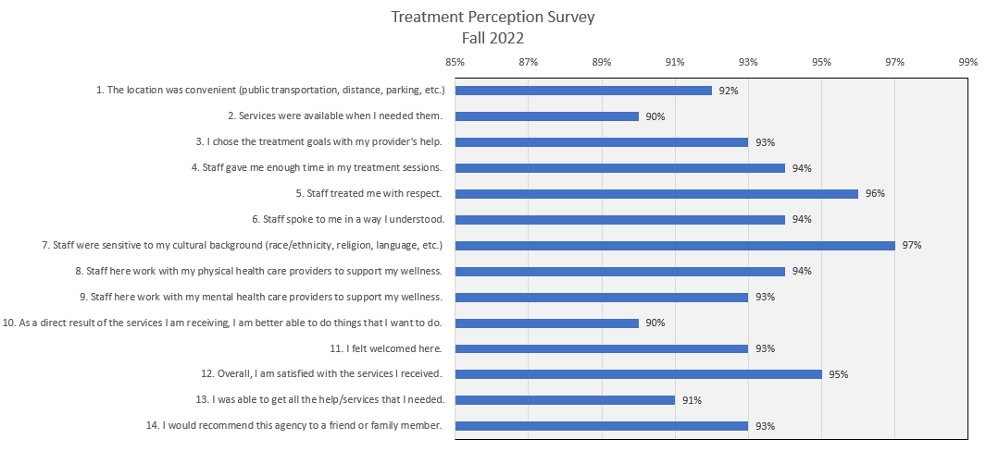
satisfaction by question

Slide 6

Contact Information
Andrea Dabrushman
Behavioral Health Planning Analyst
(661) 302-7177 cell
ADabrushman@KernBHRS.org
Donna Robinson
Behavioral Health Unit Supervisor
(661) 316-8020 cell
DRobinson@KernBHRS.org

